Slide 1
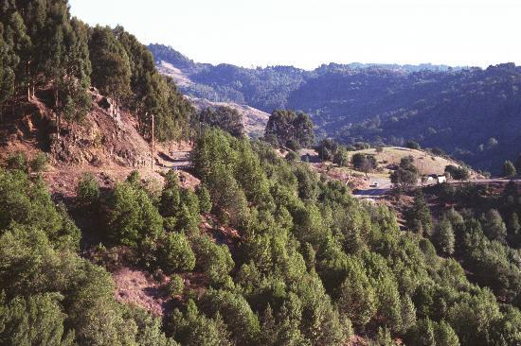
Erosion of the East Bay
Yuan Lin, EPS 109

Slide 2
Methods
Original plan was to use USGS data of Bay Area to make erosion model of East Bay
Data was found from the National Map service, but could not install GDAL package needed to manipulate data
So, instead I created my own array of the region around Berkeley and modeled erosion with that
Code is from the Perron paper
Perron, J.T. et al. (2008). Controls on the spacing of first-order valleys. Journal of Geophysical Research.

Slide 3
Animation

