Slide 1
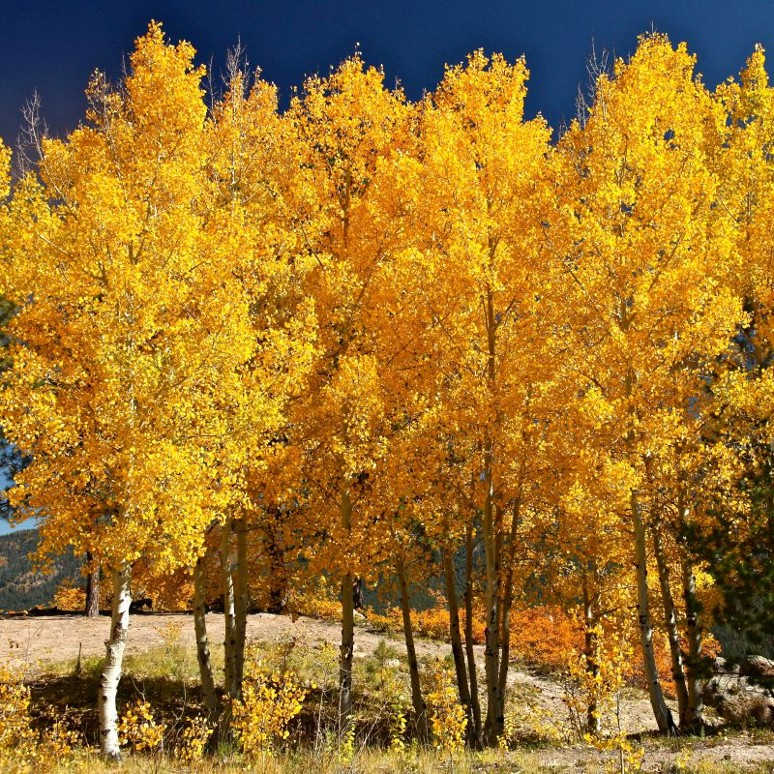
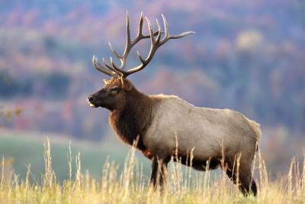
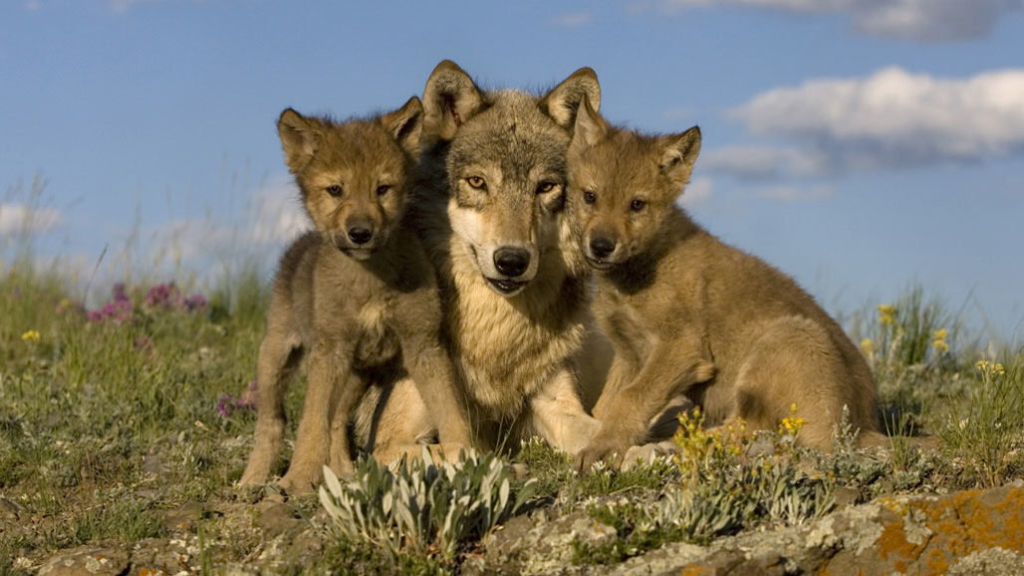
Yellowstone: Aspen, Elk, and Wolves A Simple Ecosystem
EPS 109 Fall 2020
Jacob Brumm

Slide 2
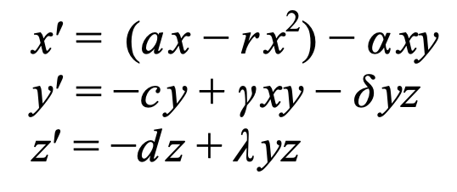
Idea and Method
The idea for choosing a predator-prey simulation comes from the constant struggle to find equilibrium in Yellowstone’s ecosystem after 1926.
1926 wolves were eradicated, and then reintroduced in 1995.
With the lack of natural predators, Elk populations were deteriorating Yellowstone’s ecosystem.
I attempt to see if there can be an equilibrium reached in a simple Yellowstone ecosystem.
Methods Used
Three nonlinear first order differential equations (Lotka-Volterra Equations)
Euler’s Method

