Slide 1
Stock Predictor
Based on Price Type
EPS 109 Final Project
Albert Zhang

Slide 2
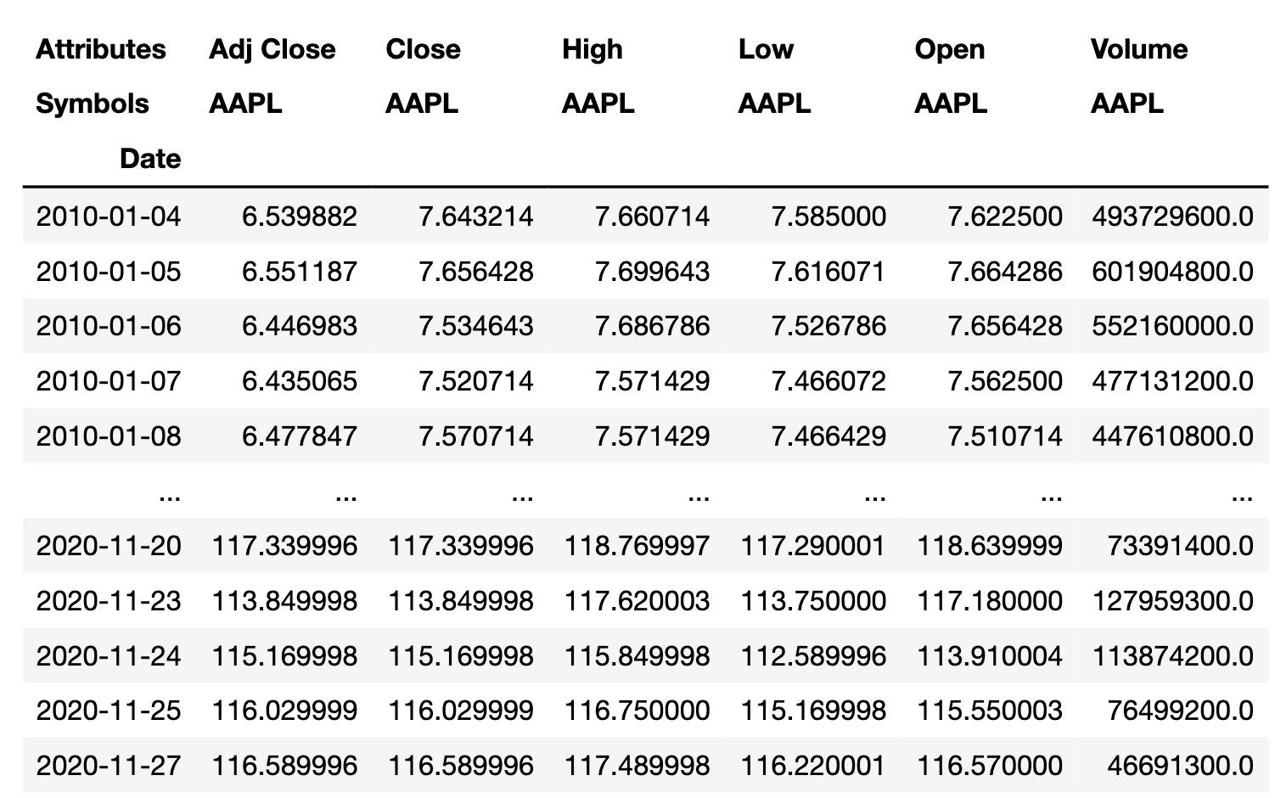
Background Information + Goal
Stock information consists of different types of stock prices (Adj Close, Close, High Low, Open) and volume
LSTM network - a RNN that learn patterns about some data over time
RMSE (root mean squared error) - # that quantifies difference between an np.array of predictions and their actual prices
GOAL: Predict the prices of a user’s chosen stocks over a specified amount of time (tomorrow, next week, next month, etc)
Notes:
CITED: https://randerson112358.medium.com/stock-price-prediction-using-python-machine-learning-e82a039ac2bb

Slide 3
Implementation
Using the “pandas_datareader module”, call web.dataReader() to obtain stock information from Yahoo Finance within specified start and end dates.
Preprocessing
Choose stock(s) and price type. Obtain data.
Scale prices using MinMaxScaler so they are between 0 and 1.
Split data into training and validation sets.
Create LSTM Model and train model
Use trained model to make predictions + calculate RMSE’s.
Graph actual and predicted prices over time.
Use model to predict future dates. Use FuncAnimation() to animate plot as data comes is calculated in real time.
DISCLAIMER: stock market is inherently unpredictable and predictions are subject to error propagation.

Slide 4
LSTM Model
model = createModel(x_train)
model.fit(x_train, y_train, batch_size=100, epochs=5)
predictions, rmse = inference(scaler, dataset, training_len, model)

Slide 5
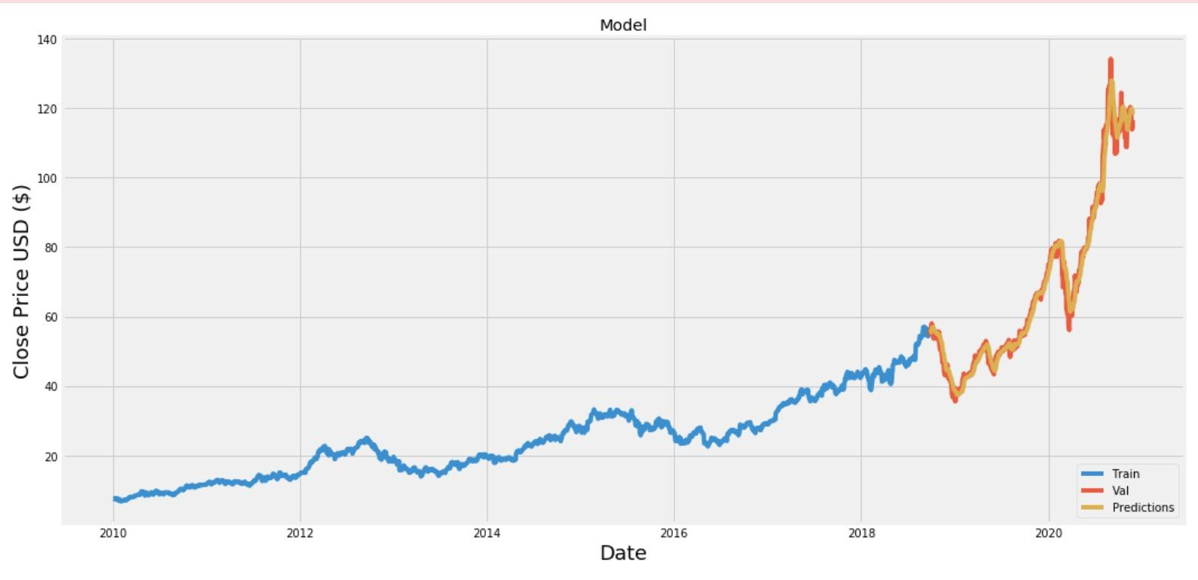
Close Price vs Date for AAPL from 1/1/10 to Today

Slide 6
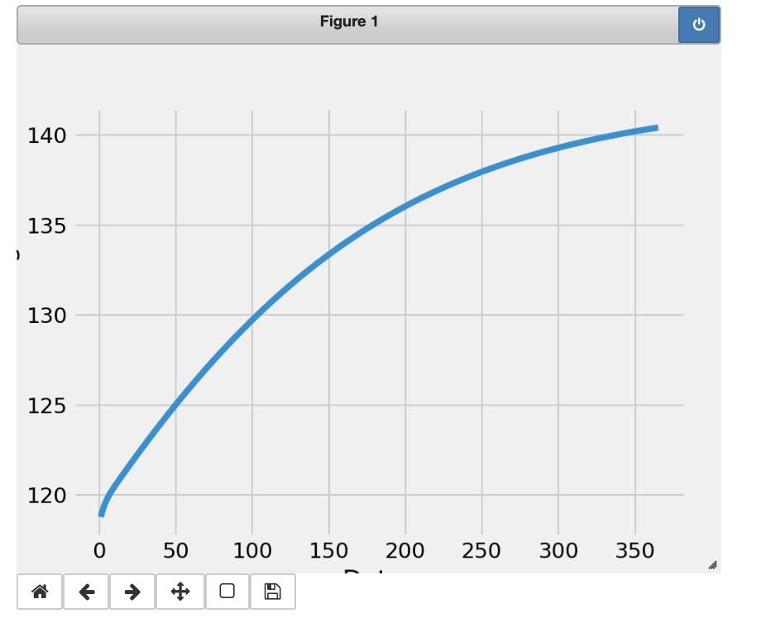
Animation
Min future price: 118.78711
Max future price: 140.42747

