Slide 1
The Giant Impact
Sandra Lucero Ramirez

Slide 2
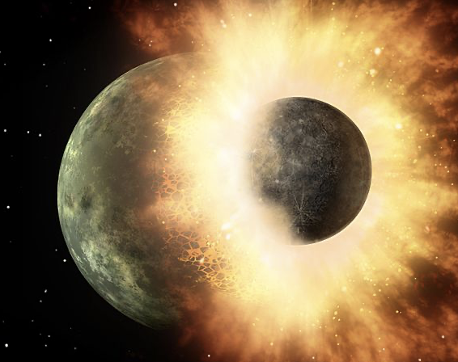
How was the Moon formed?
This theory suggests that the protoearth was struck by a mars sized planetesimal, named Theia
The debris then came together to form our moon
I tried to simulate this event but it was much harder than I expected

Slide 3
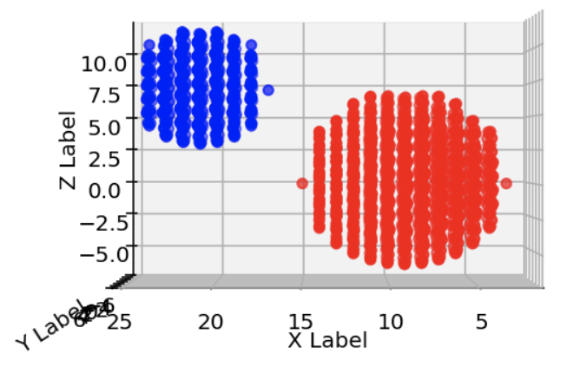
Set up
I made the objects out of many points
I wanted those points to interact with one another to simulate a collision
I was able to get Theia become the debris but had a hard time trying to get it back together

Slide 4
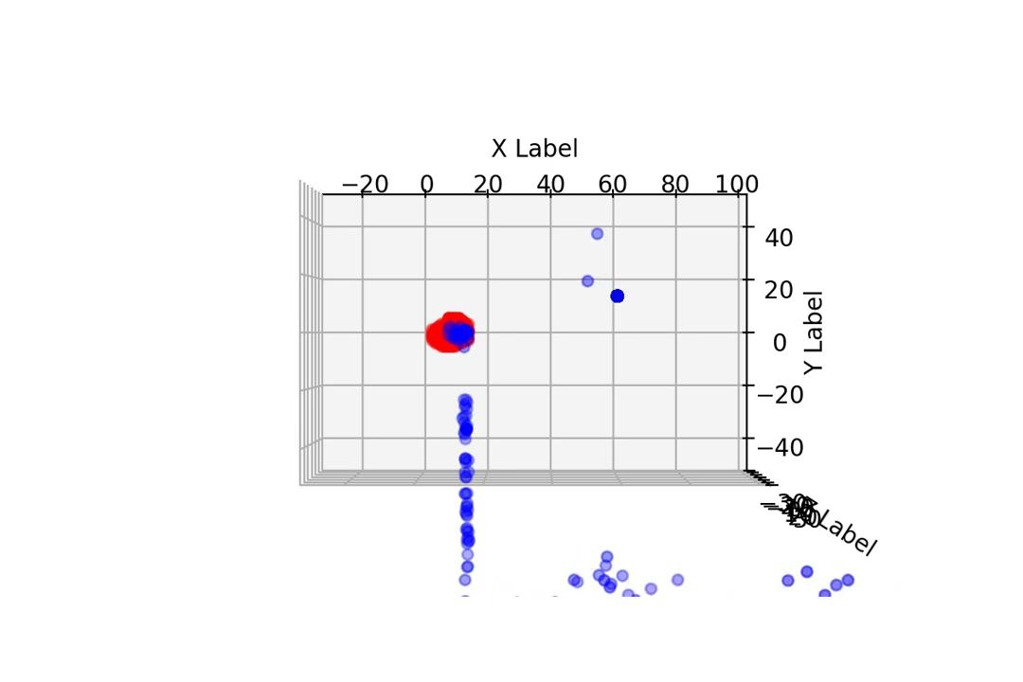
Simulation

