Slide 1
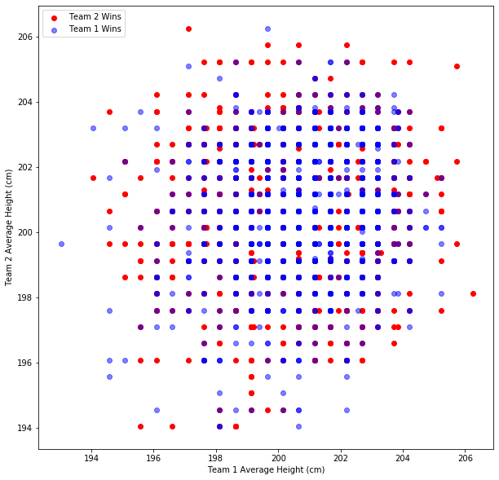
Visualizing the Effectiveness of Small Ball in the NBA
Raj Bhanushali

Slide 2
Goal of Project
The question I would like to answer through visualization:
What is the ideal height for a starting lineup in the NBA?
For example, are there distributions of heights of PG, SG, SF, PF, C that perform better than others? How can we visualize the matchups between different combinations of heights?

Slide 3
Plan:
Plan:
- Iterate through all games played in the past X seasons (can increase it depending on dataset, time to run, etc)
- For each game, get the heights for the starting lineups of both teams
- Based on which team won, update the "scores" for each starting height lineup
- The scores will be stored in a hashmap where the key is the heights of the 1-5 positions in order
- We can also record how every "average height" lineup performed against every other "average height" lineup; to do this, we will use an NxN square matrix where N is the number of average lineup heights we observe
- We will have a score for every combination of heights in the NBA, but now we need to figure out the best way to visualize this!

Slide 4
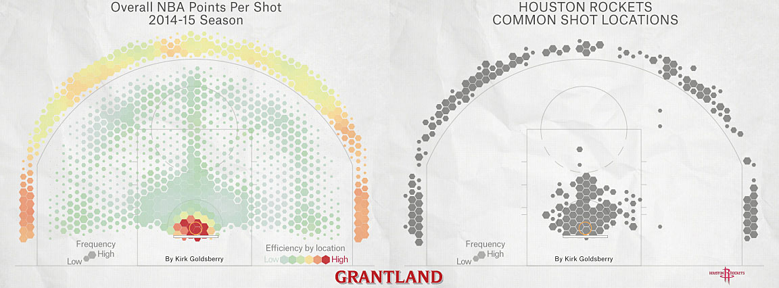

Slide 7
What about a Taller PG?

Slide 8
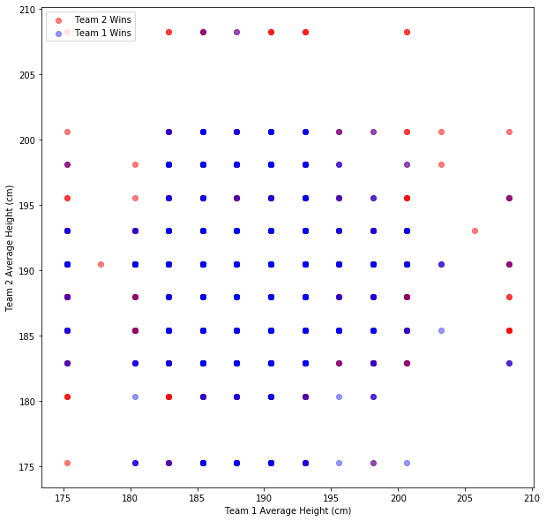

Slide 9
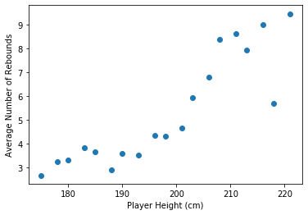
Number of Rebounds based on Height

