Slide 1
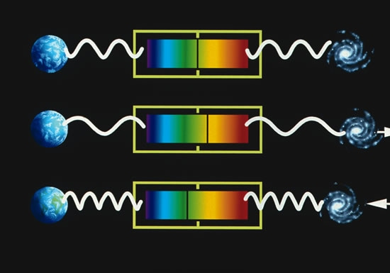
Doppler Shift
Jackie Telson

Slide 2
This project models the doppler shift of a star. The doppler shift is a cause of the star’s radial velocity around the center of motion of the system. The doppler shift causes the star’s wavelength spectrum to shift back and forth. Detecting this shift in wavelength is one way that astronomers can detect exoplanets. This is called the Radial Velocity Method. The system that I am modeling in this project is 14 Andromedae, a K-type star with one gas giant planet.
To model the star’s movement around the center of motion of the system, I used the same method that we used in Lab 11 (Keplerian Orbits). This method works for this system since the planet is on a circular orbit (eccentricity = 0.0).
To model the shift in wavelength, I implemented the formula for change in wavelength due to radial velocity at each timestep and plotted to create an animation.

Slide 3
