Slide 1
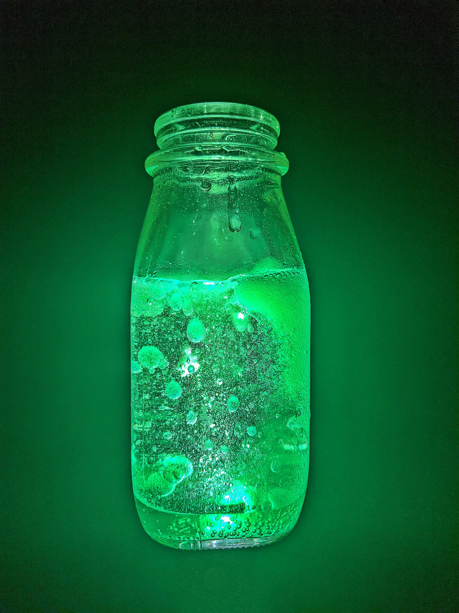
2-d Dissolving Effervescent TABLET SIMULATION
BY: MATTHEW WALKER
Picture taken for a fluid mechanics project
2-D Simulated dissolving of tablet

Slide 2
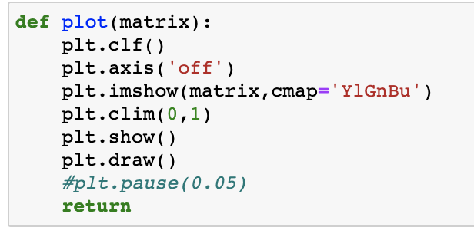
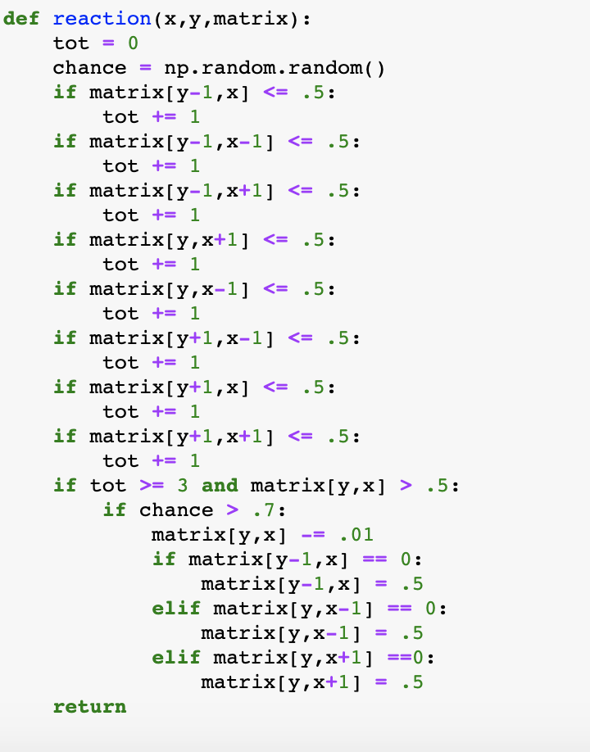
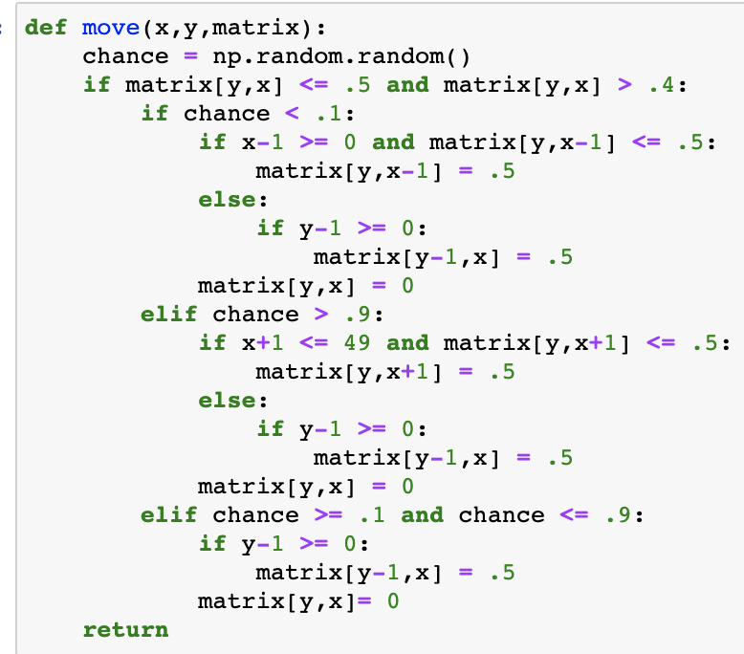
Description
Goal: Use Jupyter Notebooks and MATplotlib/Numpy to visualize a dissolving effervescent tablet
Methods:
Define reaction functions using np.random.random(), creating a bubble if a reaction occurs
Define a move function that determines location of bubbles
Define a plot function to visualize simulation
“Drop” a tablet into the water and watch as it dissolves and the bubbles travel to the surface!

