Slide 1
Visualizations With Music Files
w/ Librosa
By Connor Mack

Slide 2
Topic
Waveplots
Spectrograms
Chromagrams
3 different genres of music
Used Librosa library: McFee, Brian, Colin Raffel, Dawen Liang, Daniel PW Ellis, Matt McVicar, Eric Battenberg, and Oriol Nieto. “librosa: Audio and music signal analysis in python.” In Proceedings of the 14th python in science conference, pp. 18-25. 2015.

Slide 3
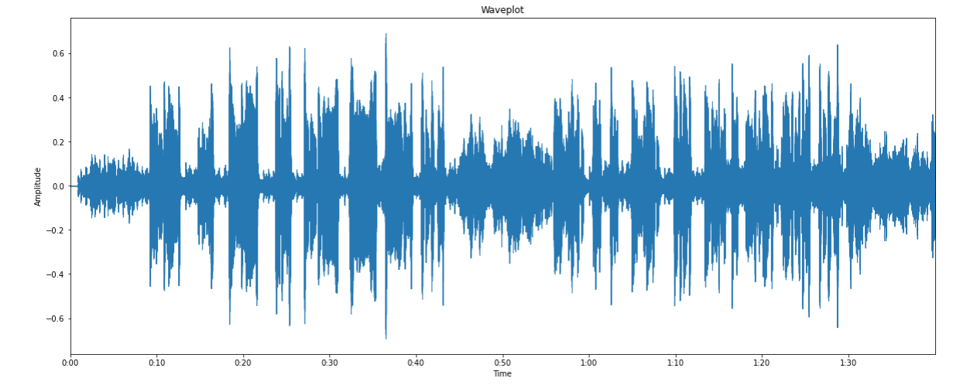
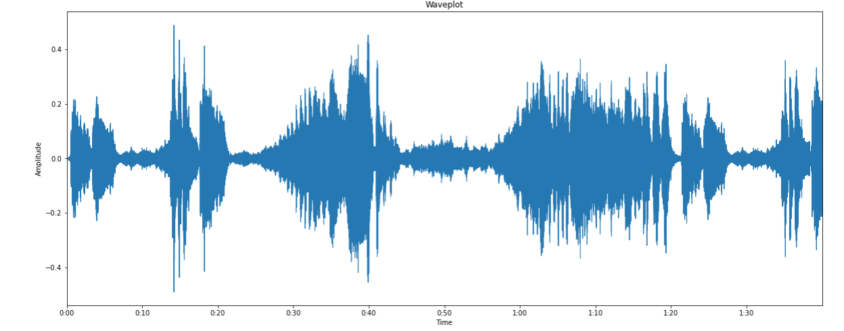
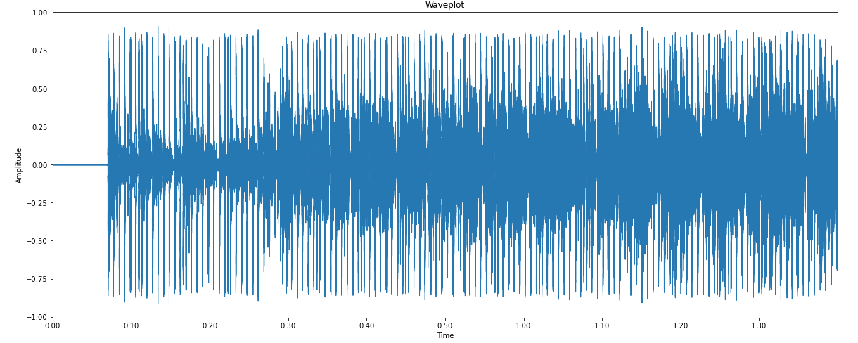
Waveplots
Folk: Don’t Think Twice by Bob Dylan
Classical: Beethoven’s 5th Symphony
Rap: Big Poppa by The Notorious B.I.G.

Slide 4
Spectrograms
Folk: Don’t Think Twice by Bob Dylan
Classical: Beethoven’s 5th Symphony
Rap: Big Poppa by The Notorious B.I.G.

Slide 5
Overlayed
Folk: Don’t Think Twice by Bob Dylan
Classical: Beethoven’s 5th Symphony
Rap: Big Poppa by The Notorious B.I.G.

Slide 6
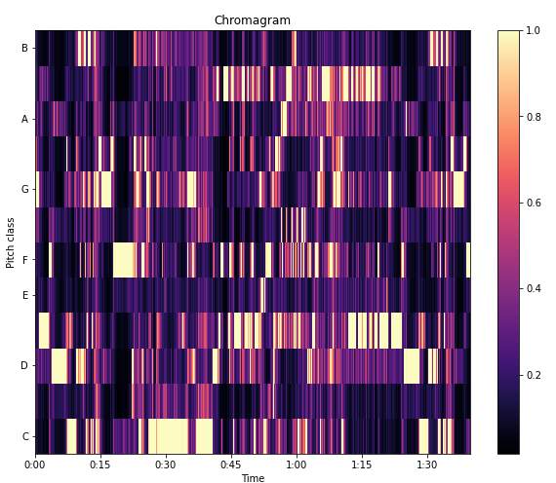
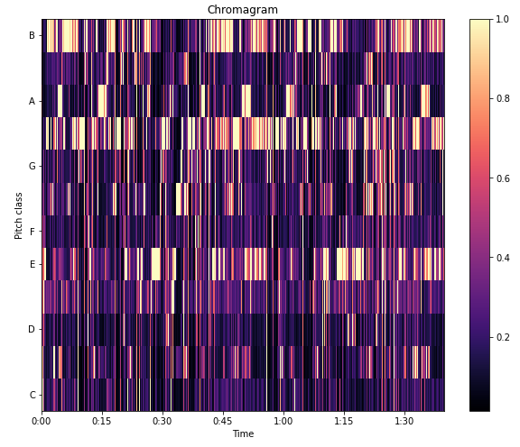
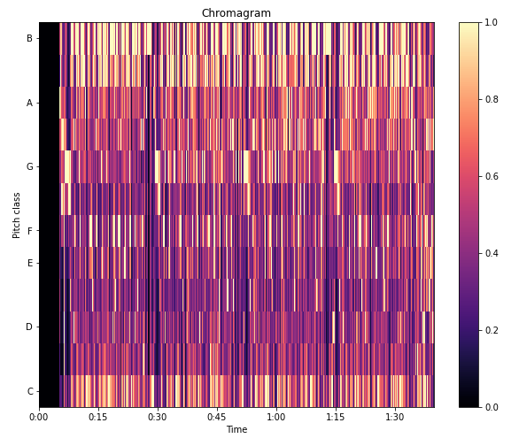
Chromagrams
Folk: Don’t Think Twice by Bob Dylan
Rap: Big Poppa by The Notorious B.I.G.
Classical: Beethoven’s 5th Symphony

Slide 7
Questions? Comments?
Concerns?

