Slide 1
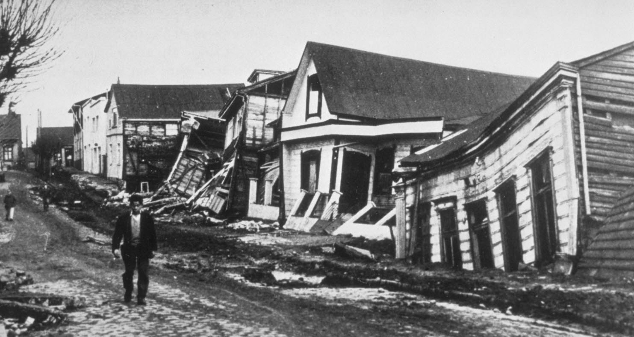
Earthquakes in Chile: 1965-2016
Gabby Petrocelly

Slide 2
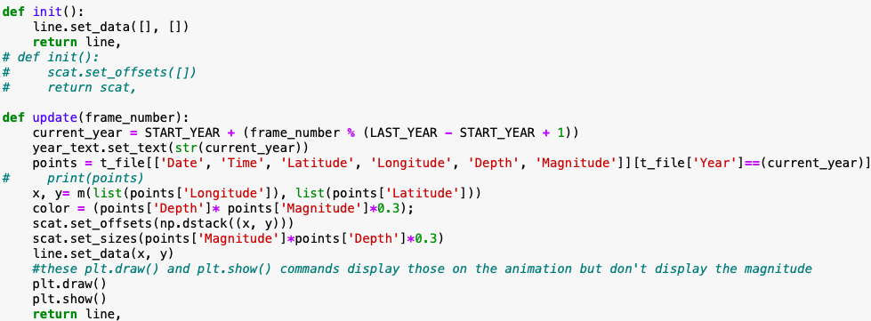
methods
Upload Relevant Libraries:
import numpy as np
import matplotlib.pyplot as plt
from mpl_toolkits.basemap import Basemap
from matplotlib.animation import FuncAnimation
from matplotlib.animation
Import FFMpegWriter
Create map
Scatter plot
Define functions
Create animation
Code Referenced from Soumitra Agarwal (2016): Visualizing earthquakes via animations

