Slide 1
Injection into a Naturally Fractured Geothermal Reservoir
Sage Quinn

Slide 2
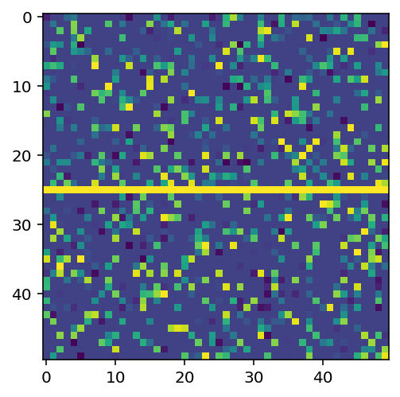
Motivation
Methods
Two Main Classes:
meshELEME: individual mesh components
Name
Temperature
Heat transfer coeff (k)
Permeability (%)
isWater
meshGEO
Matrix of mesh elements
Heat Transfer Method
2d heat equation discretized in real time
DLA method
Moves particle along randomly - more likely to move in direction of injection
More likely to enter cell with higher permeability
Run Simulation
Calls DLA followed by heat transfer and records the animations up until end time specified
No Set Way to Generate Meshes, but I chose to define some materials and randomly introduce fractures
Have a tool to set up meshes of rock and injections to see how the diffusion and heat transfer processes occur
Geothermal Energy Production
CO2 Sequestration
Potential contamination of groundwater
Easy to make mesh
Clear and helpful visualizations
Object oriented and modular for adaptability purposes

