Slide 1
Simulating Solvation and Saturation
Nathan Sweet

Slide 2
Methods
Goal: Simple demonstration of saturation of a solution
Random particle movement in a 2D box (ignore solvent)
Collisions yield a precipitate which falls to bottom
Precipitate has a chance (p) of dissolving back into solution
List of particles contains location of all particles
2D Numpy Array contains state of each particle

Slide 3
60 particles
P=.1
unsaturated

Slide 4
300 particles
P=.1
Saturated

Slide 5
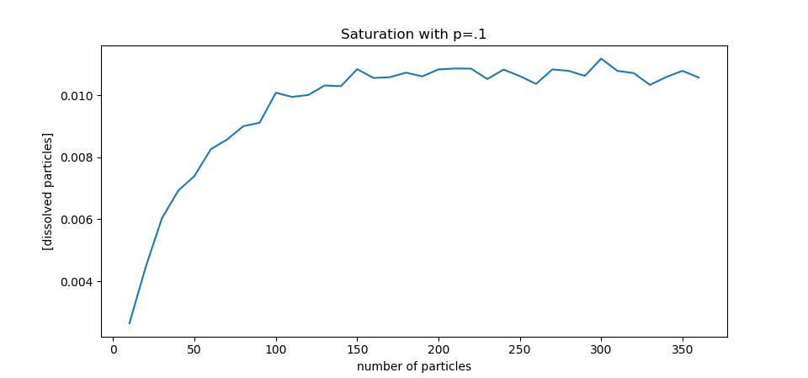

Slide 6
