Slide 1
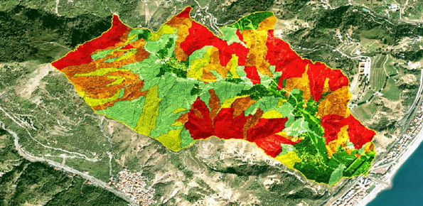
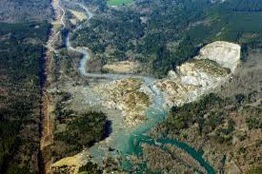
Simulating Landslide Risk Analysis
By Connor Geudeker

Slide 2
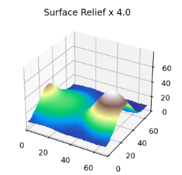
Contributing Factors to Susceptibility
Included in my simulation:
Slope Steepness
Soil/Rock Type
Vegetation Cover
Distance to River
Not included:
Distance to Fault
Land Use
Distance to nearby Roads
Loss of vegetation cover
Extraordinary Rainfall

Slide 3
General Workflow
Generate Landscape
Generate Factor Maps
Calculate Susceptibility Map
Run Simulation
Update Landscape and Maps
Add major features topographical features as desired. Generate landscape using landscape.py provided as a part of Lab 9.
From this landscape, generate slope map, vegetation map, soil map, water map, and distance to water map. .
Combining these maps, calculate a susceptibility map with the corresponding weights and equation, discussed later.
Run simulation with your choice of parameters for the landscape evolution model for either the calculated number of time steps or as long as desired.
Every iteration, update slope, vegetation, and soil maps. Recalculate susceptibility and generate and save figures as part of animation.

Slide 4
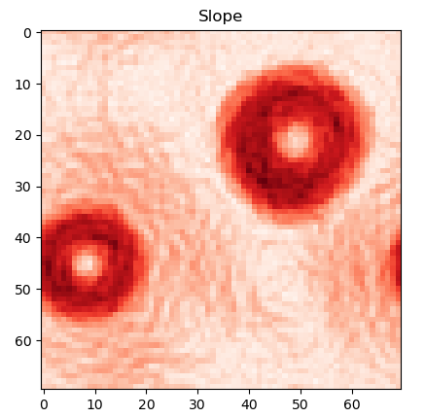
Factor 1: Slope
Steeper slopes increase landslide susceptibility.
Determined using the gradient already being calculated during the simulation for erosion equations.
Only contribution here was updating it to a map.

Slide 5
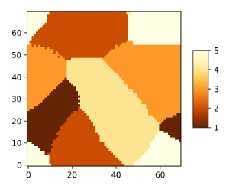
Factor 2: Soil/Rock Type
Generated map of 5 different soil types roughly on the scale of clay → silt → sand loam in terms of their characteristics.
Soil map created by starting with 5 initial points representing each soil type, then mapping rest of the points by iterating through each point and defining each point by the adjacent soil type.
Conflicts resolved by randomly choosing between equal adjacent soil types.
Essentially a Voronoi Diagram.

Slide 6
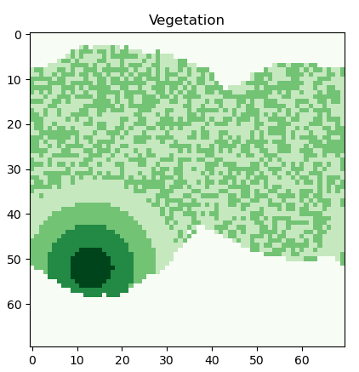
Factor 3: Vegetation
5 levels of vegetation, 5 representing the densest and 1 the least.
Random, minimal vegetation added over the entire landscape. Either a value of 1 or 2.
Random location and size of a circular forest, densest on the inside, to thinner towards the periphery.
Updated depending on soil type. Better soil will lead to denser vegetation. Poor soil will lead to loss of vegetation.

Slide 7
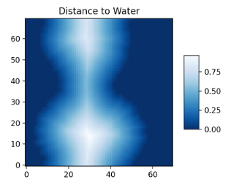
Factor 4: Body of Water
Initial body of water determined as being elevation values below the following result:
MIN(elev)+MEAN(elev)-1.5*SD(elev)
Distance to this water calculated iterating through each pair of points, then recording the minimum distance to the water.
The closer the slope to the body of water, the more susceptible it is to a landslide.

Slide 8
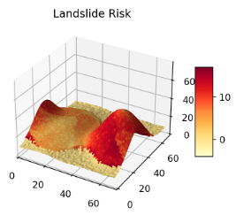
Landslide Susceptibility Map
Equation:
(1-water)*(10*slope+soil-vegetation+5*waterDist)
Slope and the distance to water were rescaled such that 1 would indicate the highest susceptibility, so largest slope and closest distance to water respectively.
Assumed places underwater weren’t going to experience landslides.

