Slide 1
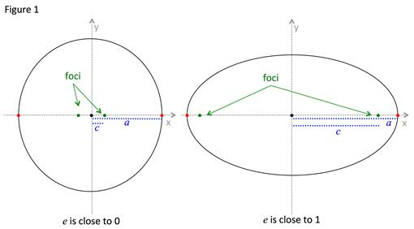
Modeling Ellipses with varying Eccentricities
Gus Tovalin

Slide 2
Goals
-Simulate and demonstrate Kepler’s first law of planetary motion
-The planets orbit the Sun in ellipses around the Sun at one focus
-To simulate how the shape of an ellipse would change with different eccentricities
Method:
-From Kepler’s first law we know that the larger the difference between the foci, the greater the eccentricity
=>therefore I gradually increased the distance between the two foci and continually updated
the ellipse’s shape
-Started with zero distance between the two foci (this led to a circular orbit) and increased the distance until there was an exaggerated ellipse

Slide 3
