Slide 1
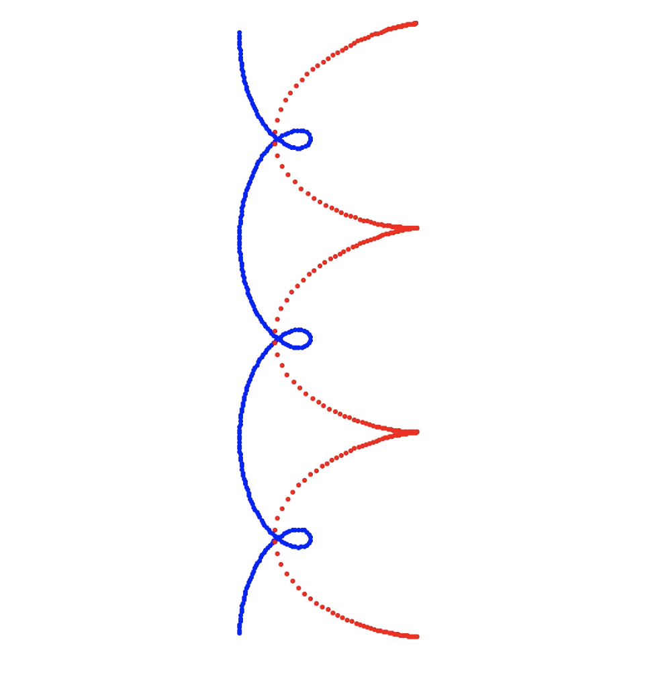
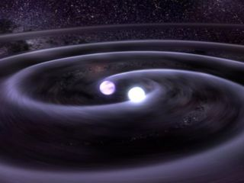
Binary Star Systems
By Danny Sallurday

Slide 2
My Simulation Topic and Methods
I chose to simulate dual celestial body systems by replacing Earth with a more massive object (a star).
Each object is the same distance from the Sun and has the same tangential velocity. The altered variable is the mass, leading to various gravitational effects.
I used Turtle graphics to trace the orbits of the two stars after writing Python functions to calculate gravitational forces and velocity/position changes.
I simulated interactions over one year for several different masses

Slide 3
mass of Earth
1/10 mass of Sun
½ mass of Sun
The Sun -- Other Star
mass of Sun

