Slide 1
EVOLUTION OF BRYCE CANYON
Olivia Salaben

Slide 2
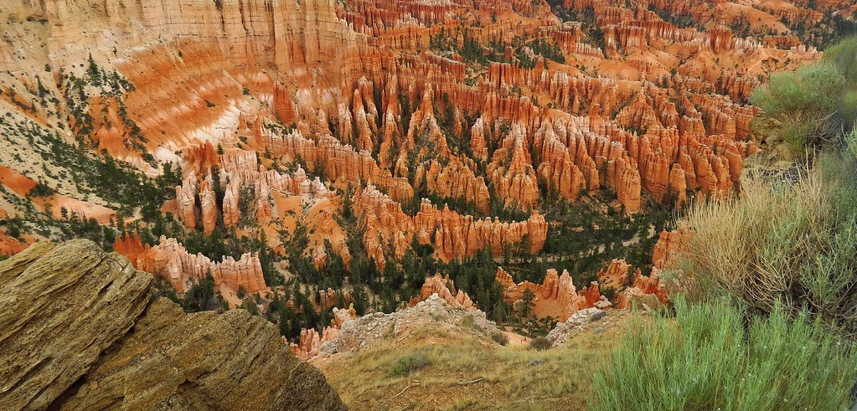
To make the parabolic, outer canyon

Slide 3
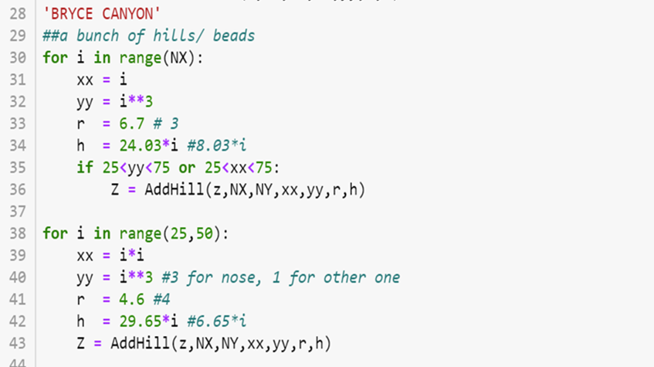
To make the little peaks

