Slide 1
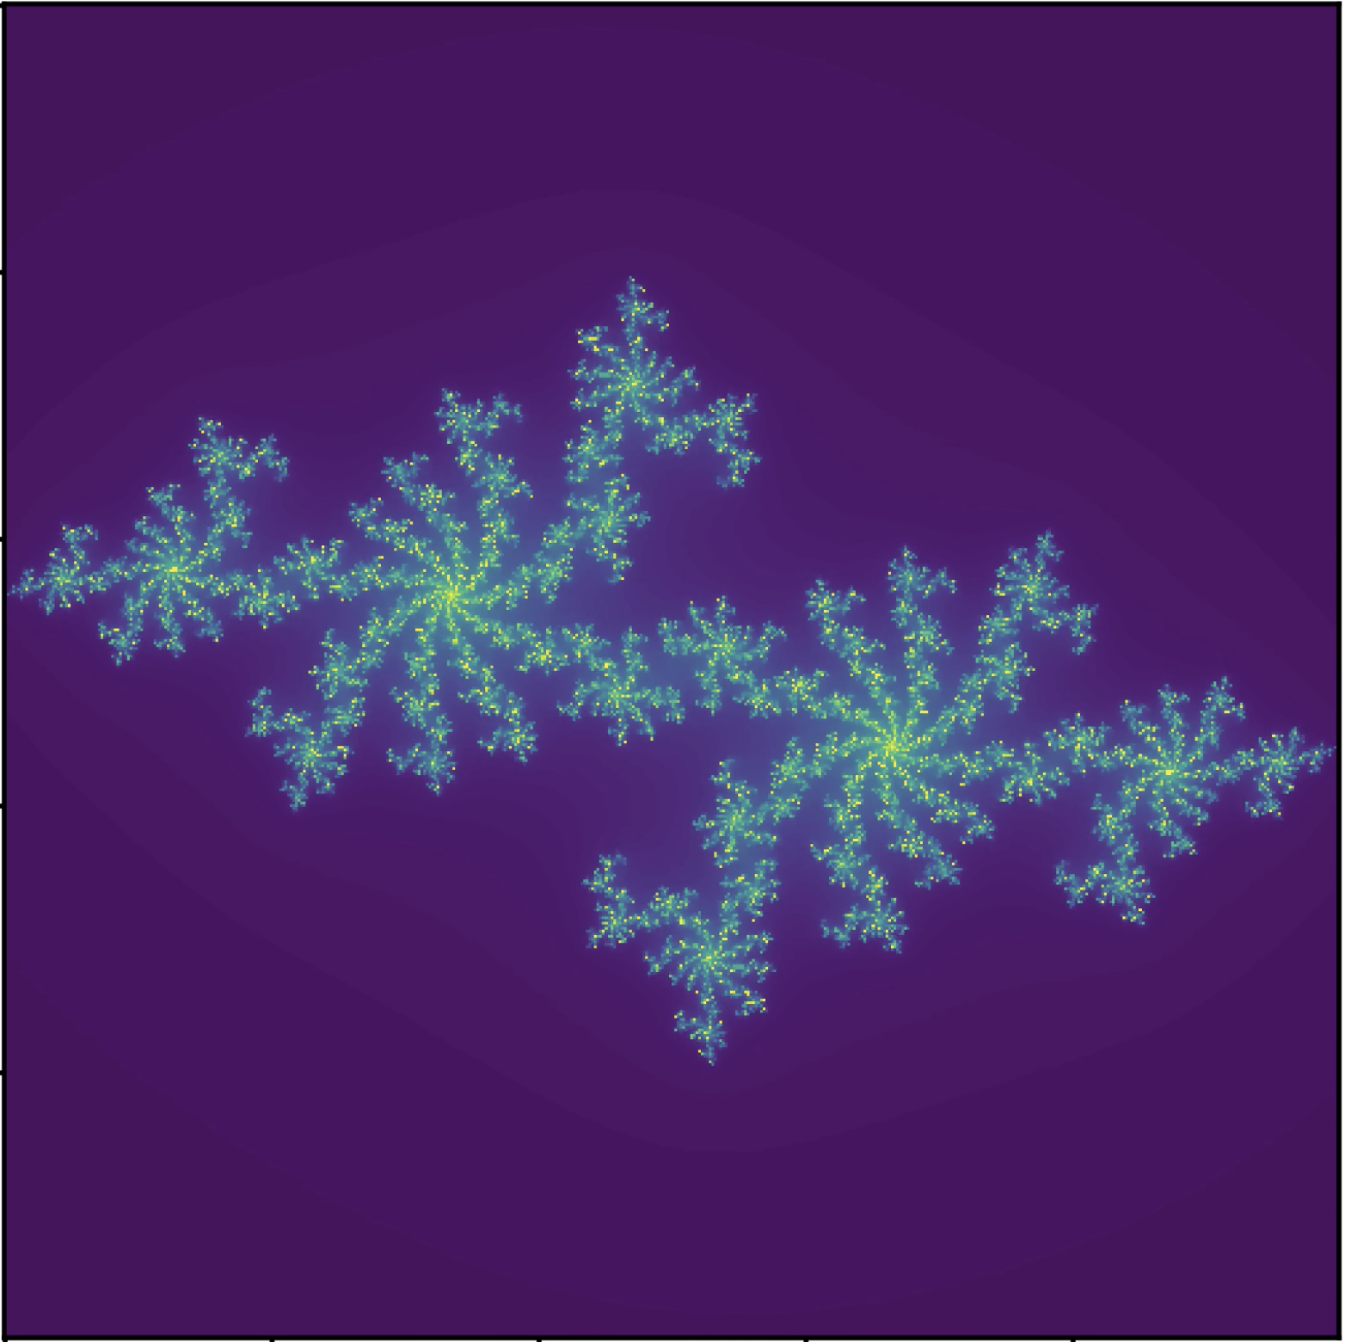
Full Julia Rotation
Gustavo De Leon
EPS 109
… because pretty

Slide 2
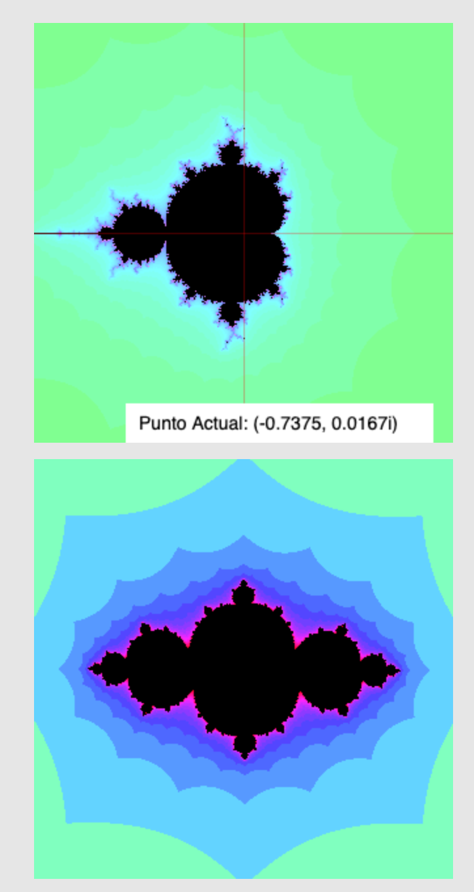
Topic and Methods
Topics
Mandelbrot Set & Julia Set
Animation
Methods
Used Mandelbrot/Julia set generator to find good starting point
Modified equation to use e^{ia} with a in [0, 2pi] to get single continuous loop of cool shapes
Profit
Sources
http://www.bluesimplex.com/2019/02/25/julia_sets.html

Slide 3
Animation

