Slide 1
A Photon's Journey
Through a Star
by Caylan Anderson
Photo Credit: https://slideplayer.com/slide/7374097/

Slide 2
Topic: Random Walk Simulation
This simulation of a photon's journey through a star is a simplistic model of photon statistics, and demonstrates the "random walk" process that photons follow to escape from a star.
Methods: numpy.random.randint() to generate six arrays of random integers, which are then used to randomly assign initial conditions of 0.1 and -0.1 for the x, y, and z vectors that were initially defined as zero matrices.

Slide 3
User Input
I decided to have the option to allow the user to specify the spectral type of the star, the number of steps in the random walk simulation, and the number of particles to run the simulation for. I accomplished this by using ipywidgets!

Slide 4
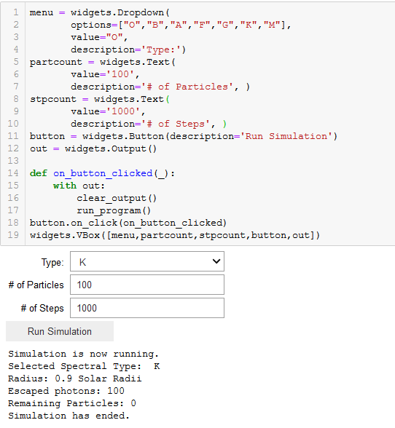
User Input: Widgets Used

Slide 5
Future Goals
Allowing more flexibility in user-defined parameters (e.g. user can input a radius and temperature, which would then influence the collision rate that the photon would undergo during diffusion)
Ability for the user to customize the speed of the animation itself

Slide 6
Simulations

