Slide 1
Land Surface Temperature
Riya Shah

Slide 2
Timescale
2012 - 2019
  Earlier data unavailable
  https://neo.sci.gsfc.nasa.gov/view.php?datasetId=MOD_LSTD_CLIM_M
Winter Data
  Average surface temperature in January
Summer Data
  Average surface temperature in July

Slide 3
Initial Hypothesis
Non-ambiguity of climate change
Atmosphere increasing in temperature
  https://climate.nasa.gov/evidence/
Does this affect land temperature?
  It should, right?

Slide 4
Wrong!

Slide 5
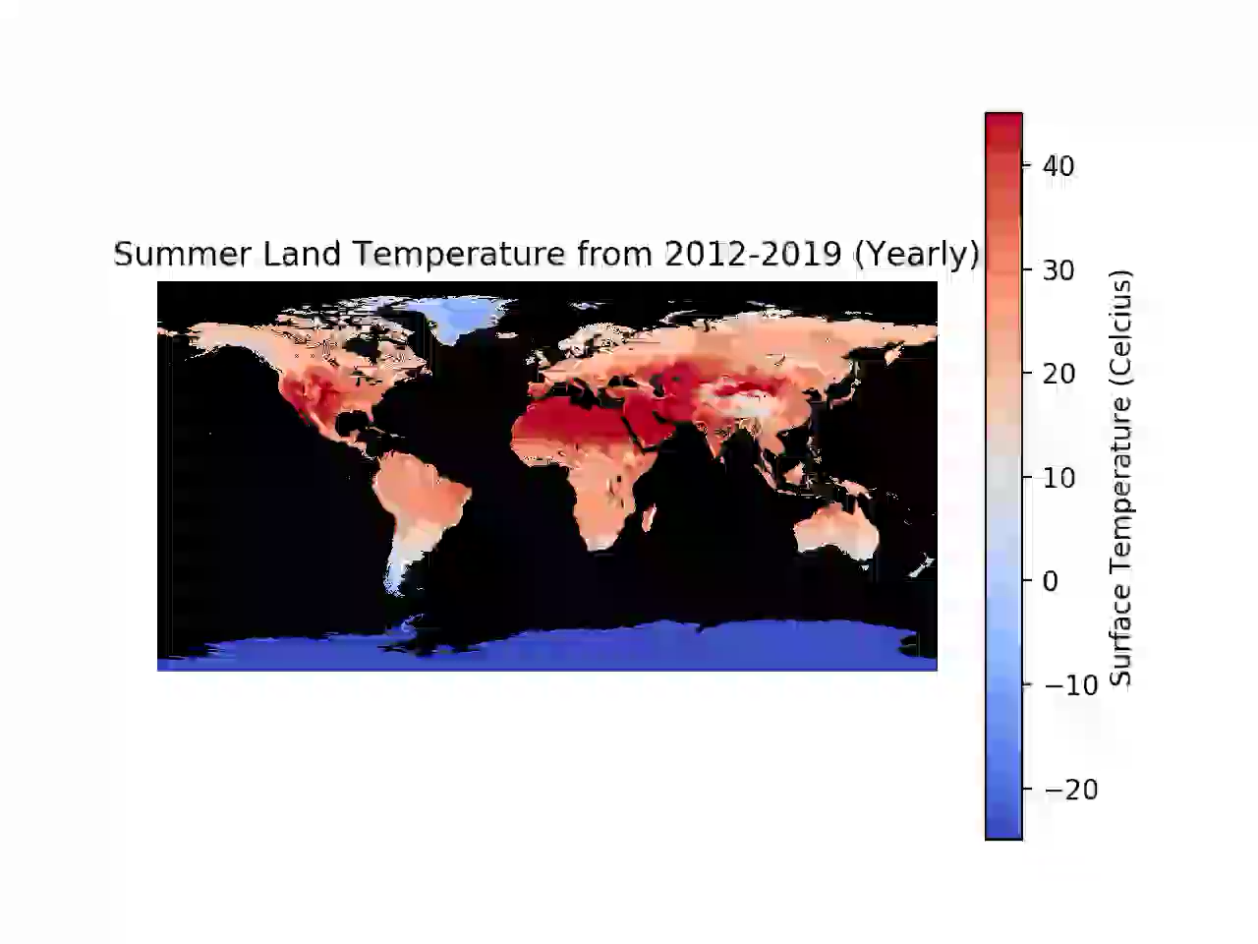

Slide 6
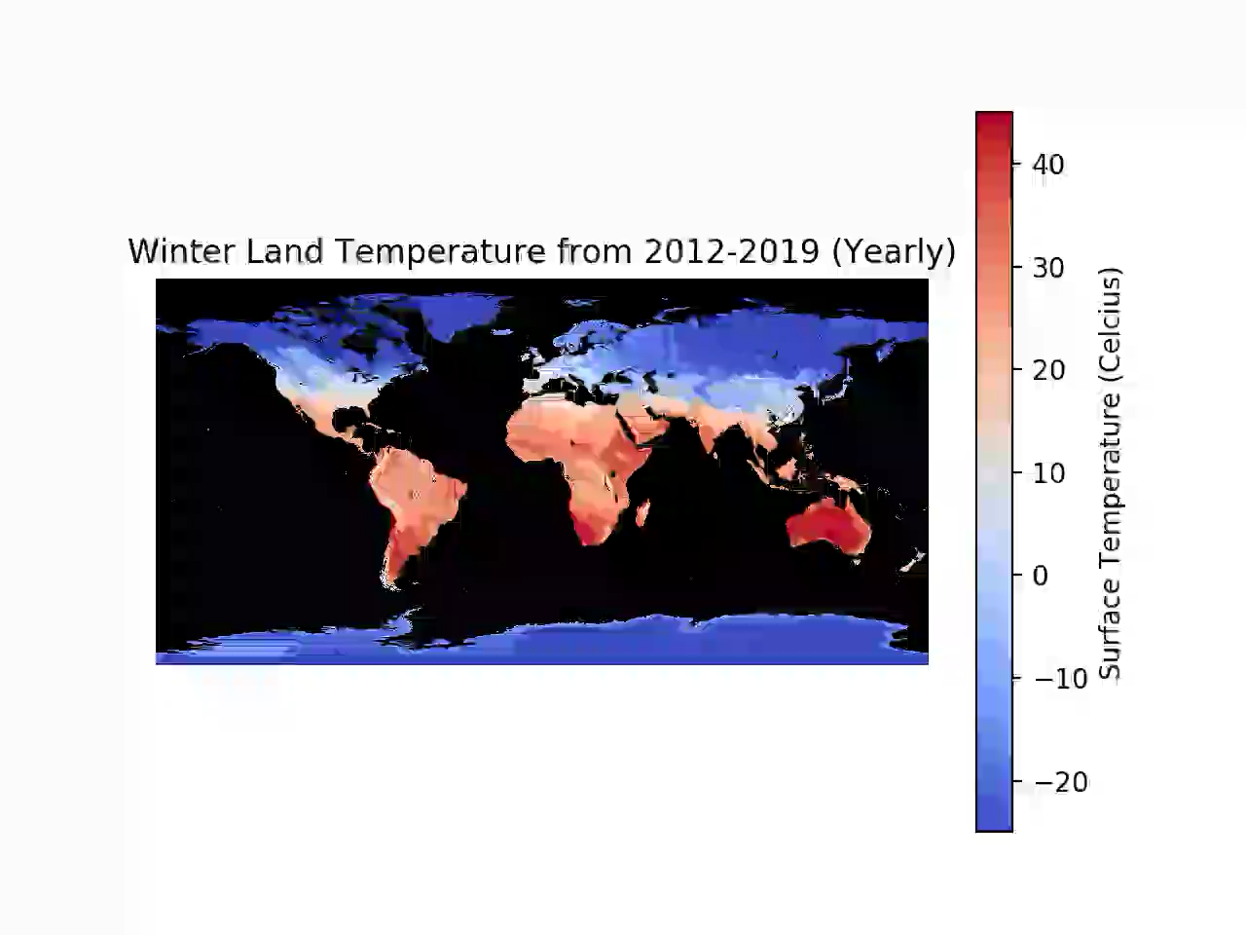

Slide 7
Why is surface temperature unaffected?
High heat capacity
Not long enough timescale

Slide 8
Thank you!

