Slide 1
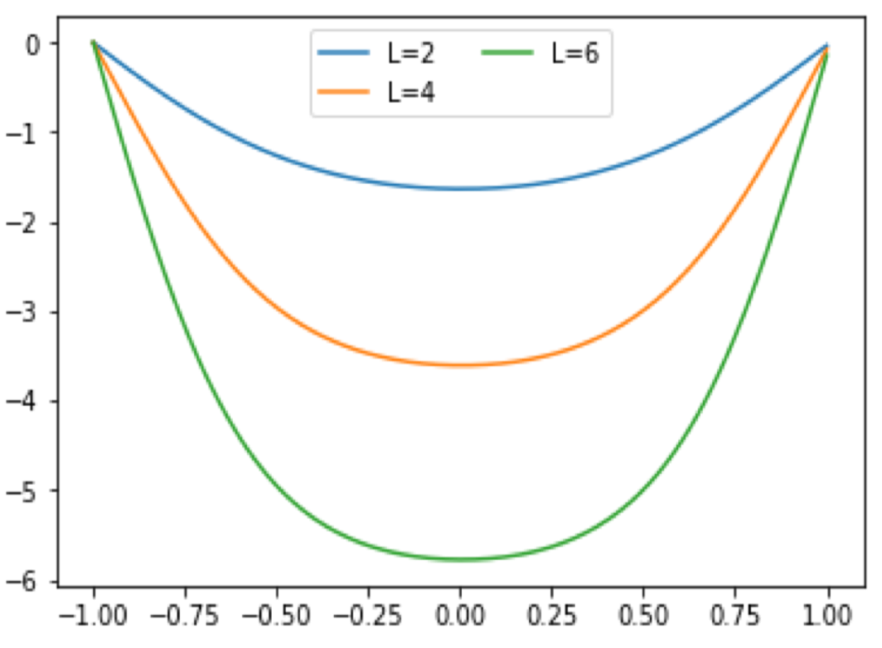
the Shape of a Skipping Rope
Lu Tian

Slide 2
Methods
Runge-Kutta 4th Order Method
Initial Value Problem: $y\left(−a\right)=0$,
Shooting Method
To determine $h_{0}, α$
.
.
.
.
.
.

Slide 3
Simulations
with different angular velocities
ω=2
ω=2.5

Slide 4
References
Mohazzabi, P. and Schmidt, J. R., Profile of a rotating string: Can. J. Phys. 77: 505–513 (1999) 505-513
Nordmark, A. and Esse ́n, H., The skipping rope curve: Eur. J. Phys. 28 (2007) 241–247
And Questions?

