Slide 1
Circuits Inverters
Juan Cai

Slide 2
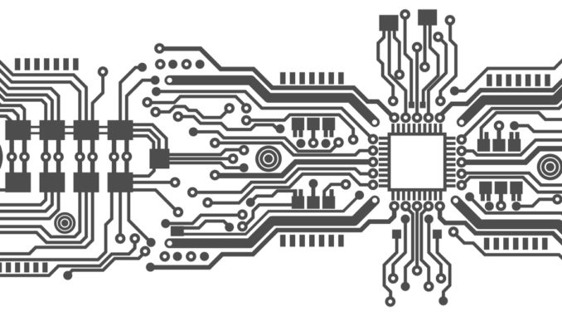
What are Inverters?
Digital Circuit
Notes:
A device that implements a logic negation (1 xor 0)
Important building block for logic circuits
Inverter gate delay limits speed and Power of computers

Slide 3
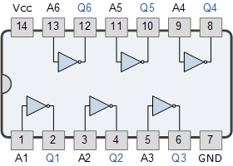
What are Inverters?
Digital Circuit
Digital Logic Gate
Notes:
A device that implements a logic negation (1 xor 0)
Important building block for logic circuits
Inverter gate delay limits speed and Power of computers

Slide 4
What are Inverters?
Digital Circuit
Digital Logic Gate
Digital Circuit
INVERTER
Notes:
A device that implements a logic negation (1 xor 0)
Important building block for logic circuits
Inverter gate delay limits speed and Power of computers

Slide 5
Propagation delay of Inverters
Problem:
Propagation Delay: difference in time to see output, after applying input
Goal:
Find the right time to measure output.
Notes:
Unrealistic to immediately switch from a value to its negation
Has some latency aka gate delay

Slide 6
Modeling with RC circuits

Slide 7
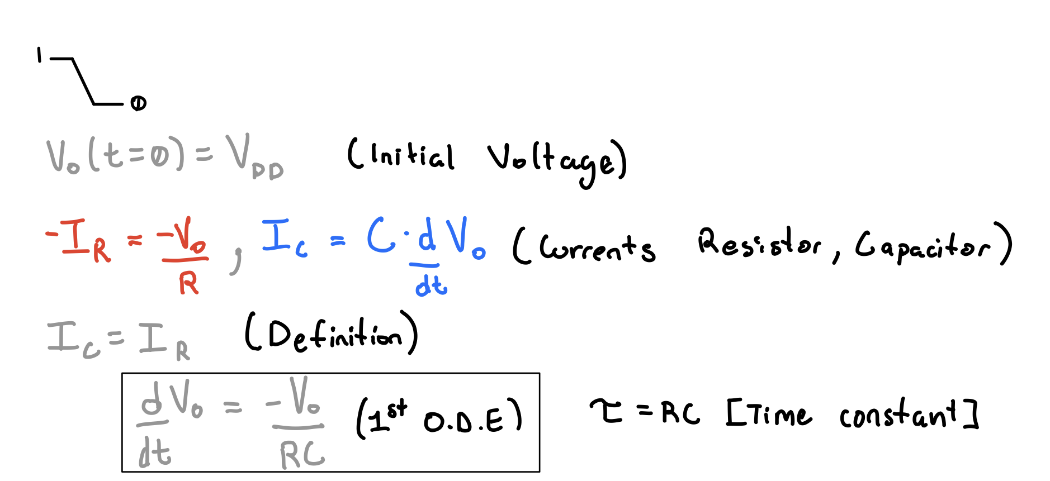
High-Low

Slide 8
Low-High

Slide 9
Runge-Kutta to estimate GOAL

Slide 10
Animation

Slide 11
Credit
https://www.vlsisystemdesign.com/propagation-delay-of-cmos-inverter/
https://www.electronics-tutorials.ws/logic/logic_4.html
https://jakevdp.github.io/blog/2012/09/05/quantum-python/
https://resources.altium.com/pcb-design-blog/compensating-propagation-delay-keep-your-pulse-trains-on-time
https://www.vlsisystemdesign.com/propagation-delay-of-cmos-inverter/
https://www.nextplatform.com/2019/08/20/intel-focuses-on-scale-out-ai-training-with-new-chip/

