Slide 1
Random Walk Maze Generation
Erik Ostien

Slide 2
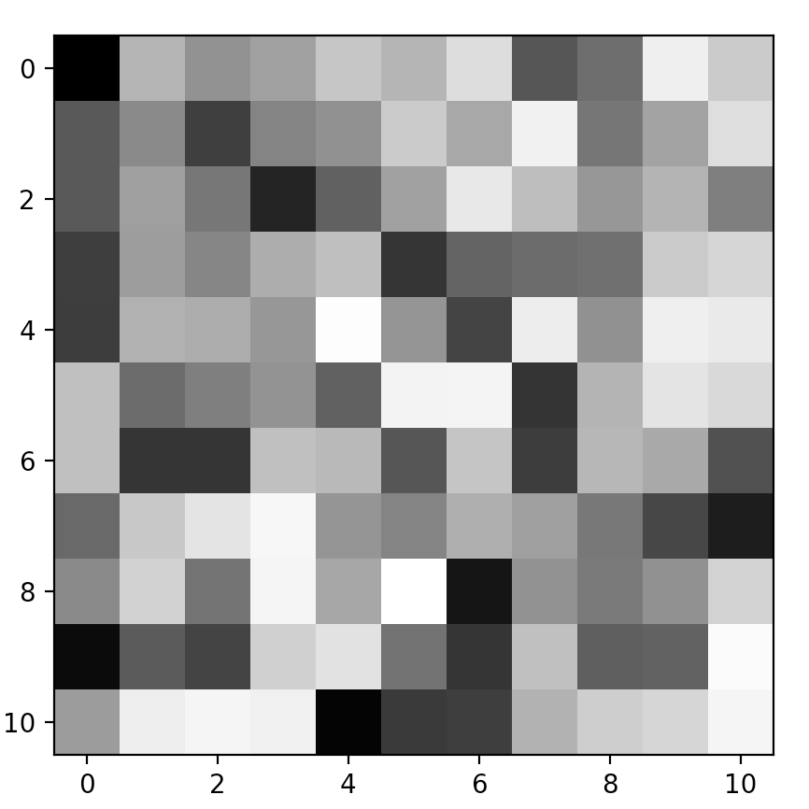
Maze Generation
Methods
Random Walks
Prim’s Algorithm
Considerations
No Loops in the maze
Only one unique solution
Initial Conditions
Initialize the ‘board’ to random values 0 through 1
Start the maze generation on the left side of the maze ‘board’

Slide 3
Random Walks

Slide 4
Prim’s Algorithm

Slide 5
Random vs. Prim’s

