Slide 1
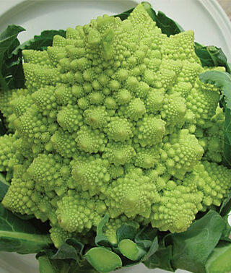
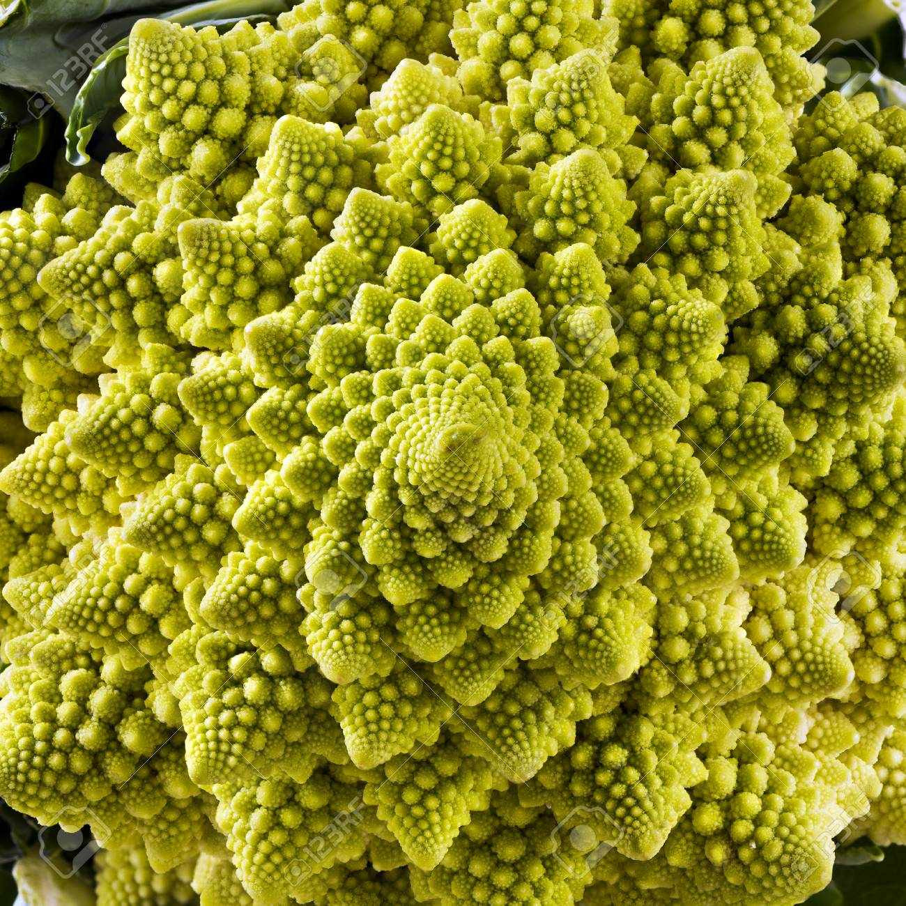
Romanesco Fractal/Broccoli
Jason Hu

Slide 2
Romanesco fractal topics
Mandelbrot set / quadratic map based on golden angle
Fractal self-similarity
Recursion
Reference: http://joyofprocessing.com/blog/2011/12/romanesco/

Slide 3
Fractal Animation

Slide 4
Zoomed In Animation

