Slide 1
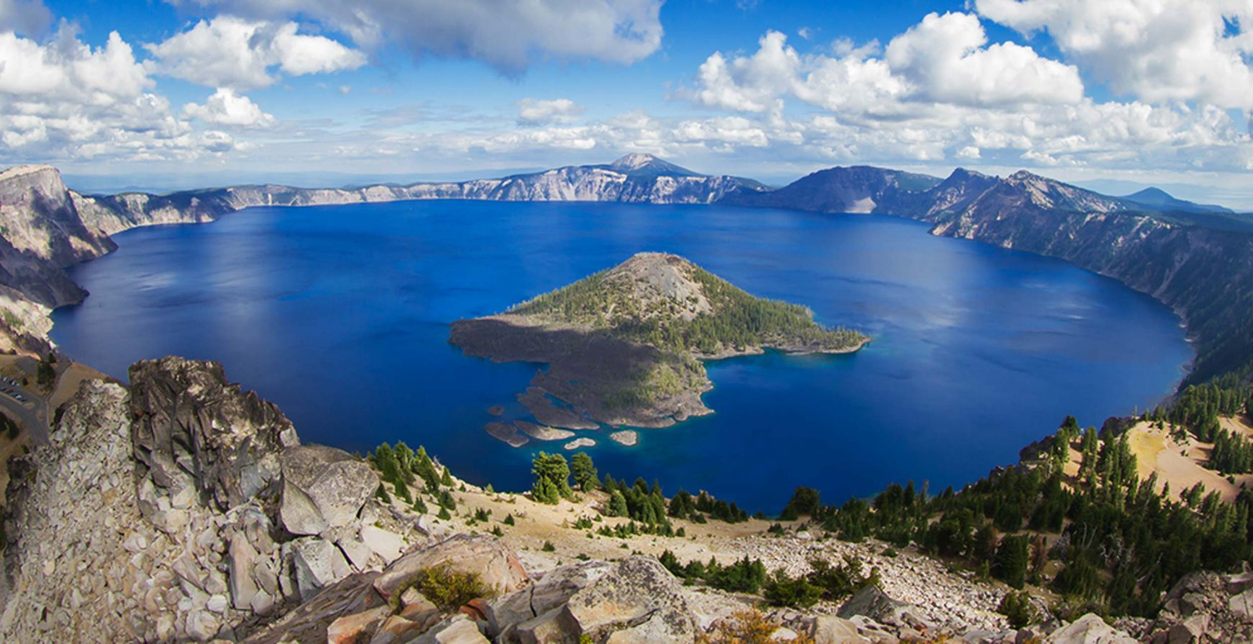
Erosion of Crater Lake, Oregon
By Saeed Yahya Mohanna

Slide 2
Methods
Goal was to see how the shape of Crater Lake would change over a time frame of 1.5 million years, assuming it did not dry up.
Refined the erosion homework to be able to use external data.
Used USGS’ Earth Explorer (https://earthexplorer.usgs.gov/) to find SRTM 1 Arc-Second Global elevation data.
Code needed to compute the fraction of pixels which had an elevation equivalent to that of the lake itself.
To avoid high-run time, resizing the image and zooming into the crater lake was also required.
Sources of error:
Snow/cloud cover can falsely place some pixels at higher elevation
Lake fraction code overestimating value slightly due to counting pixels that are not within lake area.
Citations:
Paper erosion code is based on: Perron, J. Taylor, et al. “Controls on the Spacing of First-Order Valleys.” Journal of Geophysical Research, vol. 113, no. F4, 2008, doi:10.1029/2007jf000977
Physical parameters for erosion obtained from: https://websoilsurvey.sc.egov.usda.gov/App/WebSoilSurvey.aspx

Slide 4
