Slide 1
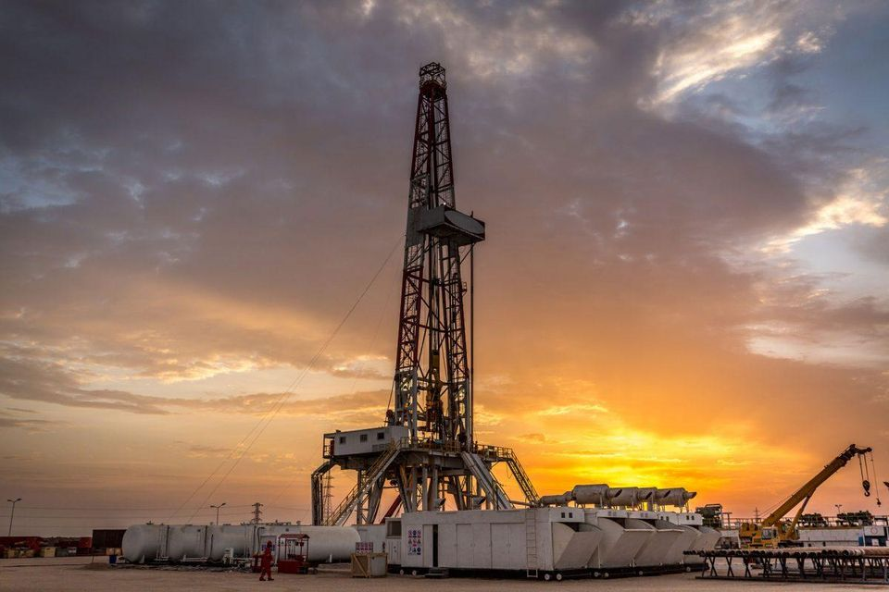
Earthquakes in the Midwest
Audrey Salo

Slide 2
Methods
Goal: to create an educational illustration of recent uptick of earthquakes in Midwest due to fracking.
Used obspy catalog manipulation tools (Lab/HW 9)
Downloaded all earthquakes of magnitude 3.0 and above from midnight, January 1st, 1969 to midnight, December 1st, 2019, in latitude range [33N: 49N], and longitude range [103 W, 89 W]. (Essentially the middle of the country, where natural earthquakes are much rarer than on the coasts.)
Adjusted backdrop slightly using basemap
Plotted earthquakes recorded for each year, saved as .png files
Used ffmpeg to string the .png files together into an animation
Repeated process for most active area in the main map, Oklahoma.

Slide 3
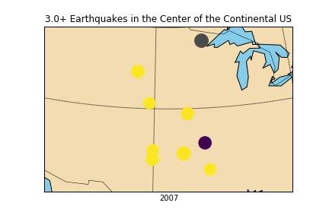
Animation 1: Full-Scale

Slide 4
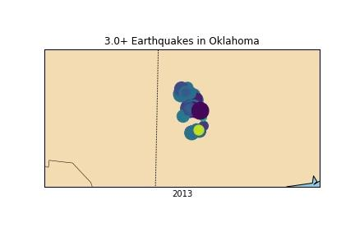
Animation 2: Oklahoma

Slide 5
Conclusions and Improvements
Can clearly see small spike in 1980s and large spike in 2010s, successful in this regard
Could be improved by:
Adding fracking sites in contrasting color to show correlation
Adding in state borders for context
Earthquakes can pile up and become hard to see; could be more illustrative to have each one appear on the map one at a time — but would have been an ungodly number of frames to animate.

