Slide 1
Evolution of Thermal Wind Balance in Atmosphere
By: Ciara Dorsay

Slide 2
How do you get wind?
Variations in temperature
Pressure gradients
Wind flow
In this simulation, only cared about meridional temperature/pressure gradients.
Initial case:
Planet with no external heat source (i.e. the Sun)
Assuming IDEAL CONDITIONS
200 mb
z
400 mb
600 mb
800 mb
y
Surface Pressure
x

Slide 3
Evolution of Geopotential Surfaces (and thus wind) with time
200 mb
H
400 mb
600 mb
800 mb
L
x
x
2. Disturbance caused by uneven heating of Earth’s atmosphere
3. Thermal wind balance, atmosphere in equilibrium
1. No motion
- ɸ

Slide 4
How can one actually solve for how (geostrophic) wind and geopotential surfaces evolve?
Thermal Wind Balance Equation
R = gas constant for dry air
P = pressure
f = Coriolis parameter
For simulation, combination of:
Real data (radiosonde data provided by University of Wisconsin)
Heat conduction equation (for evolution of geopotential surfaces)
Runge-Kutta method (solving for geostrophic component of wind)
Decomposes to this in vertical z or pressure coordinates
f = 2Ωsinɸ
Ω = 7.2921E-5
rad/s and
ɸ = latitude
dely = 111319.488
cos(ɸ)
Z -> height of constant pressure surface

Slide 5
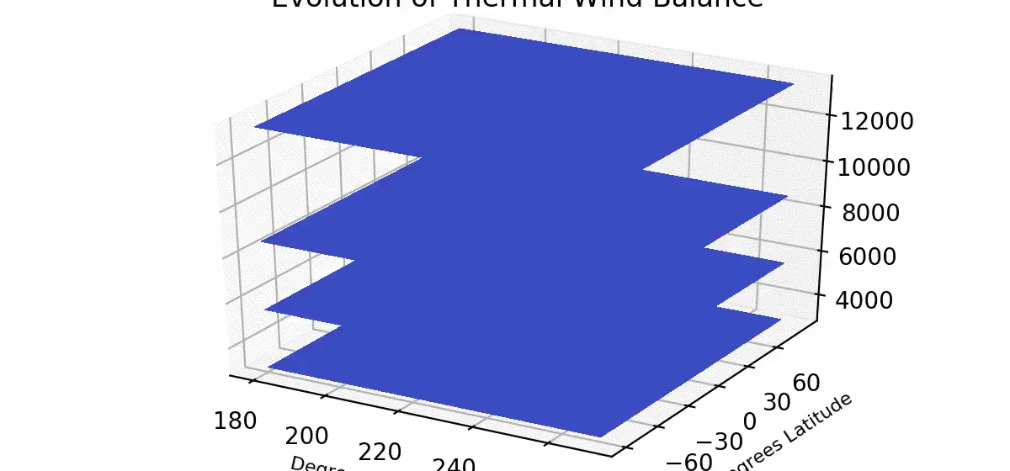
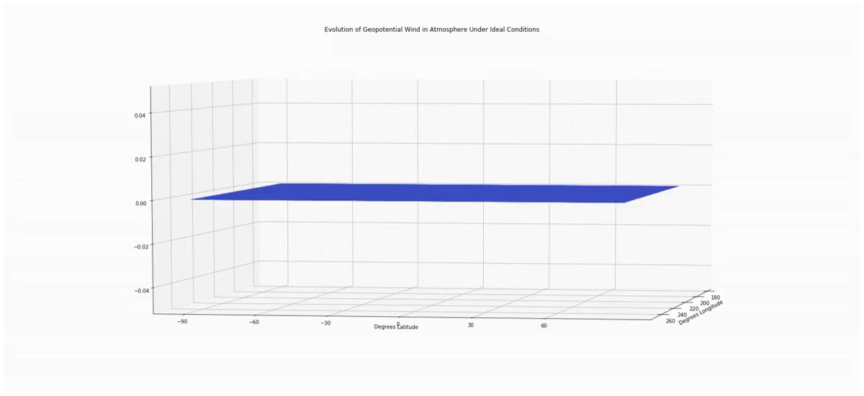
Animations
Evolution of Geopotential
Surface Elevations
Evolution of Geostrophic Component of the Wind (Zonal)

Slide 6
Sources
http://weather.uwyo.edu/upperair/sounding.html
https://www.spc.noaa.gov/exper/soundings/19112612_OBS/
https://rda.ucar.edu/datasets/ds627.1/docs/Pressure_and_isentropic_levels/
https://www.google.com/url?sa=i&rct=j&q=&esrc=s&source=images&cd=&cad=rja&uact=8&ved=2ahUKEwivqav3wp_mAhWHvp4KHZXGBucQjhx6BAgBEAI&url=https%3A%2F%2Fslideplayer.com%2Fslide%2F4330068%2F&psig=AOvVaw1xHKqYyITDpxLN9urtP5zm&ust=1575670127114413
https://www.google.com/url?sa=i&rct=j&q=&esrc=s&source=images&cd=&cad=rja&uact=8&ved=2ahUKEwioiZ6Nxp_mAhVxCTQIHelQAt4Qjhx6BAgBEAI&url=https%3A%2F%2Fslideplayer.com%2Fslide%2F4767713%2F&psig=AOvVaw2EYVUlO1ILmUlmpW33lIiV&ust=1575670851152123

