Slide 1
Rudimentary Rockets
Lauren Koch

Slide 2
Calculates the flight path of a simple model rocket launched from a planet
Rocket parameters: rocket mass, fuel mass, burn rate, velocity of fuel ejection, drag coefficient, reference area
Planet parameters: mass, radius, molar mass of atmosphere, average temperature, surface pressure
Variations on the Runge-Kutta method are applied for each stage

Slide 3
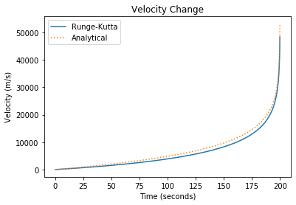
Stage 1
Proceeds until fuel is exhausted
dvdt = (F_{th} – F_{g} – F_{d})/M(t)
Compared against the Tsiolkovsky rocket equation
Stage 2
Proceeds until maximum vertical height is achieved
dvdt = (-F_{g} – F_{d})/M
Stage 3
Proceeds until the rocket returns to the ground
dvdt = (-F_{g} + F_{d})/M

Slide 4
Rocket parameters
10,000 kg rocket
10,000 kg fuel
100 kg/s burn rate
7000 m/s fuel ejection velocity
0.5 drag coefficient
10 m² reference area
Planet parameters (Earth)
0.0286 molar mass of atmospheric gas
282.32 K average temperature
101,325 Pascal surface pressure

