Slide 1
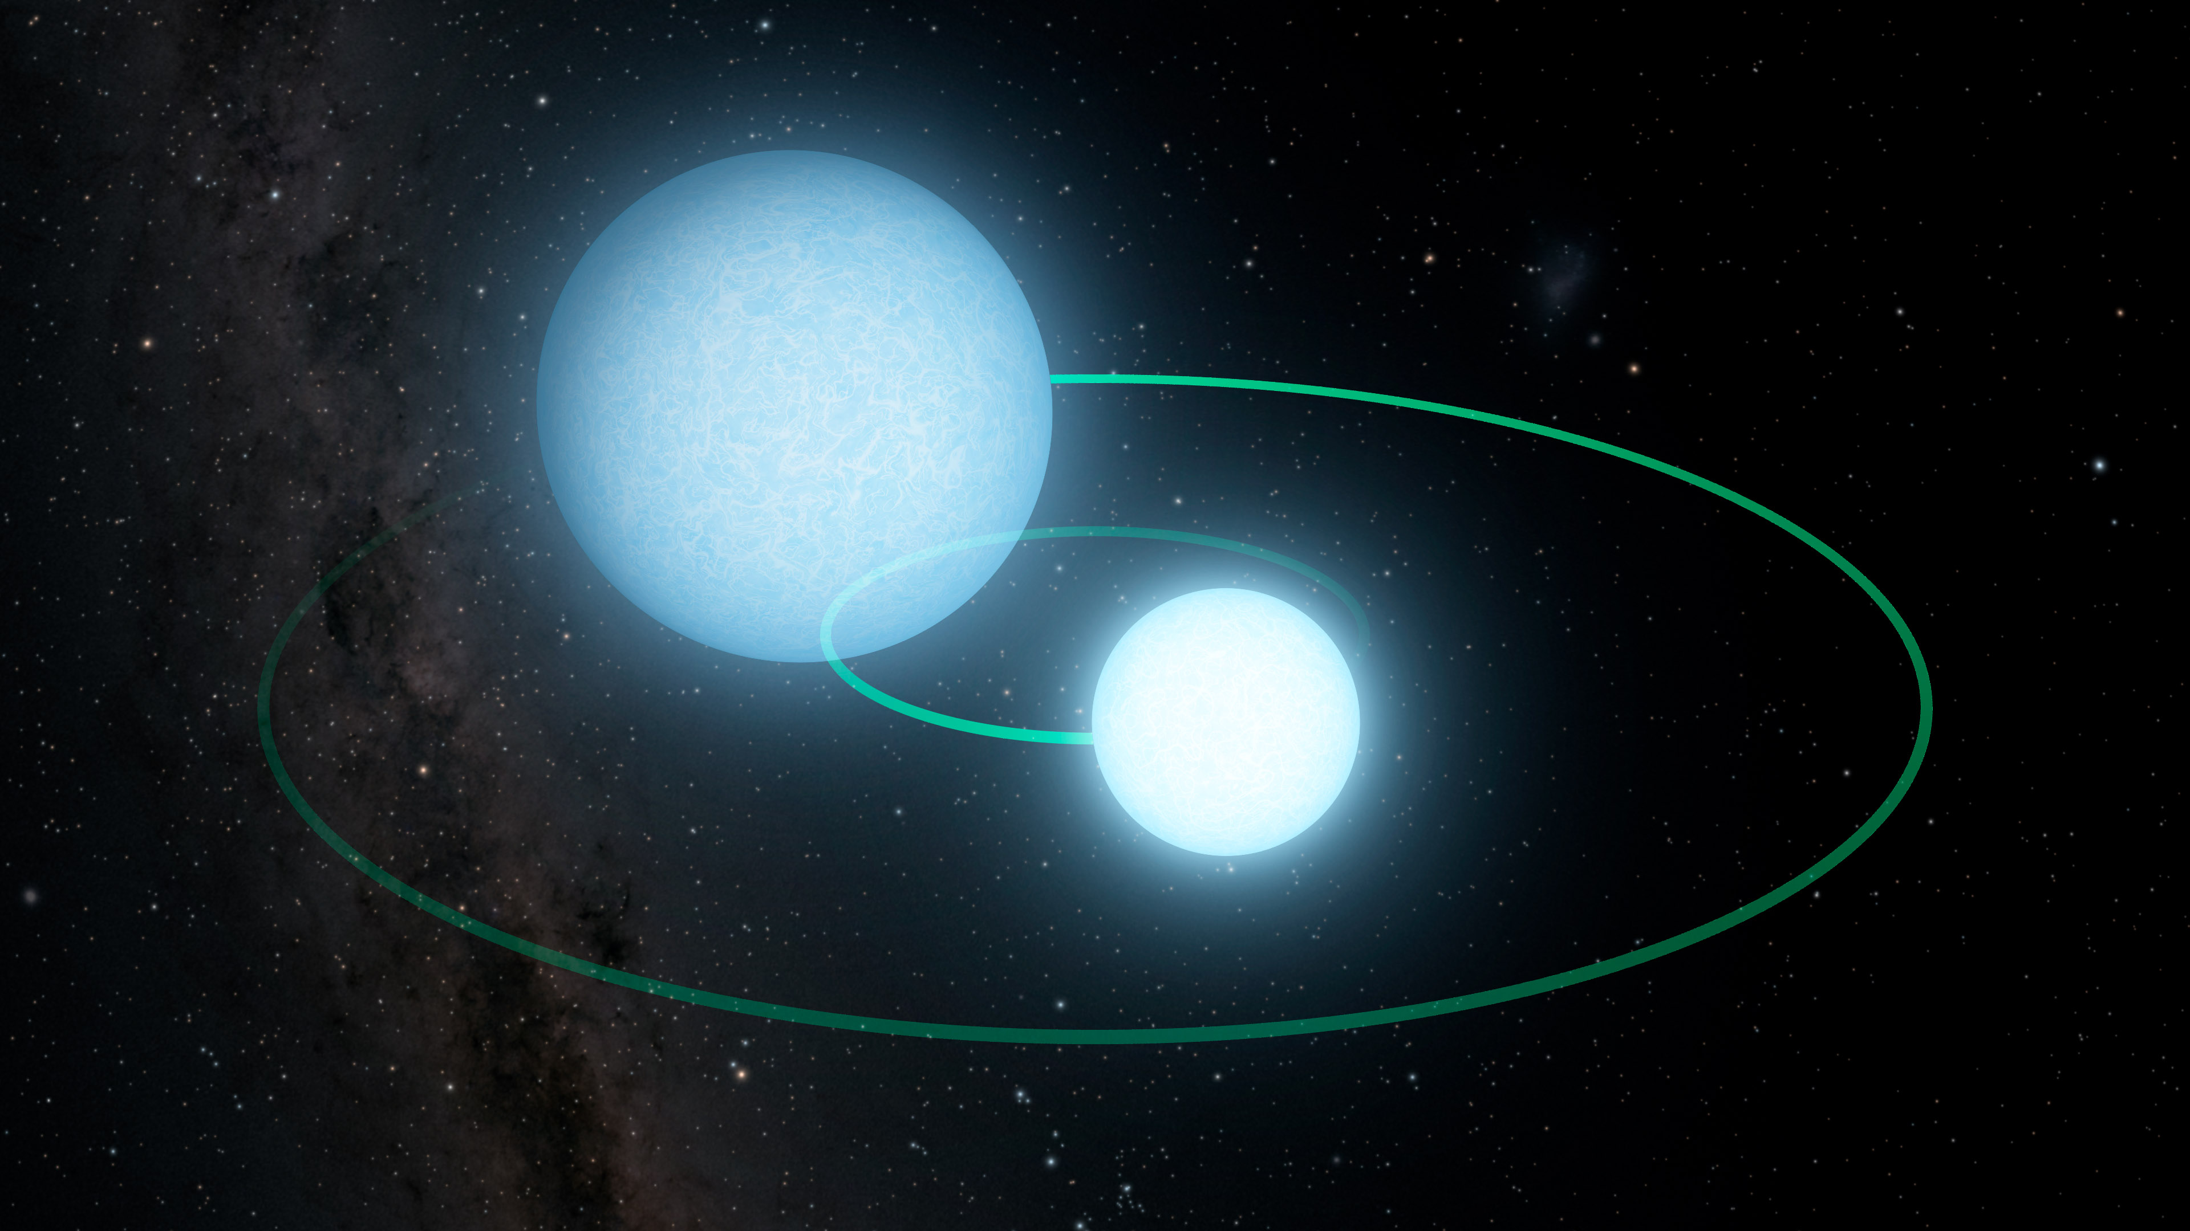
Eclipsing Binary Transit Light Curves
By Elliot Cantor

Slide 2
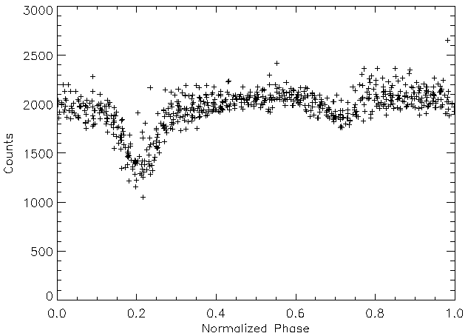
Eclipsing Binary Transits
Light curves from eclipsing binary systems can mimic those from exoplanet transit but have secondary transits.
Transit Depth:
batman: BAsic Transit Model
cAlculatioN in Python
(Kreidberg, 2015).
3D plot of equal mass binary stars
with corresponding normalized light curve with added gaussian noise.
Astrophysics and Space Research Group – University of Birmingham

Slide 3
Animation!

