Slide 1
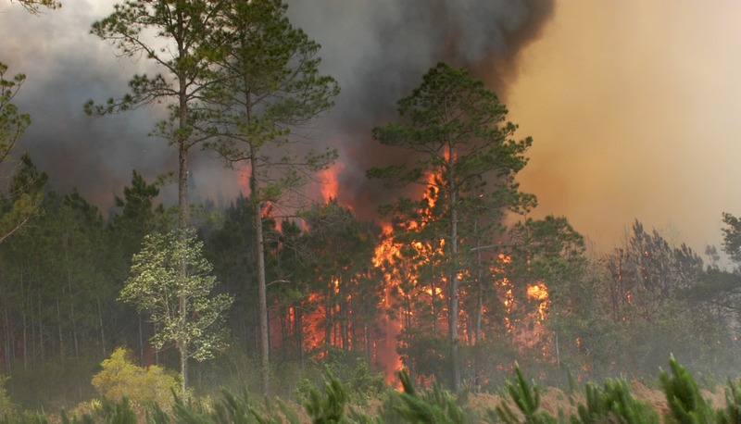
Forest Fire Simulation
Emily Ma
This Photo by Unknown Author is licensed under CC BY-NC

Slide 2
Forest Fire Modeled by Cellular Automata
Four states: vegetation (green), empty spaces (brown), burning (orange), and burnt (gray)
Three probabilities: density of vegetation (D), chance of ignition (I), and chance of becoming burnt (B)
Every iteration through matrix:
Check neighbors of burning cells for burning vegetation
Check if burning cells cool
Rodolfo Maduro Almeida and Elbert E N Macau 2011 J. Phys.: Conf. Ser. 285 012038 https://iopscience.iop.org/article/10.1088/1742-6596/285/1/012038/pdf

Slide 3
D = 0.6, B = 0.5, I = 0.5
D = 0.6, B = 0.22, I = 0.2

