Slide 1
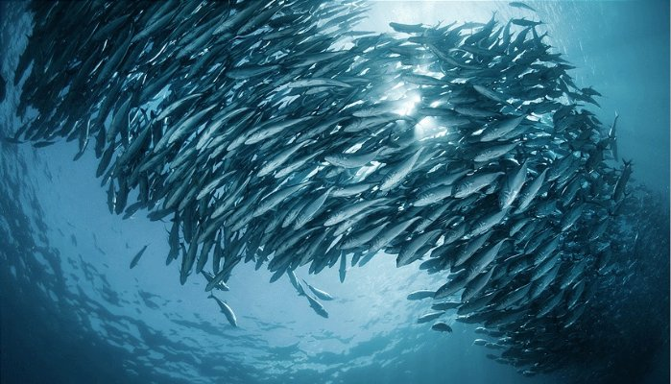
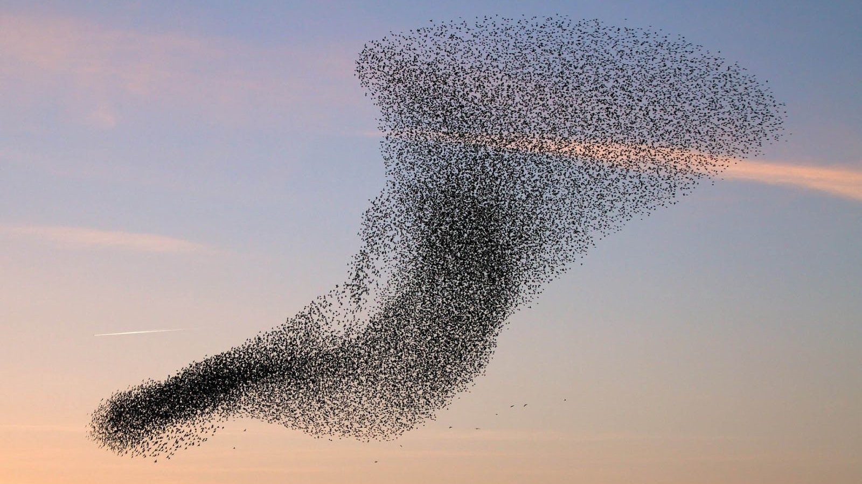
Swarm behavior
By Warren Tse

Slide 2
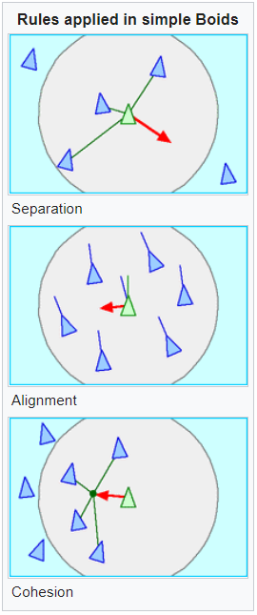
Topic and method
Topic – swarm behavior of animals (in the presence of predators)
Collective motion of a large number of self-propelled entities
Method – simulation with “boids” to model swarm patterns
Each “boid” is assigned a random initial position and velocity
At every time step, the boids have their position updated by their velocities, and then have their velocities updated by their acceleration
At the end of each time step, all the boids check for other boids and predators that are within a certain distance
The acceleration of each boid in this model changes depending on three factors: 1) alignment, 2) cohesion, and 3) separation
Sources:
https://medium.com/better-programming/boids-simulating-birds-flock-behavior-in-python-9fff99375118
https://en.wikipedia.org/wiki/Boids

Slide 3
ANIMATION

