Slide 1
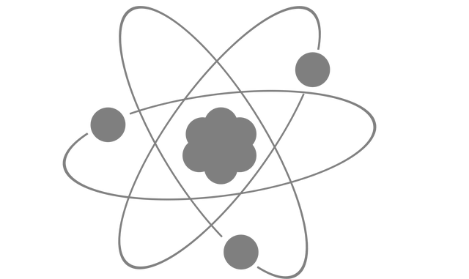
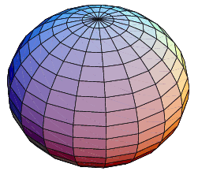
Orbits around an oblate planet
Cee Gould

Slide 2
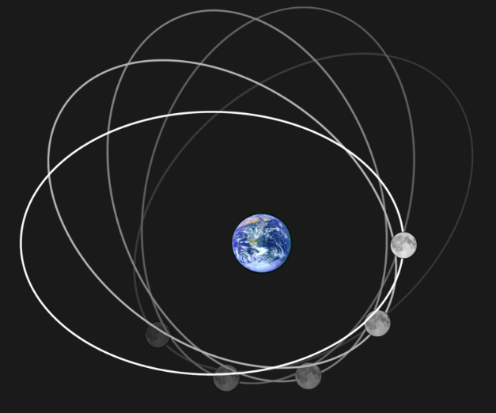
Motivation
Lunar apsidal precession first noted by ancient Greek astronomer Hipparchos
Caused in part by Earth oblateness -- not a sphere so gravitational potential cannot be described using Newton’s Equation alone V !=!
Goal: model a test particle in an oblate gravitational field

Slide 3
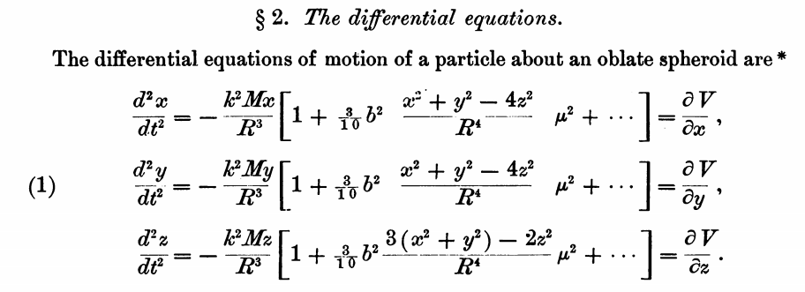
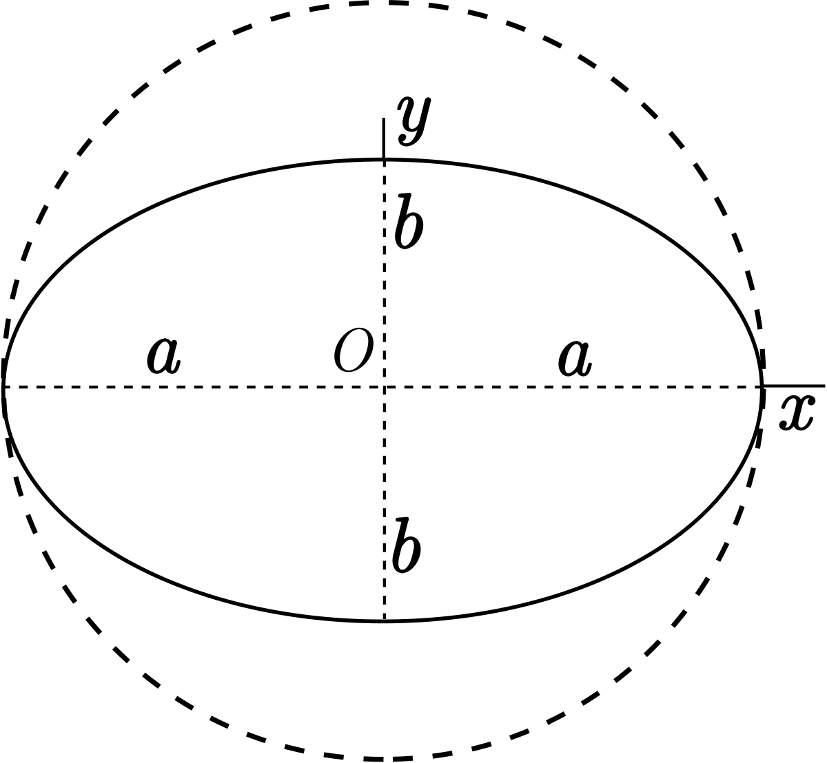
Methods
k = Gaussian Gravitational Constant = 0.017 rad/days, proportional to sqrt(GMsun).
mu = eccentricity of spheroid
Evaluate using 4th order Runge-Kutta
WD MacMillian (1910)

Slide 4
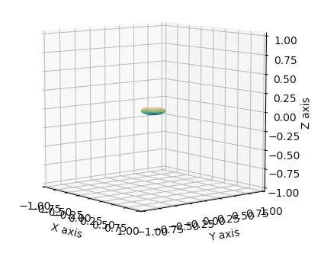
Initital Conditions
M = 10^6
R = [ 2 -1.5 0.5 ]
V = [ 0 12 0 ]
mu = 0.75
(highly oblate)

Slide 6
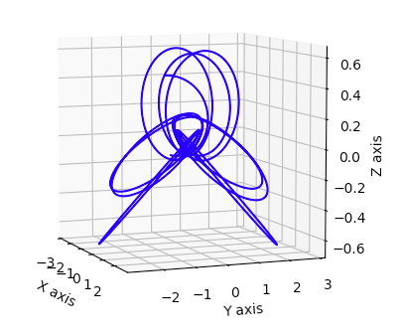
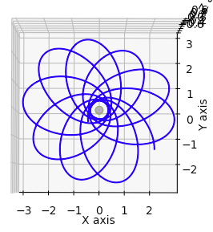
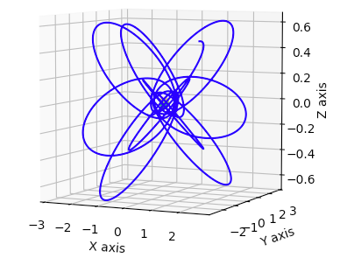
Final Conditions

