Slide 1
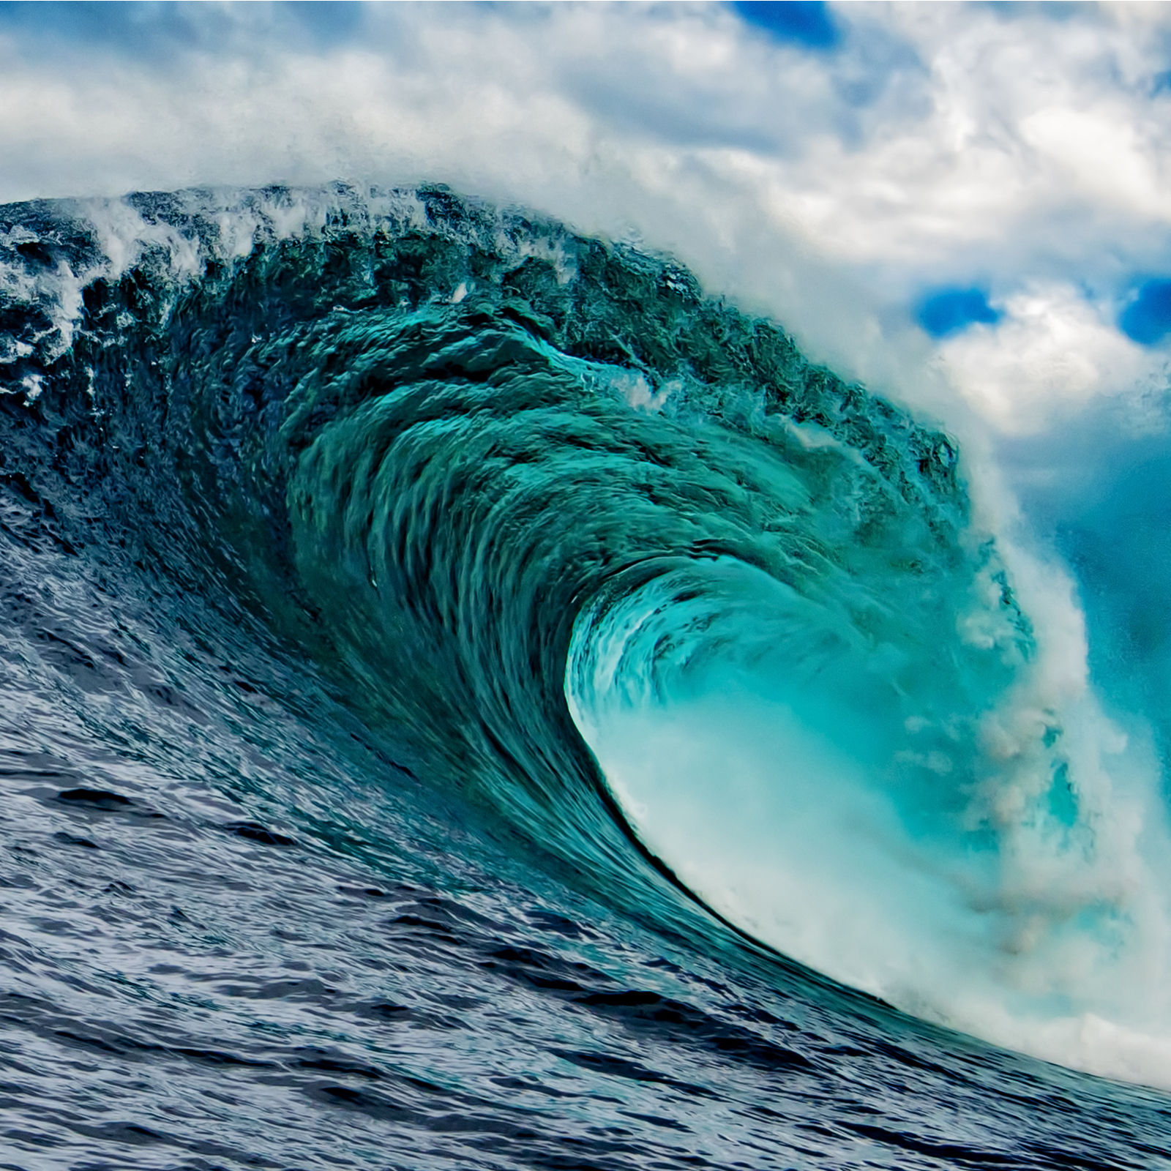
„This is my tidal“
Final Project
Selma Muminovic

Slide 2
Overview/Methods
For my project I did animated simulations of waves. Since we didn‘t do the wave assignment this semester, I used some online resources¹ for the foundational code. I ended up using the maplotlib.animation module, and for the actual animating part I used matplotlib.animation.FuncAnimation, which takes in the initialized figure object, a function that is called at each frame to update the visual, and some optional parameters regarding the number of frames, delay between frames, repetition, etc. This function handles updating at each iteration using the function passed in and number of frames, so it abstracted away the process we did in wave1d/2d.pynb where we had the for loop within the writer.saving block. The helper function that I used to pass into FuncAnimation follow similar logic to some things we’ve done in this class, where you populate an array for plotting. I experimented with different amplitudes, wave speeds, and types of waves to produce different animations. I decided to add some rotation of the graph as well, which I did by writing a helper function that used view_init and allows you to rotate.
1 http://firsttimeprogrammer.blogspot.com/2015/07/the-wave-equation-2d-and-3d.html

