Slide 1
Modeling Quantum Mechanics
Annie Leal

Slide 2
Simulation Methods
Original velocities determined by random numbers, which were scaled to a constant kinetic energy at a given temperature
Not many particles (dilute) to prevent any other unwanted interactions
Ordinary Differential Equation methods similar to those used in the Kepler orbit assignment
  Runge Kutta Method used to reduce error
Animation captured using writer.grab_frame() methods used in this class

Slide 3
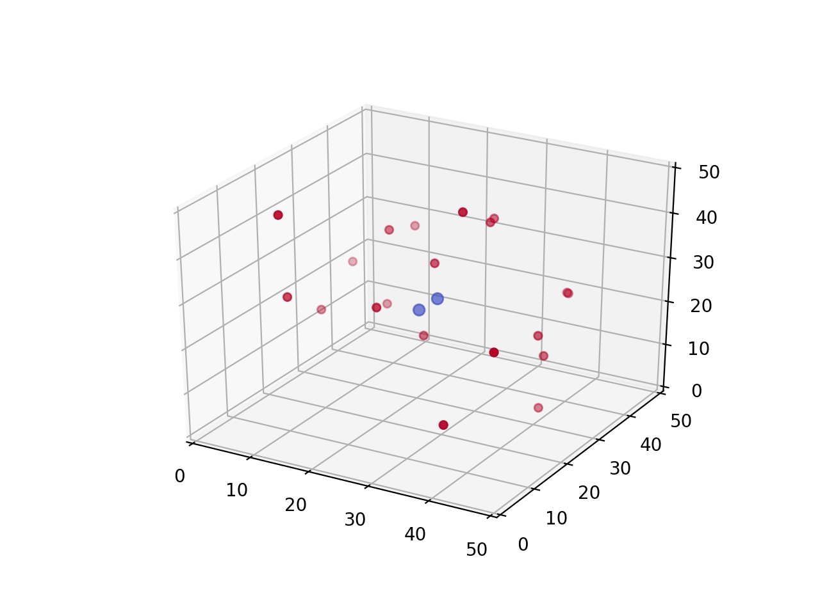
Animation at Room Temperature

Slide 4
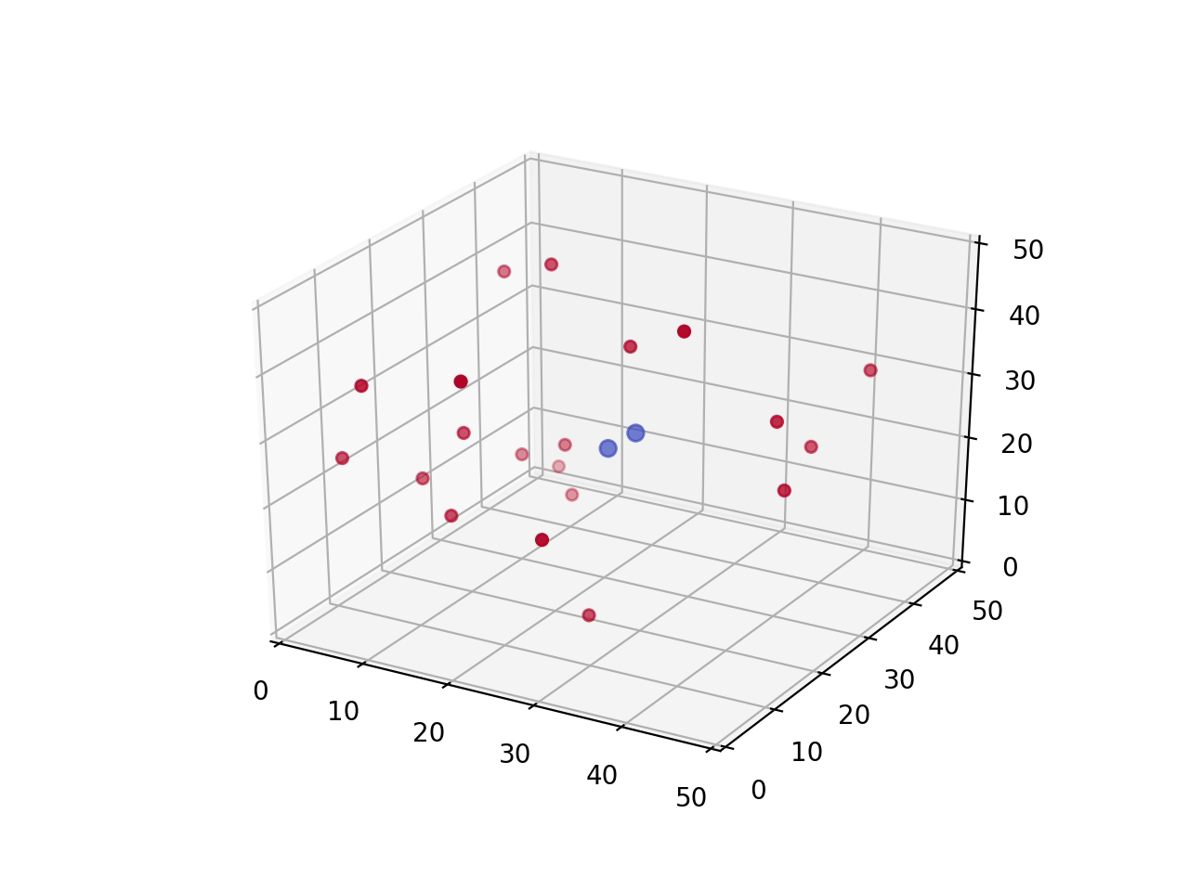
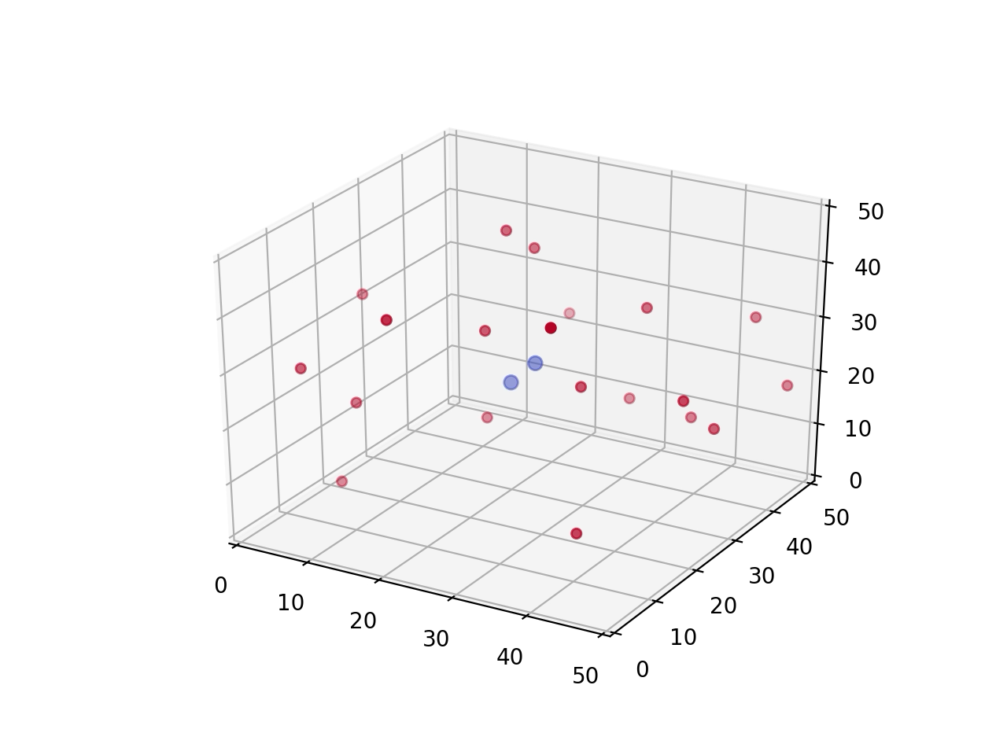
At Low Temperature: 50K
At High Temperature: 1000K

