Slide 1
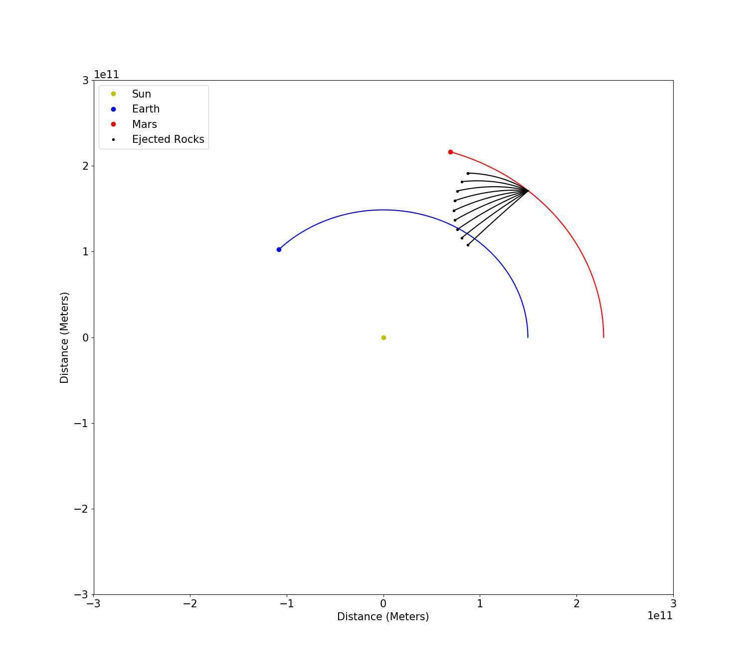
Tracking Mars ejecta
By Nicholas Pellegrini

Slide 2
Goal:
Simulate an impact on Mars that ejects multiple small rocks
Find a situation where one or more of these rocks collide with Earth
Method:
Recreate the orbits of Mars and Earth around the Sun
Use real-life values for object mass, radius, and semi-major axis
Timestep equal to 1/500th of the Earth's orbit period
Continuously update with following equations: a' = -g*ms*p/d^3, v' = a*dt, p' = v*dt
Eject rocks from Mars
Vary the ejection point in Mars' orbit, as well as the angle and magnitude of the ejection velocity
Find combination of angle, speed, and timing that results in an Earth collision

Slide 3
Failure
Success

