Slide 1
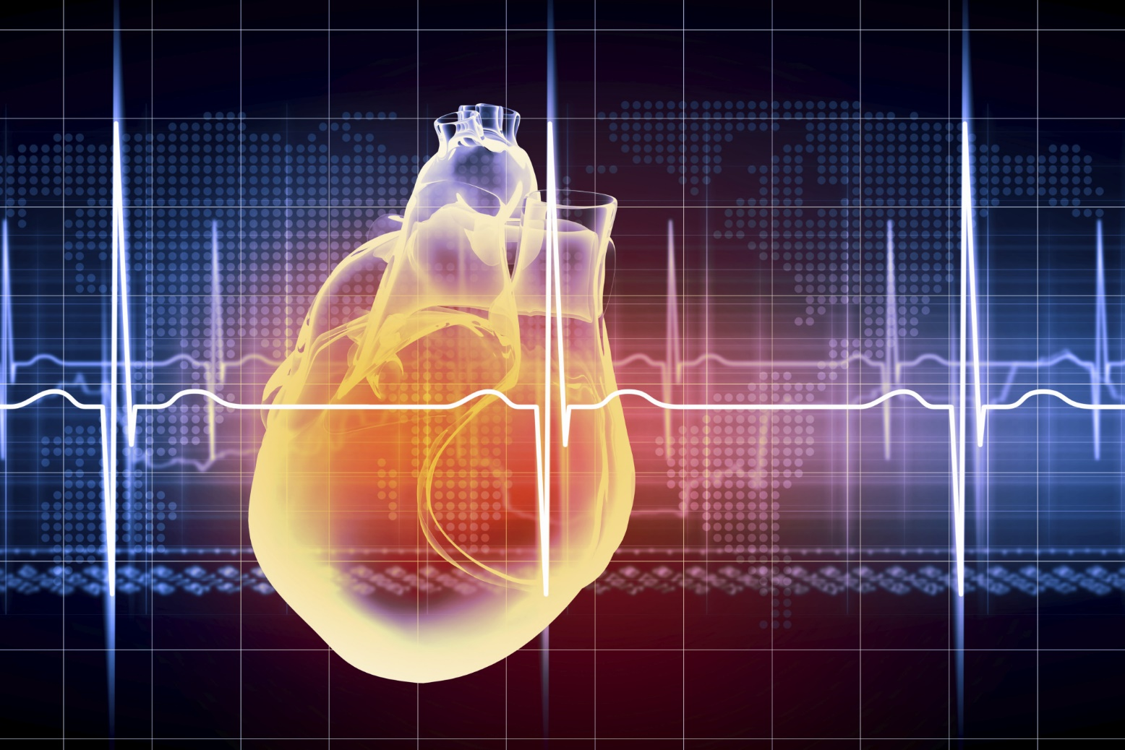
Modeling the Velocity Profile of Blood Flow in the Internal Carotid Artery
Jake Yung

Slide 2
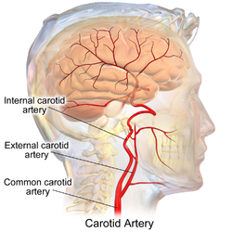
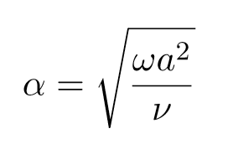
Methodology
The first animation is shown in real time and the second is shown in 1/3 speed.
This was achieved by setting the time inputs as the inverse of the animation FPS for the first animation.
For the second, I set the time inputs to be the inverse of 3 times the FPS
Sexl-Womersley Flow – Flow in a circular pipe driven by an oscillating pressure gradient
Source: https://en.wikiversity.org/wiki/WikiJournal_of_Medicine/Medical_gallery_of_Blausen_Medical_2014
Where,
a = Radius of the Internal Carotid Artery
y = dimensionless radius variable (r/a)
A = Resting Pulse Pressure
μ = Dynamic Viscosity of Human Blood
ν = Kinematic Viscosity of Human Blood
J₀ = Homogeneous Solution to 0th Order Bessel’s Equation (solution to a common diff. eq.)
α = Sexl-Womersley Number
ω = Frequency of Pressure Gradient Oscillations (Values set by α)
‘Exercise’ is simulated by an increase in the Sexl-Womersley number, α, which corresponds an increase in frequency, ω
Note: I used α values that probably exceed normal human values to accentuate the ‘wall shear.’

Slide 3
Real Time
1/3 Speed

