Slide 1
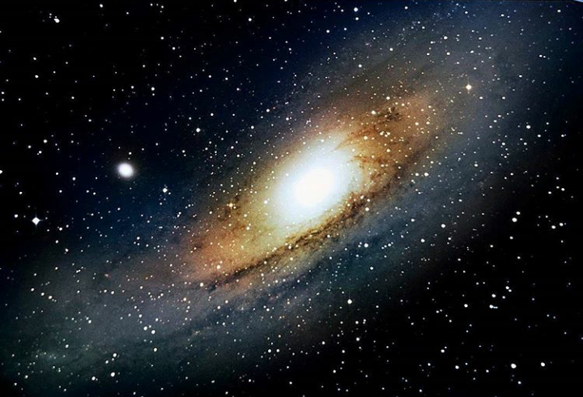
Modelling the Universe
By Costas Soler
The Andromeda Galaxy,
Imaged by Costas Soler

Slide 2
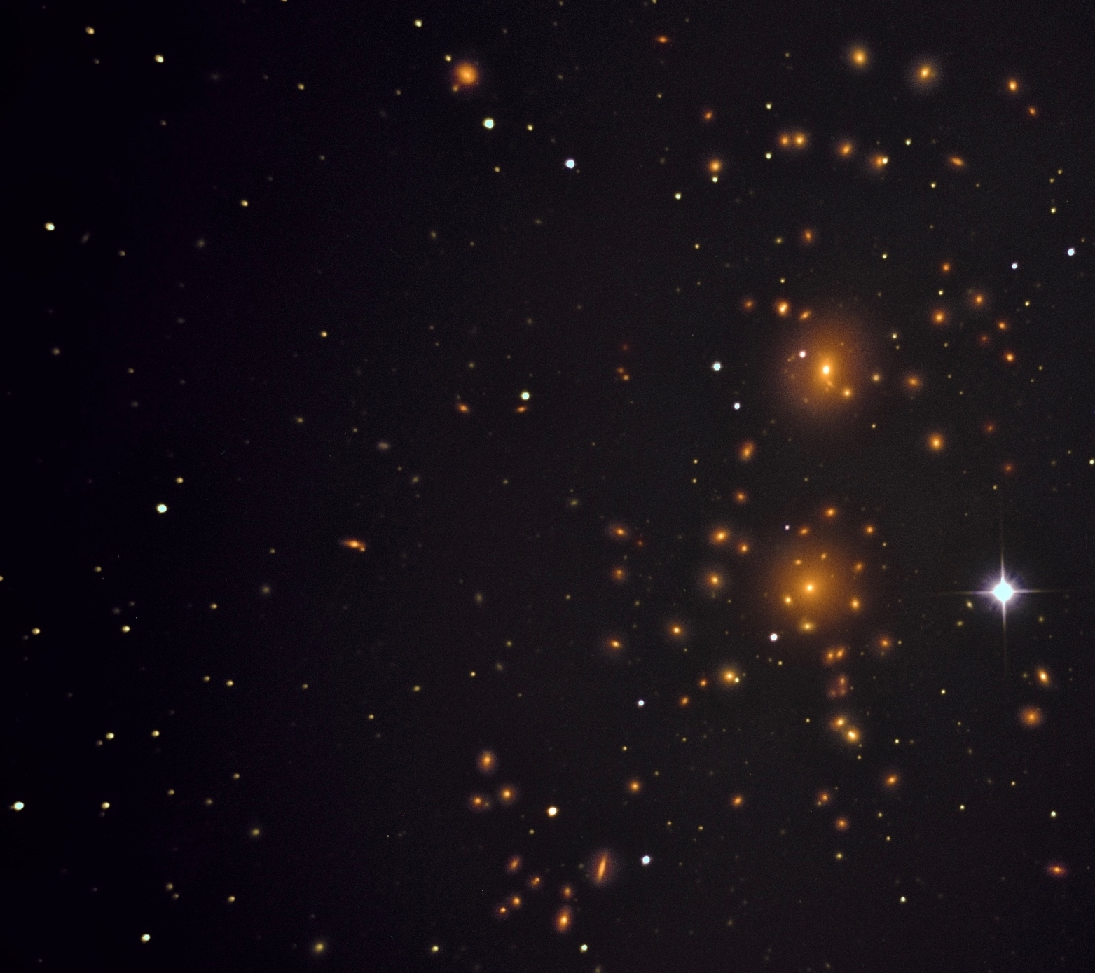
Ingredients of a Galaxy
~10% Baryonic Matter (stars, planets, dust, gas): This is only the matter we can see. It often clumps up to form stars or solar systems
~90% Dark Matter (?): Exists as an invisible ‘halo’ around galaxies. If it really is matter, then it outweighs all the matter we know by about 9:1
g ~ constant/r = acceleration due to DM’s gravity
Where r = a star’s distance to the center of the ‘halo’
The Coma Cluster (photographed by yours truly)
Notes:
The Coma Cluster (photographed by yours truly): Galaxies here move so quickly here that astronomers realized that there must be a huge amount of unseen “Dark” Matter

Slide 3
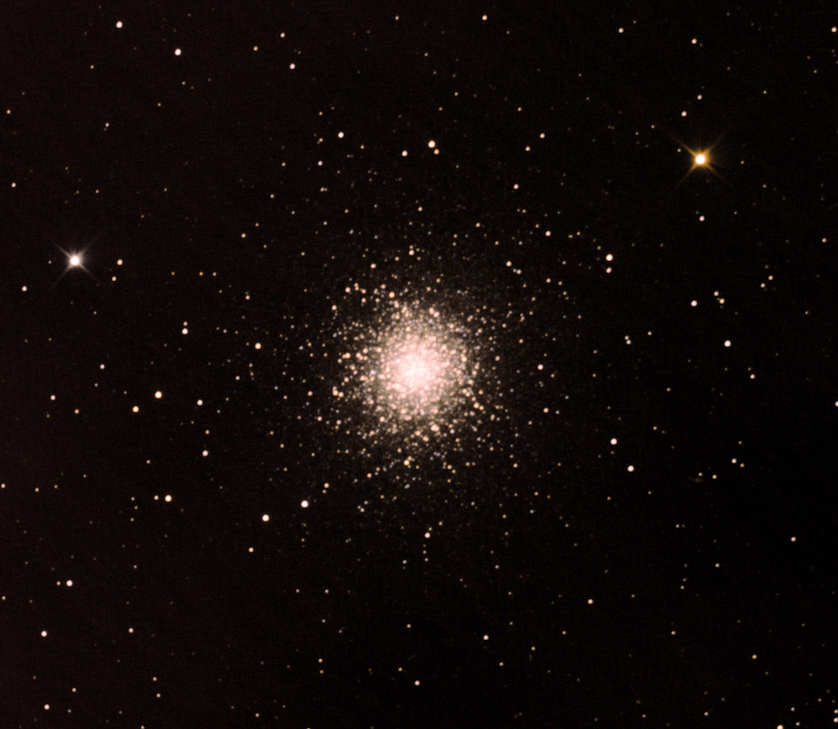
Here’s the model:
…and the real thing:
Compared to one of my favorite objects, the Hercules Cluster, this doesn’t look too far off! We even reach a steady state that shows a uniform mixing of stars.
Compared to one of my favorite objects, the Hercules Cluster, this doesn’t look to far off. We even get a similar even mixing of stars!

Slide 4
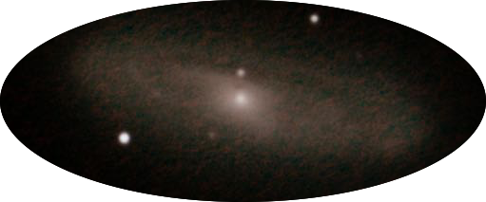
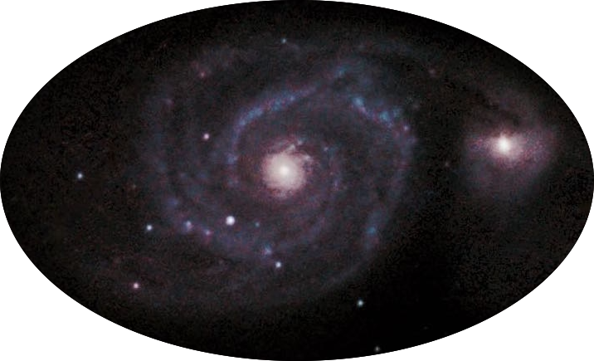
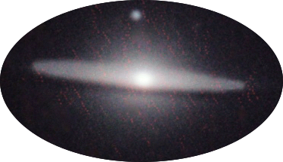
The real ones:
And my model:
Notice regions with high densities of stars. There, stars slow down as if they’re in a traffic jam. This is similar to the density waves/arms we see in real galaxies!

