Slide 1
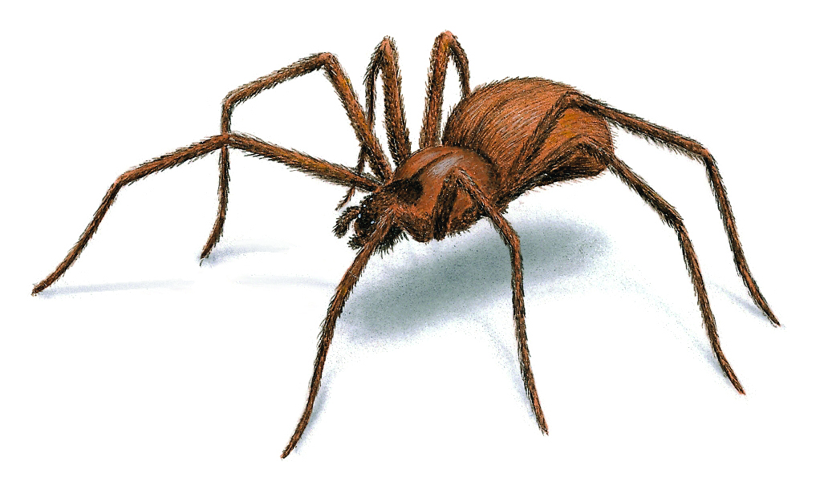
Cobwebbing with a Spider by Theresa Sawi

Slide 2
.
Logistic Map and Cobweb Plot Quick Review:
Maps the function: f(xn) = xn+1 = xn*r*(1-xn)
Fixed point – value of x for which f(x) = x
Cobweb Plot – helps analyze the behavior of multiple iterations of the mapping transformation
A spider lives next to two branches: a diagonal branch, x = y, and a curved branch, y = f(x), where f(x) = x*r*(1-x)
Flies like to land where the branches meet (at the “Fly Position”, or “FP” – (fixed point) ) :
This spider is very clever and she has figured out how to use the function f(x) to catch the flies, regardless of her starting position.
To approach the fly, the spider starts at any point (x,y) on the diagonal branch and makes these moves:
Go vertically to a spot on the curved branch that is at (x, f(x))
Go horizontally across until she reaches the diagonal branch, at (f(x),f(x))
Recalculate position (x,y) and repeat from step 1 as required.
Stable FP
No Stable FPs
**Higher values of r mean a bigger “reach” between branches, and if r gets too big, then her movements become less directed and eventually chaotic
**If the fly position is ‘stable’, then she spirals in for the kill

