Slide 1
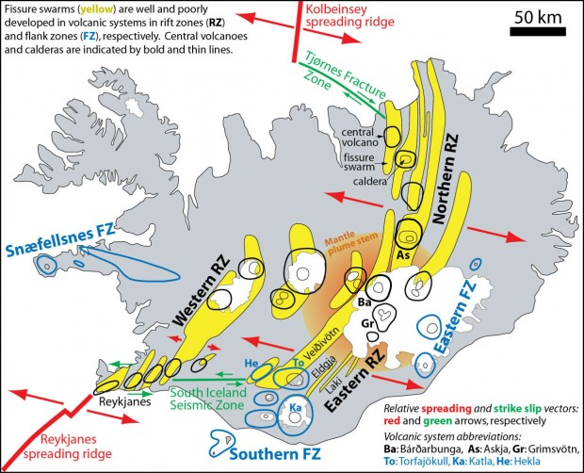
Splitting of Iceland
Sean Osaki
http://forskning.no/blogg/reidar-tronnes/bardarbunga-nornahraun-eruption-ongoing-demonstration-rifting-and-volcanism

Slide 2
Methods
Simulating the movement of the Iceland on the Mid-Atlantic Ridge between the North American Plate and the Eurasian Plate
Predicting the location of Iceland over a course of 25 million years
How was it done?
Used the San Andreas Fault HW as a guideline
Getting coordinates of Iceland
Downloaded an exchange file known as “Borders” by Chad Greene for MATLAB
Coping latitude and longitude coordinates onto Notepad
Importing coordinate as a .txt file onto MATLAB
Getting two Icelands
Splitting the coordinates into two separate .txt files for western Iceland and eastern Iceland
Adding the coordinates of the fault and rift zones to each of the new .txt files
Some assumptions were made
Since Iceland is growing and not splitting, I assumed Iceland is splitting
The splitting of Iceland is occurring today
Made approximations for the fault and rift zones, as exact coordinates were quite difficult to find
A few points were used for the fault and rift zones based on the coordinates of volcanoes, which makes it appear slightly unnatural
Both the western and eastern part of Iceland are splitting at the same rate of 18 mm/yr and at a direction 180° from each other at 165° and -15 ° respectively.

Slide 3
Movie

