Slide 1
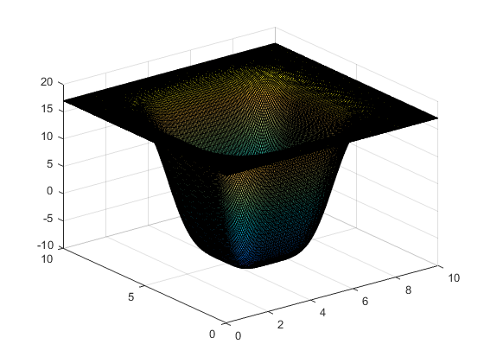
Modeling rates of ice melt
Xin Suen Ong

Slide 2
Topic & Methods
Global warming is causing ice to melt faster than before, and the melting ice is creating a positive feedback loop that further enhances the warming effect.
This simulation aims to provide a simplified model that captures the rate at which ice melts, based on true parameters.
The main concept used to create this simulation is using partial differential equations to model heat flow.

Slide 3
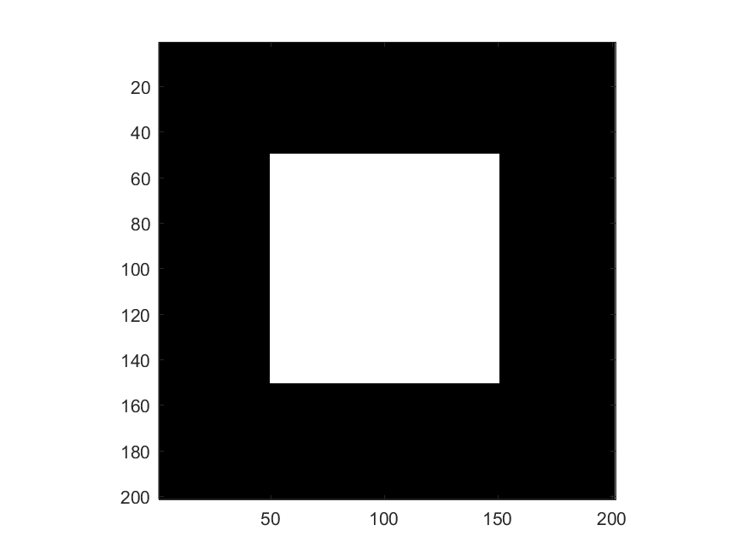
Temperature profile

