Slide 1
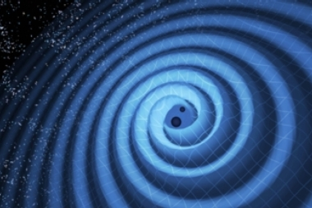
Gravitational Waves and Radiation
By Michael Maestas

Slide 2
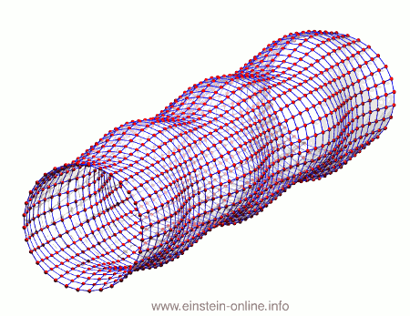
Neutron stars/Black Holes orbiting each other before merger.
When 2 black holes combine
Predicted before by Gravitational Radiation
Explained by the Animation
LIGO found gravitational waves in February of last year but announced its discoveries September of the same year.
Proves one of Einstein’s theories on General Relativity
For my Matlab Files, the run the file “Homework11” for the simulation to play.

