Slide 1
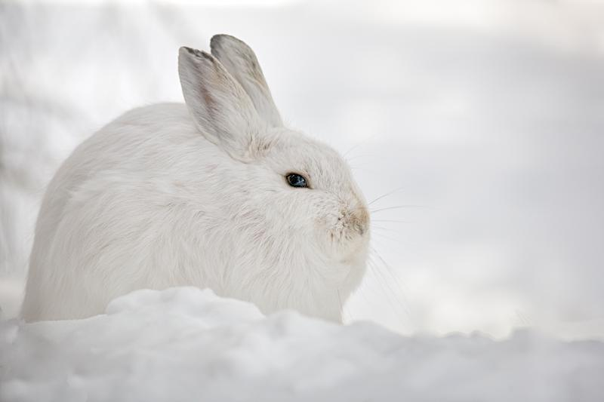
Survival of the Fittest
Modelling Natural Selection in a Population of Rabbits
Madelief Schelvis

Slide 2
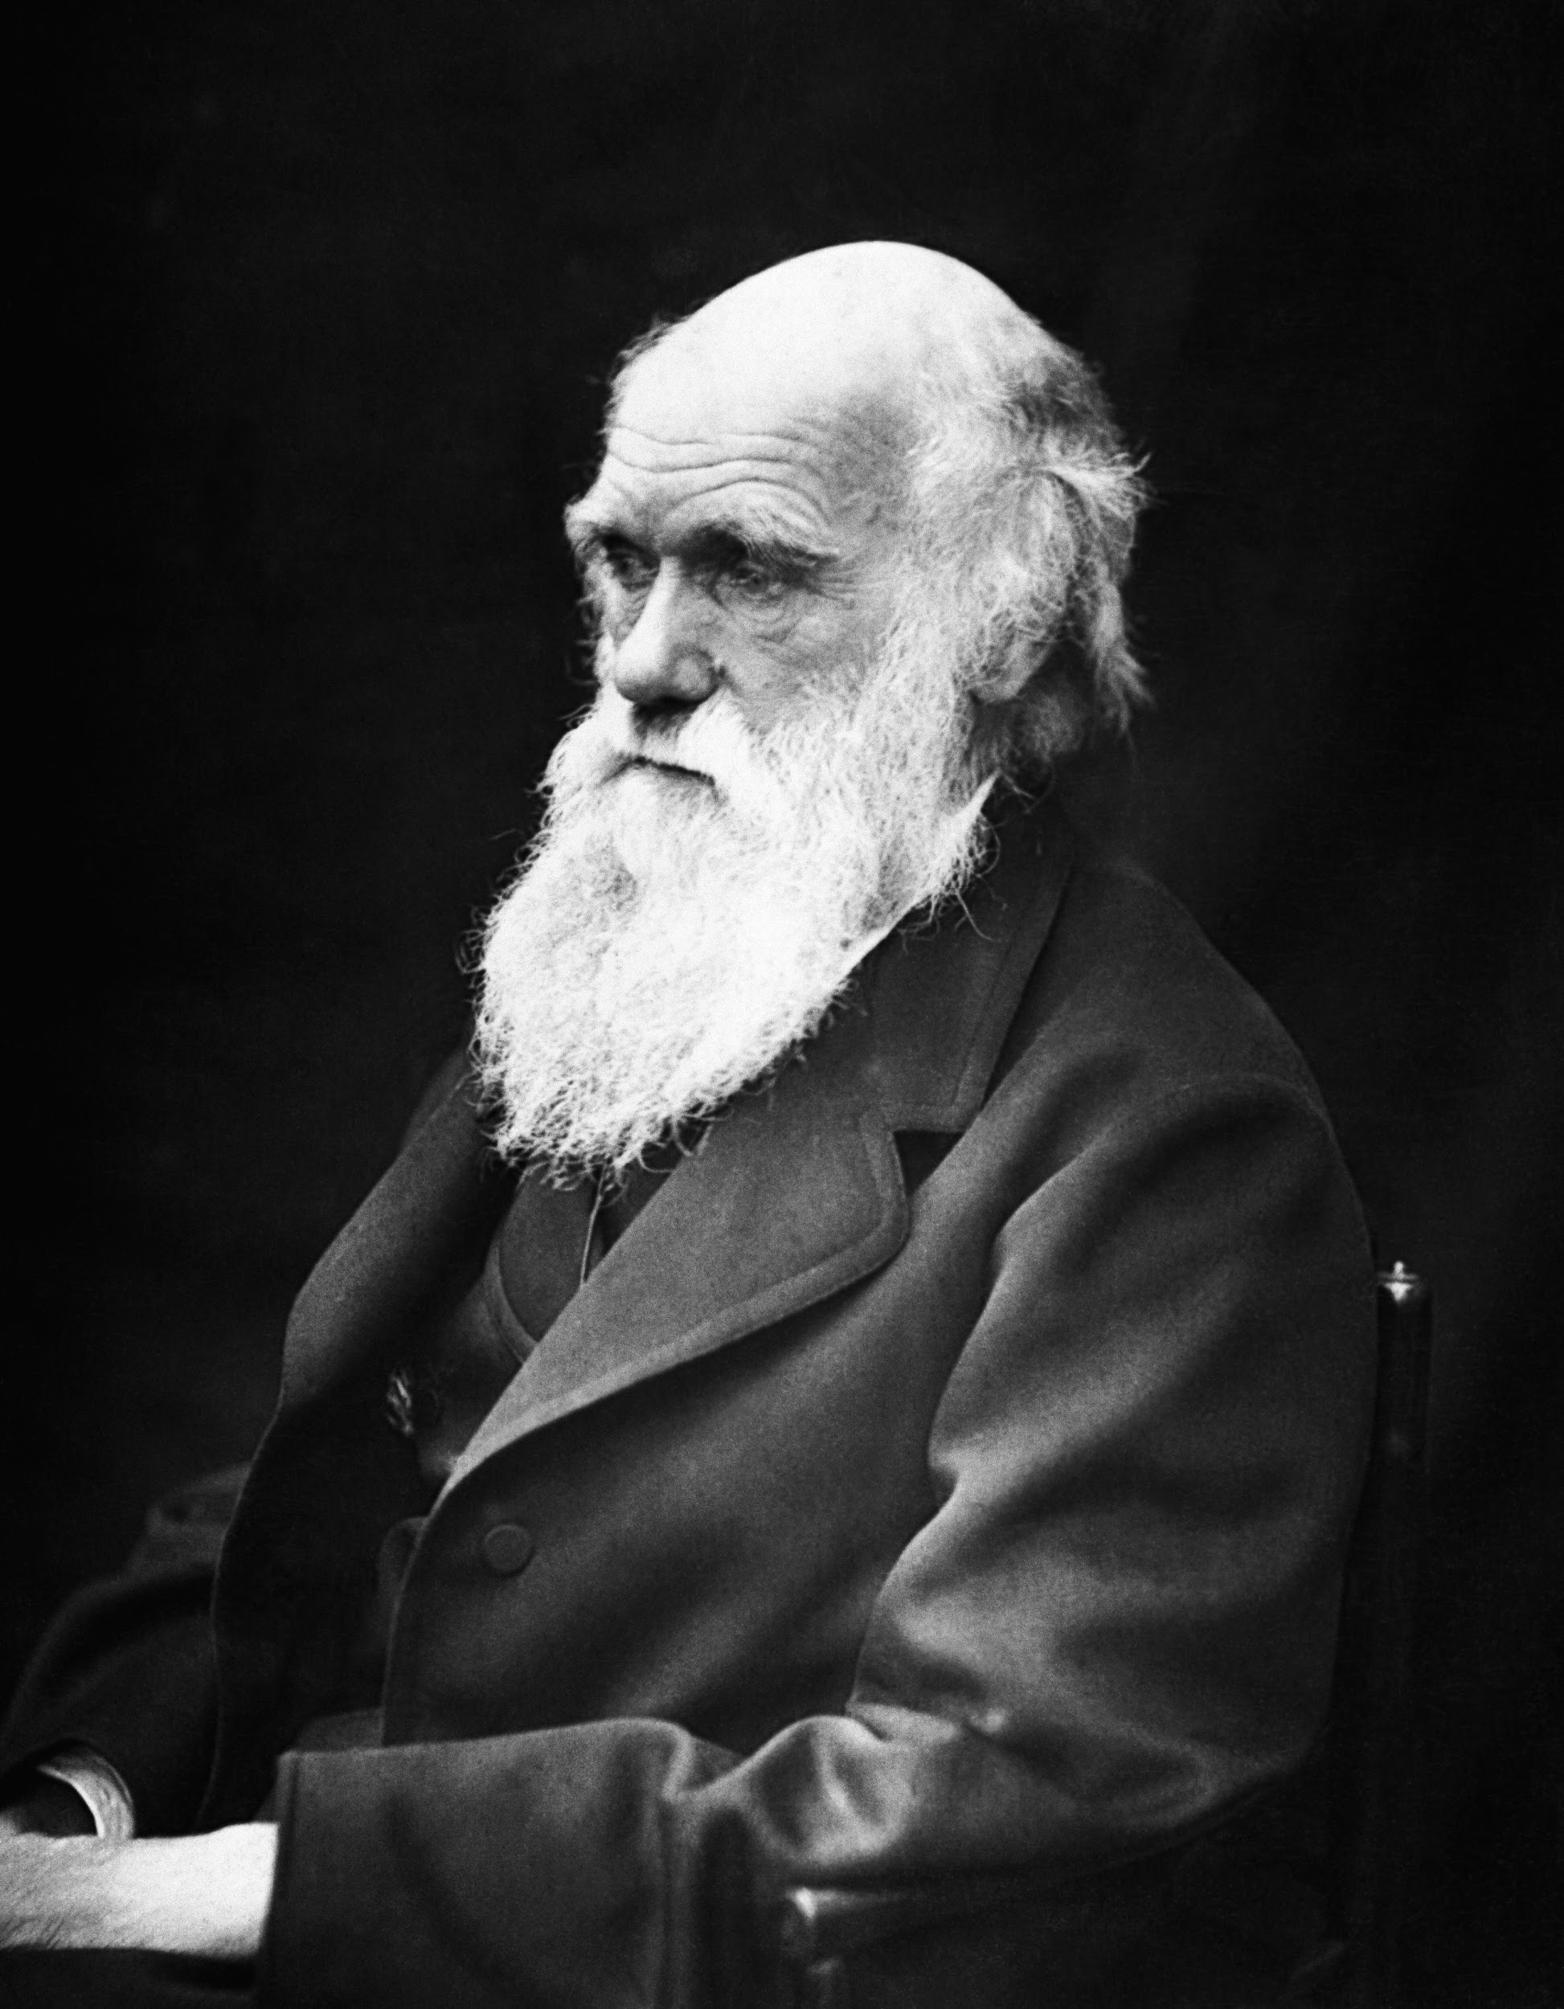
The Mechanisms of Natural Selection
Variation in Traits
Create a population of randomly generated sizes.
Differential Survival and Reproduction
Over each generation, half of the individuals die.
The probability of death is a function of size.
The survivors reproduce.
Heredity of Traits
Survivors each produce one offspring.
The offspring is the same size as the parent, plus or minus a random fraction of the parent’s size.
Variation is maintained by adding a mutant to each generation. The mutant’s size is randomly generated and independent of the parent’s size.

Slide 3
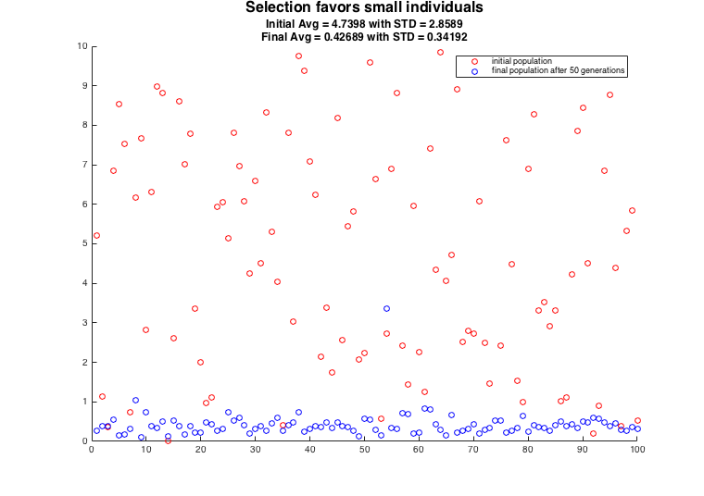

Slide 4
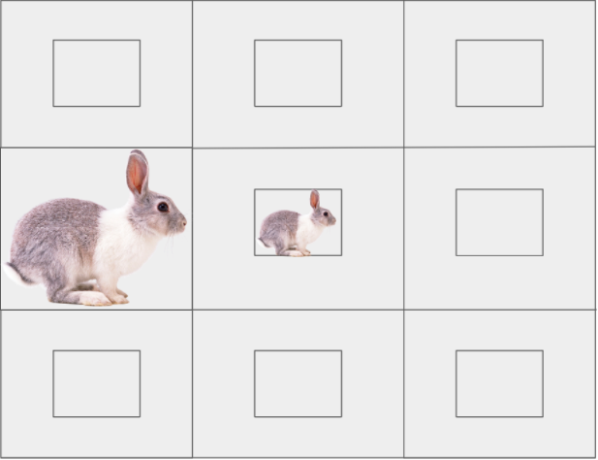
Visualizing the Rabbit Population
Begin with an image R = rabbit.png
Create a matrix large enough to contain N full-size images, where N is the population size.
Modify the original image by a factor of L, where L contains the individual sizes.
Use imresize(R, L(i)) to change the size of the image.
Scaled between 0.5 and 1.
Use L(i)*R to change the brightness of the image.
Scaled between 0.5 and 1.5.
Place a modified image in the center of each square.

Slide 5
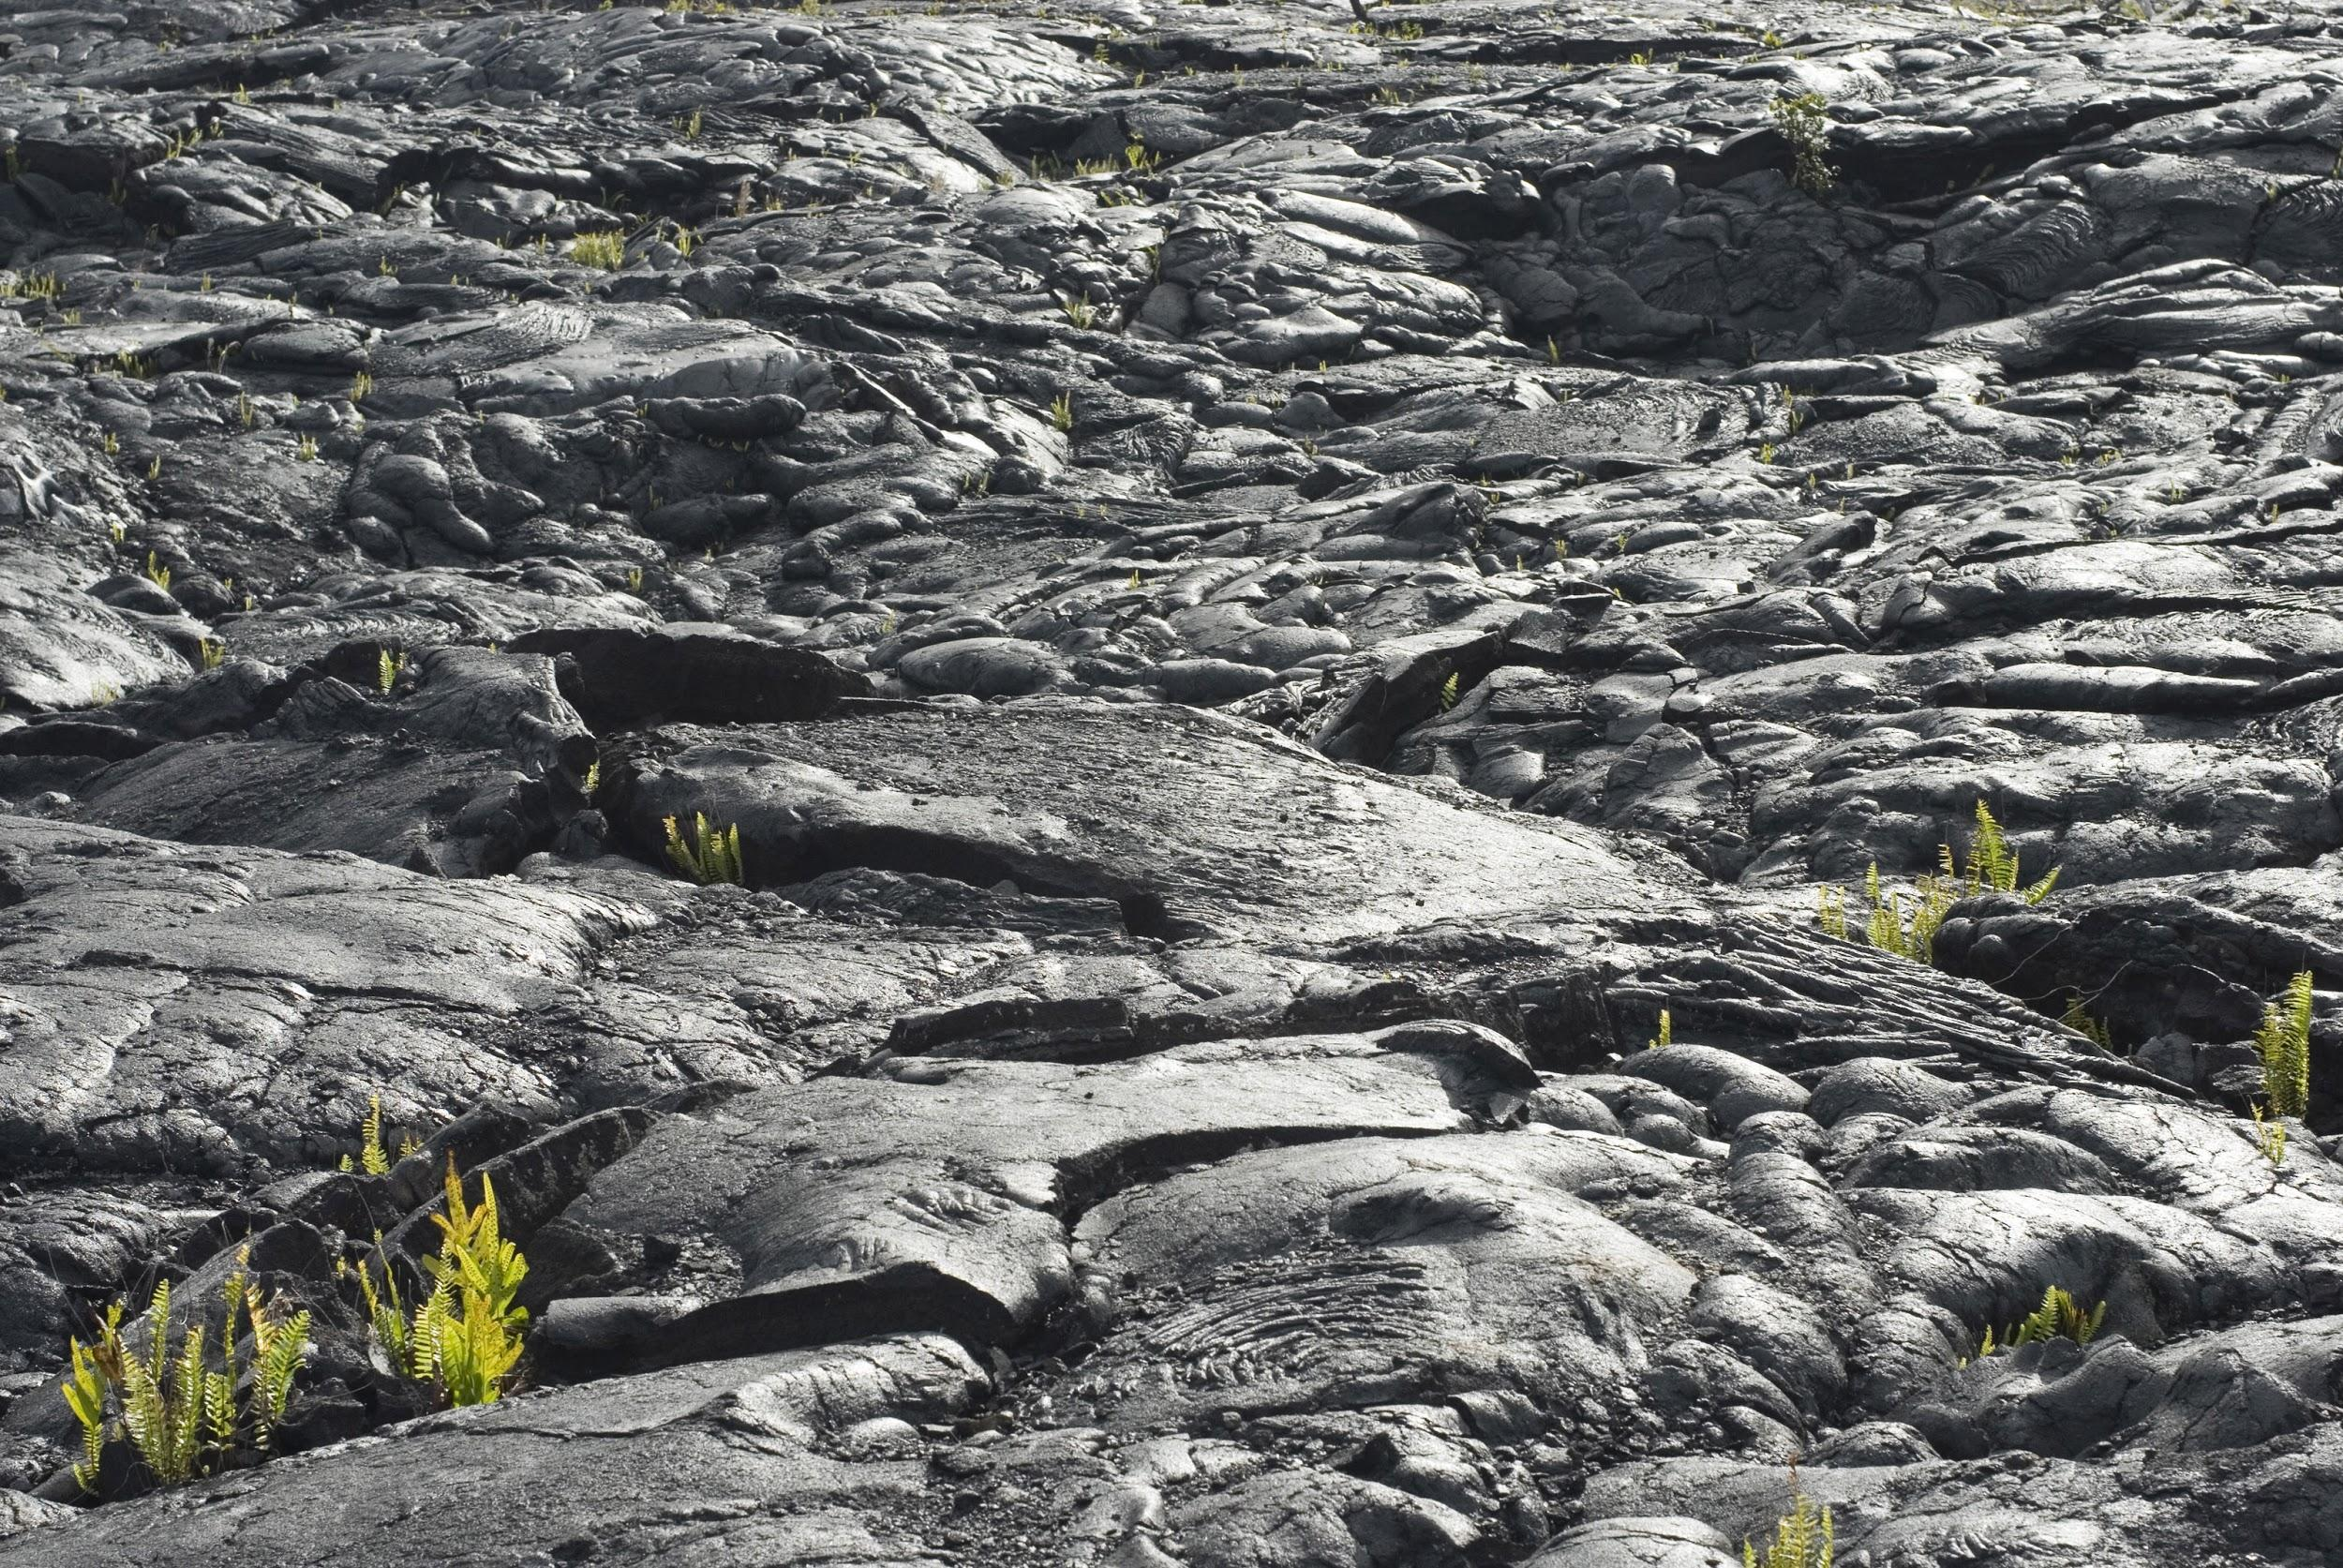
On a dark landscape, natural selection will likely favor small, dark-colored individuals

Slide 6
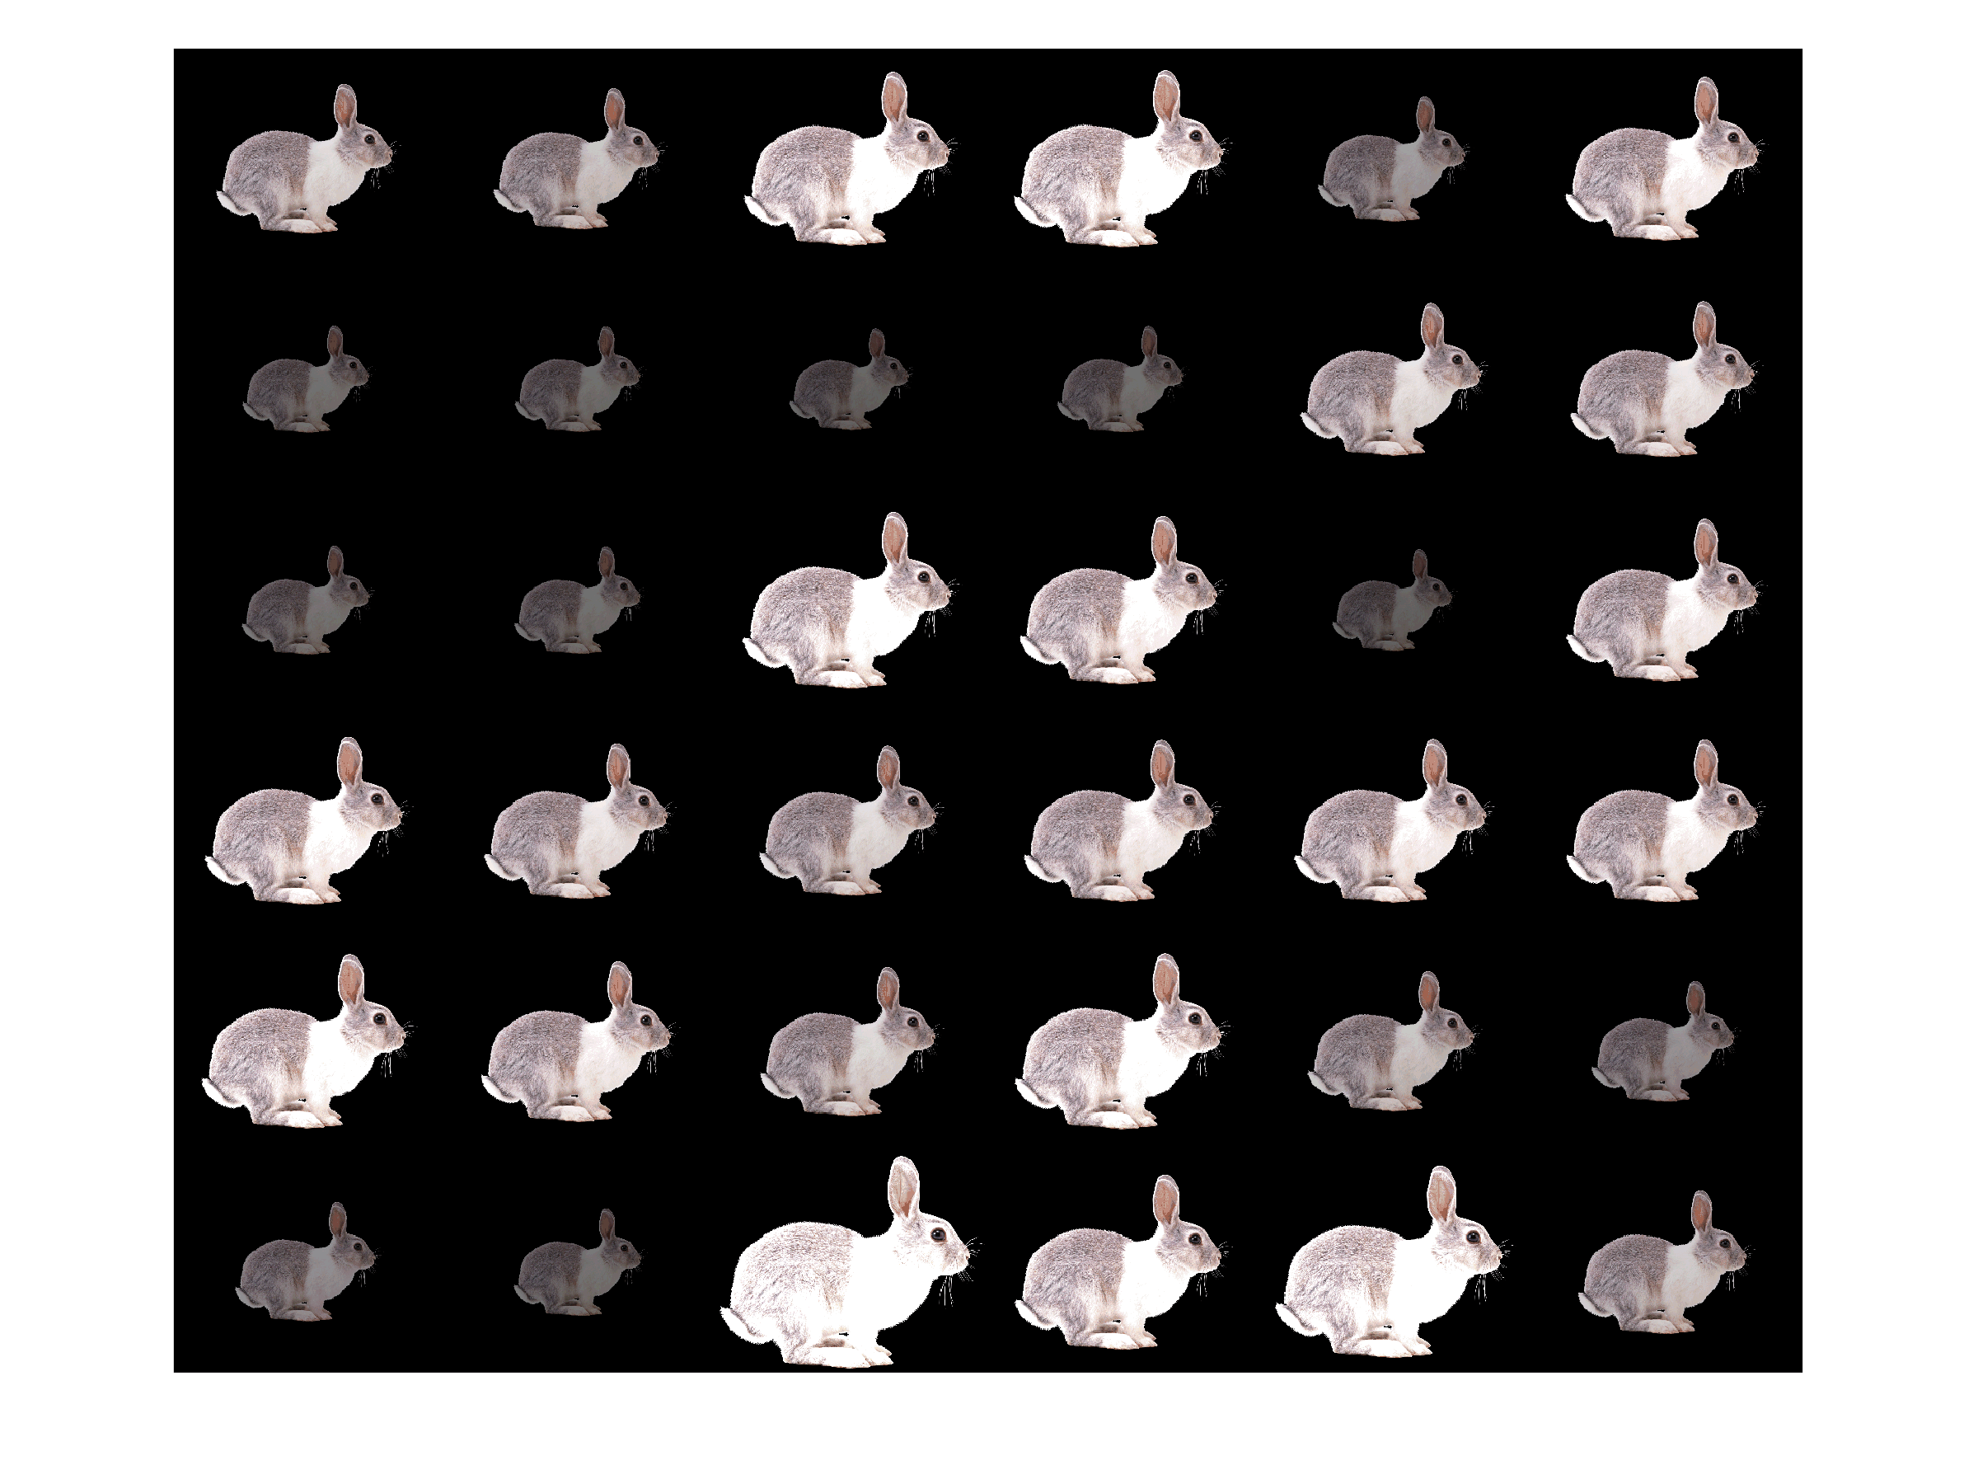

Slide 7
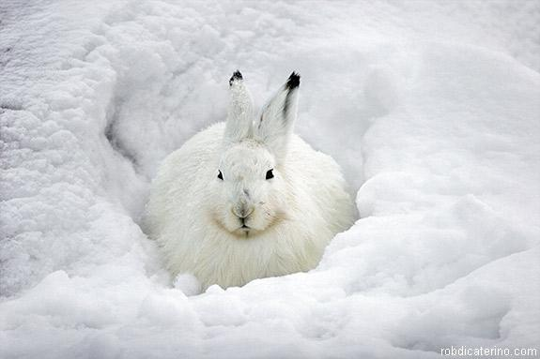
On a bright white landscape, natural selection will likely favor small, light-colored individuals

Slide 8
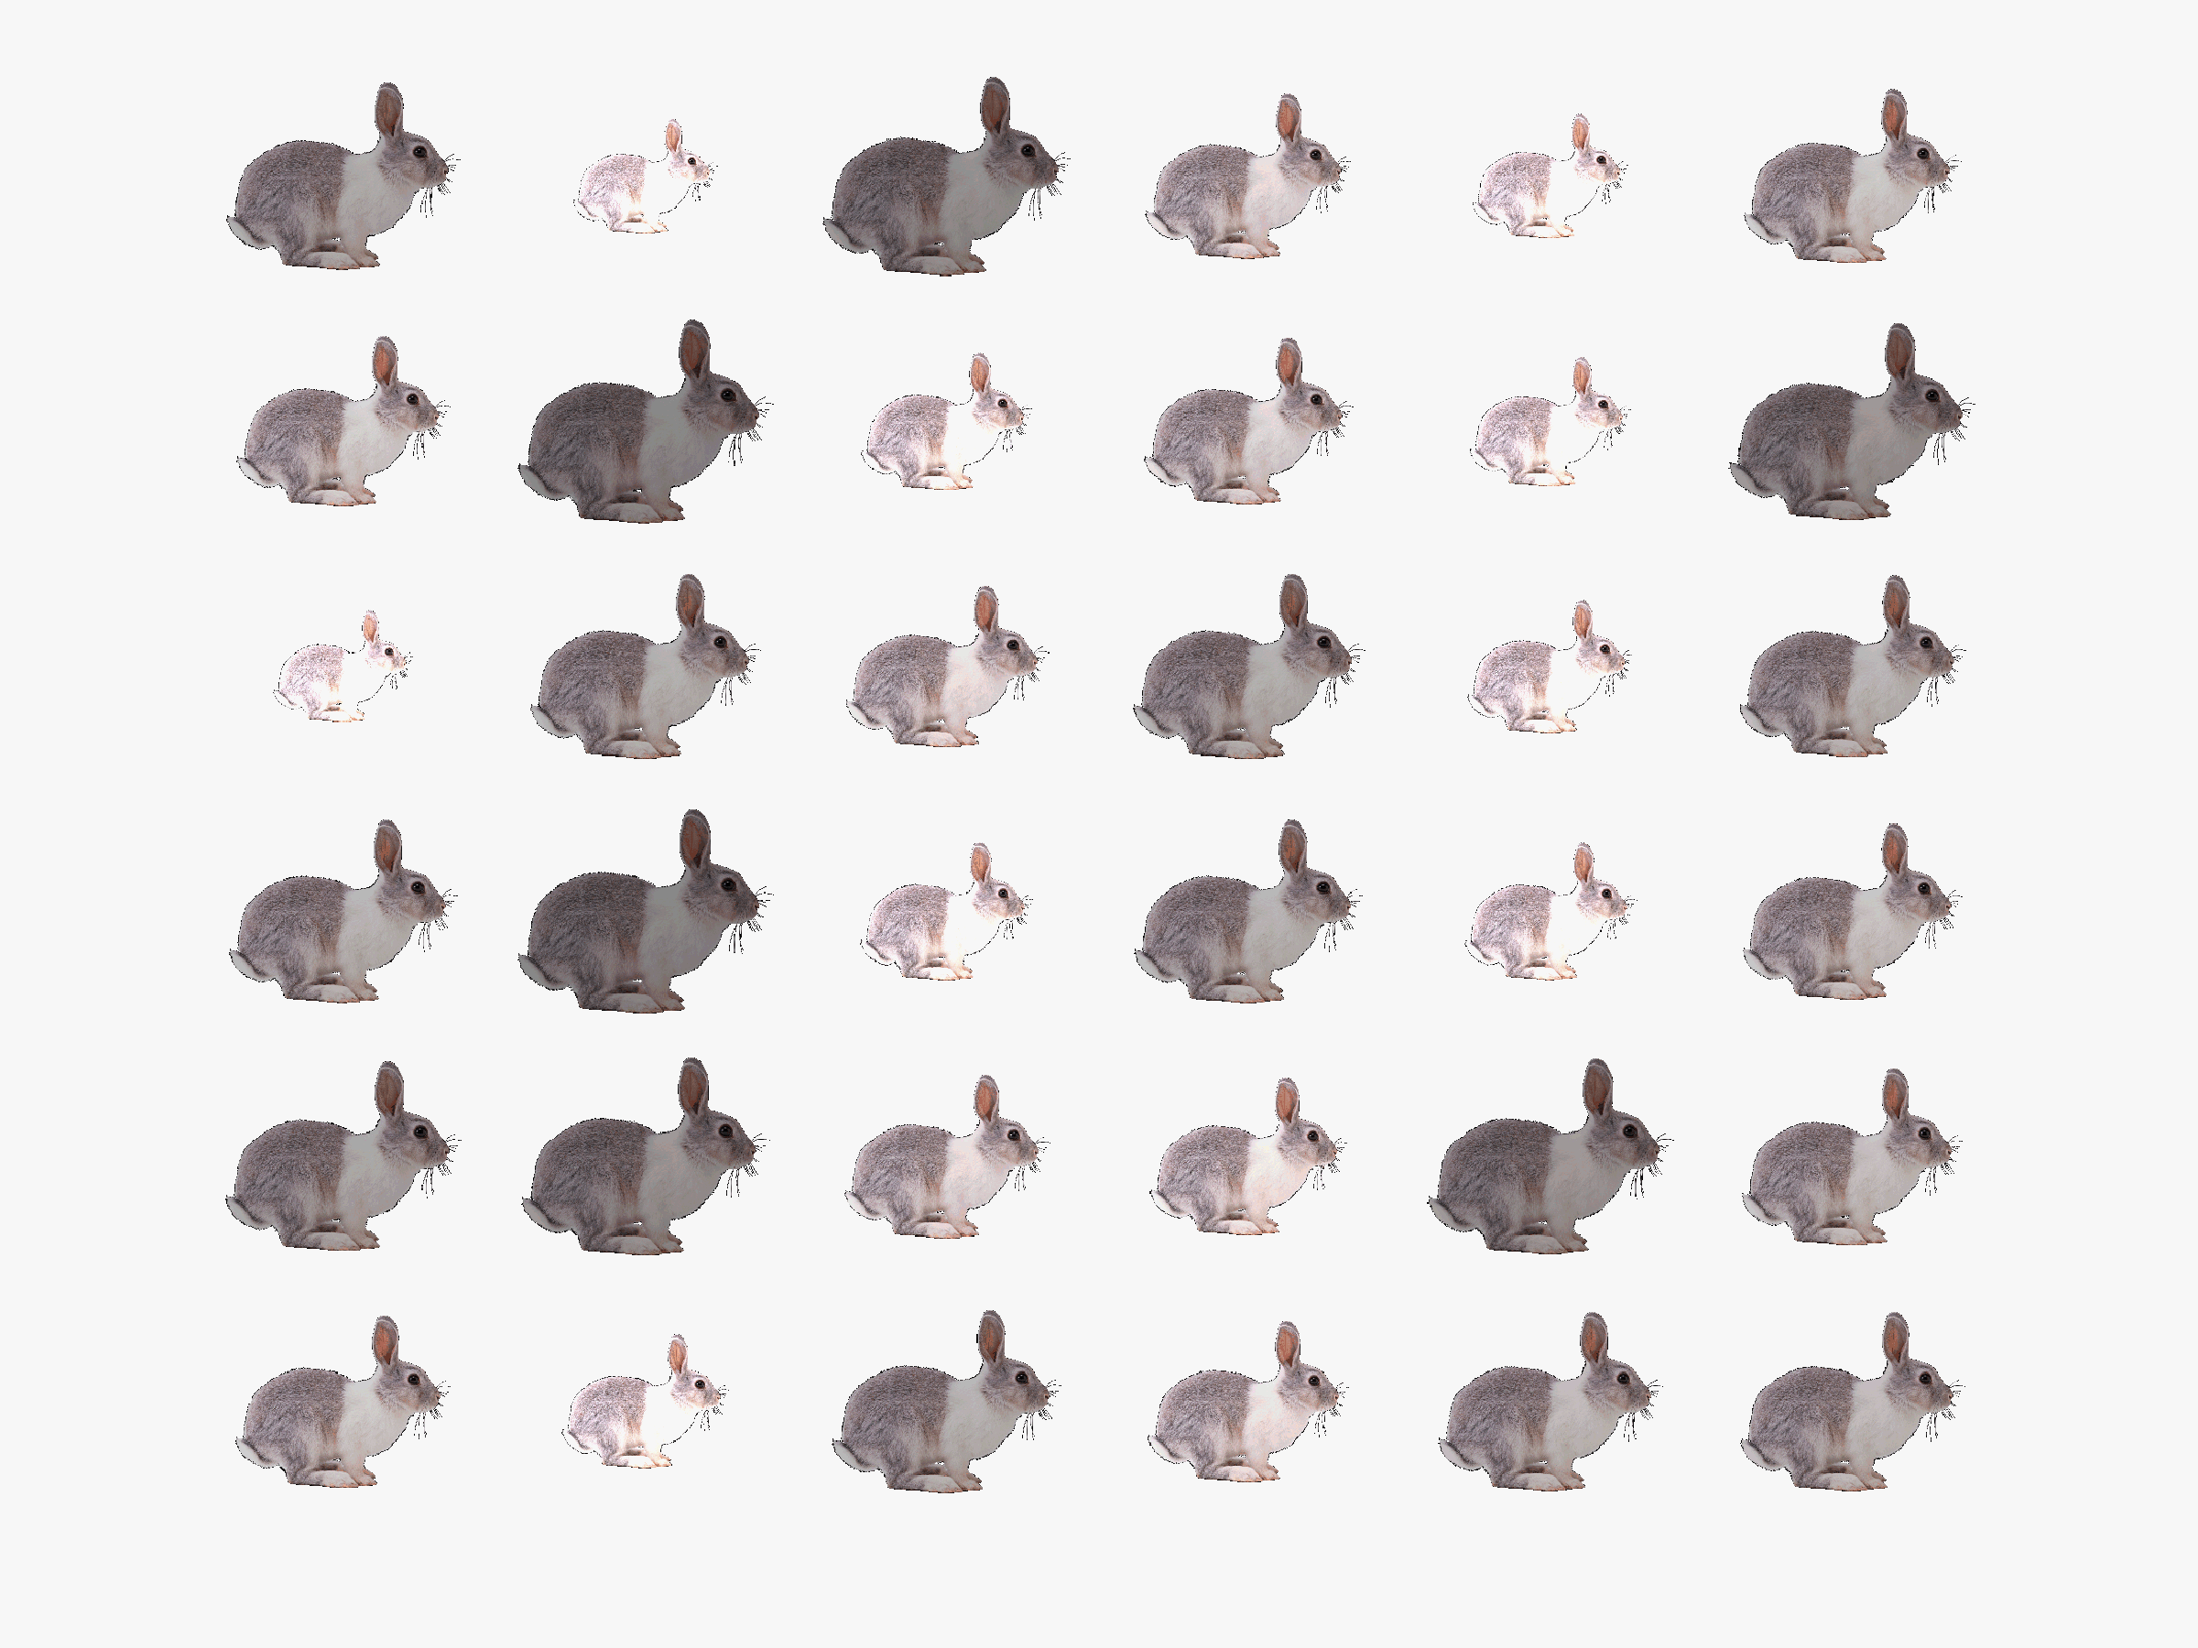

Slide 9
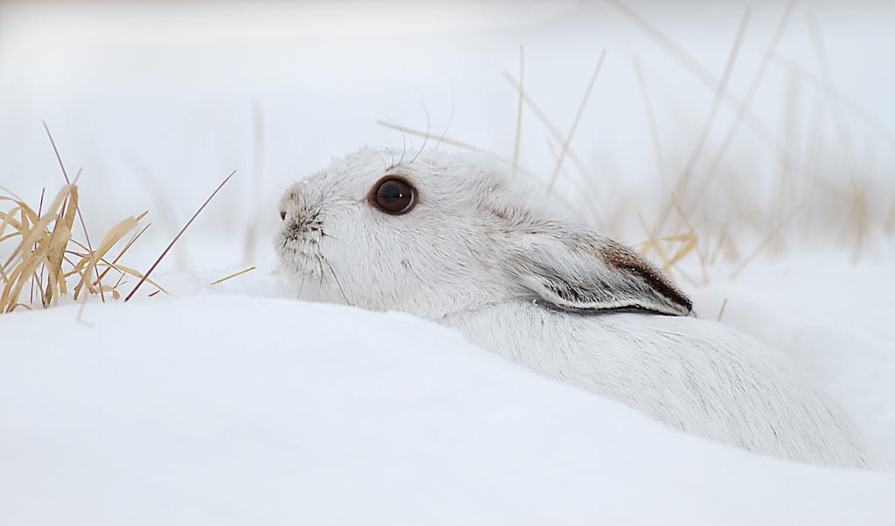
Questions?

