Slide 1
Plume Dispersion Modeling
Cheryl Zhang EPS109 2015

Slide 2
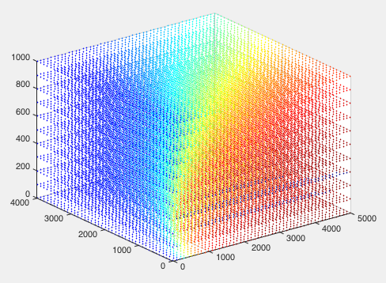
Method
ODE method to generate the velocity and positions
(no science involved)
Open boundary condition
Gaussian Dispersion Model
Borrowed really advanced code.
http://www.mathworks.com/matlabcentral/fileexchange/13279-gaussianplume
Shows average pollutant concentration depending on position.

Slide 3
Change initial condition(wind speed) to get different result

Slide 4
Thank you! Good luck with finals ☺

