Slide 1
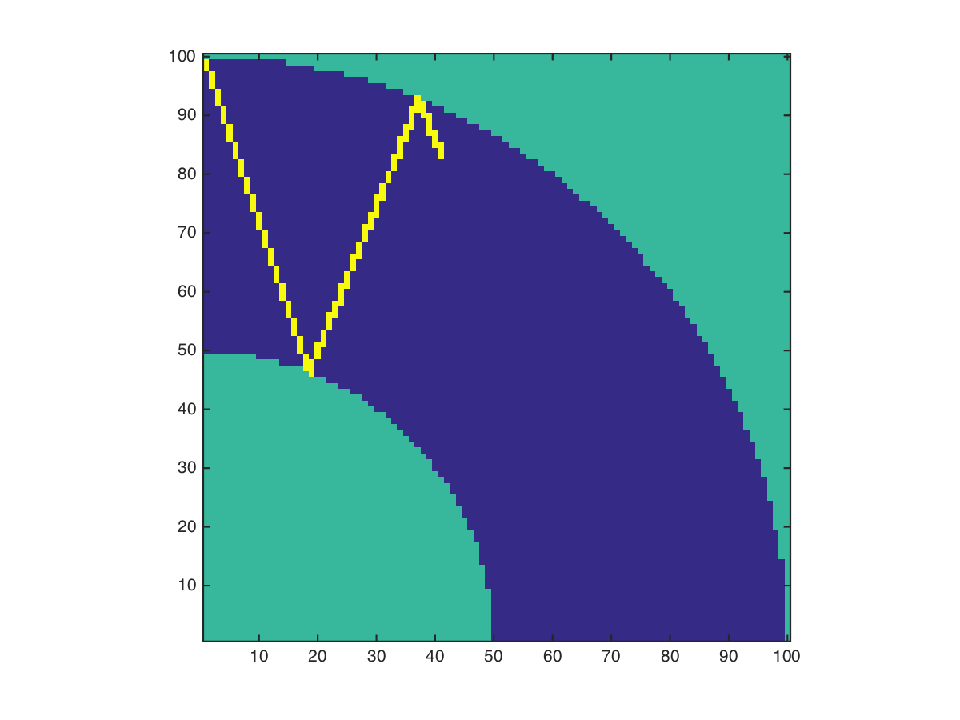
Seismic wave propagation and reflection in Earth’s mantle
By Lindsay Harrison

Slide 2
Methods
Math behind the problem: ODE
Programming behind problem: more like the DLA assignments
Dependent upon boundary conditions

Slide 4
Sources
Introduction to Seismology by Peter Shearer
Professor Burkhard Militzer

