Slide 1
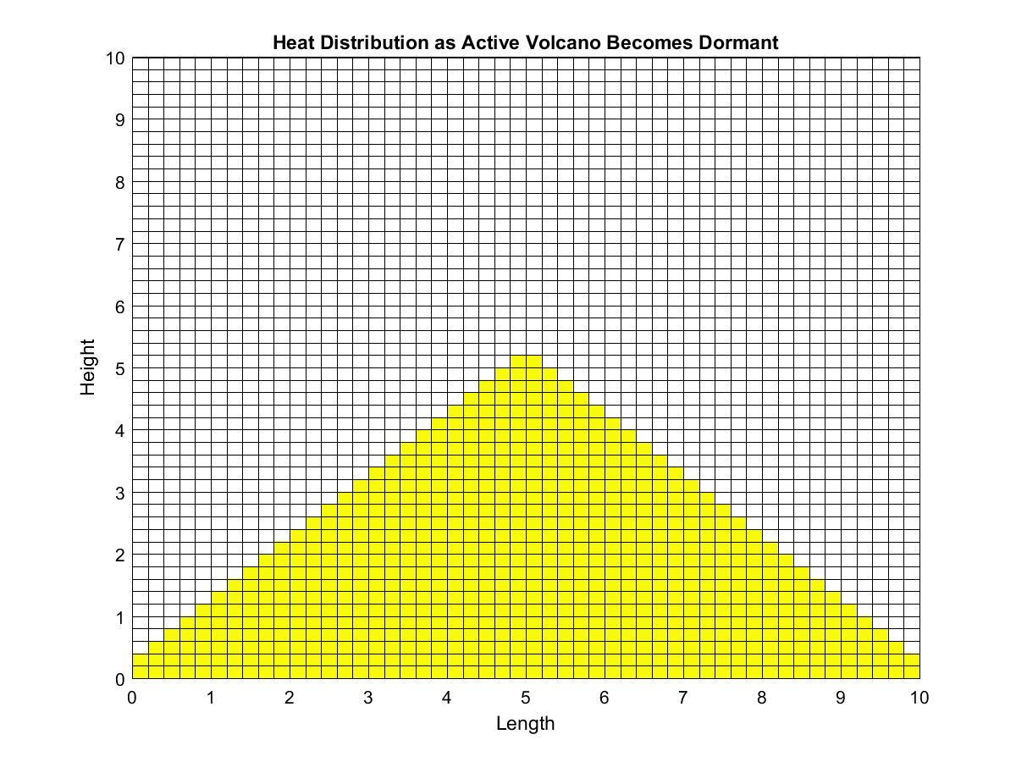
Volcanism
Ryan Clark

Slide 2
The Death of an Active Volcano
Topic: I simulated an active volcano becoming dormant over a period of time following the complete expulsion of all magma
Methods: I used PDEs for heat distribution, several unique boundary conditions, and colormap modifications to create the final movie
Assumptions: I assumed that the temperature at the beginning was roughly uniform given that magma inside and lava outside have been present significantly long enough to heat the entire mountain evenly. Magma and Lava have temperatures ranging from 700-1300C and 700-1200C so I used an averaged value.

Slide 3
Movie Time
Note: The darker region shows where significant cooling has taken place. These areas are now serving as insulation for the remaining heat inside the mountain.

