Slide 1
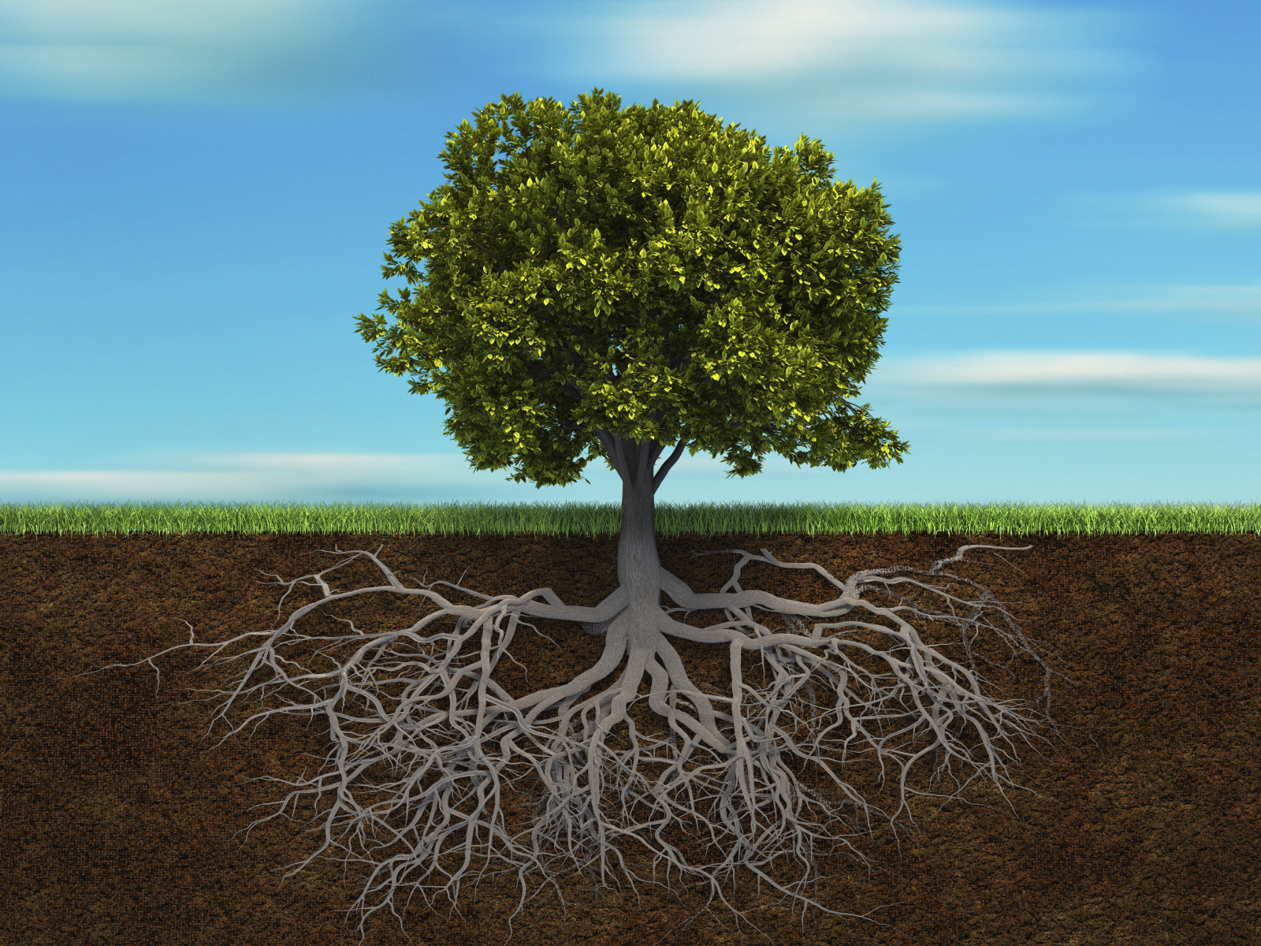
Root growing simulation
By Max Lin

Slide 2
-Simulating how roots grow underground -Used DLA

Slide 3
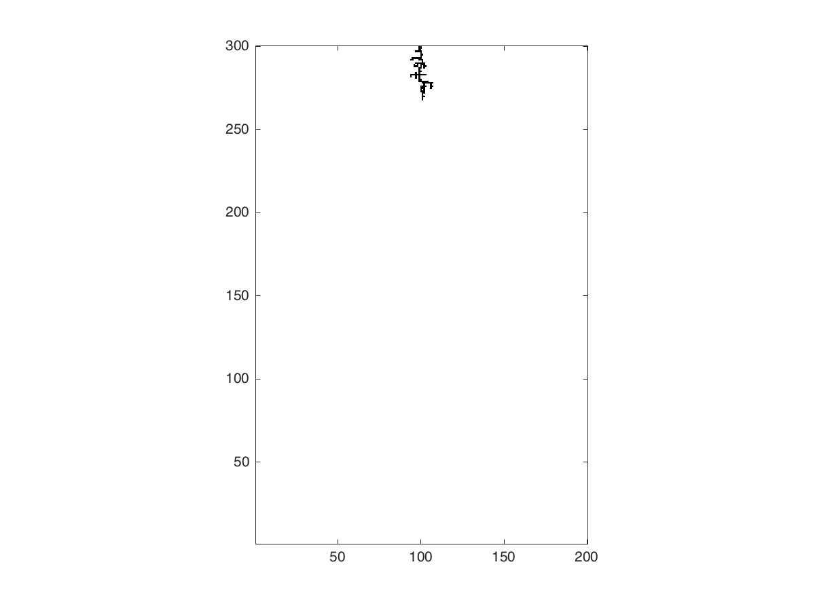
Taproot Firbous root

