Slide 1
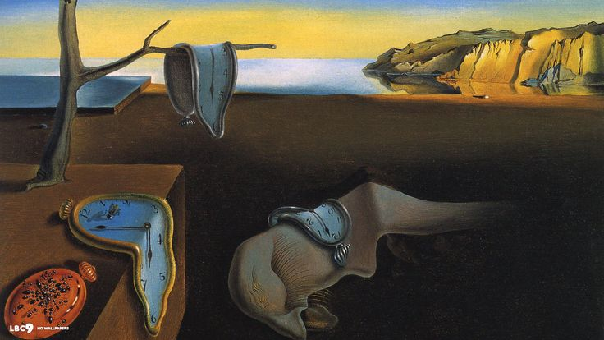
MELTING PICTURES
Colleen Murphy
EPS 109
Fall 2015

Slide 2
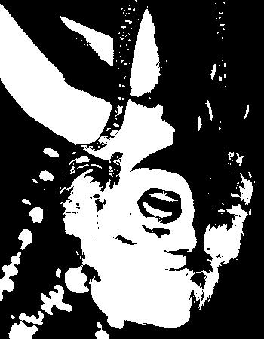
METHODS
2D heat diffusion
Dirichlet Boundary Conditions (i.e. fixed temperature at the borders)
Load an image into MATLAB
Binarize the image
Use the 1 values to give the initial regions of elevated temperature.
APPLICATIONS
Model heat diffusion for irregular shapes, e.g. a cross-section through an imaged magma chamber.

