Slide 1
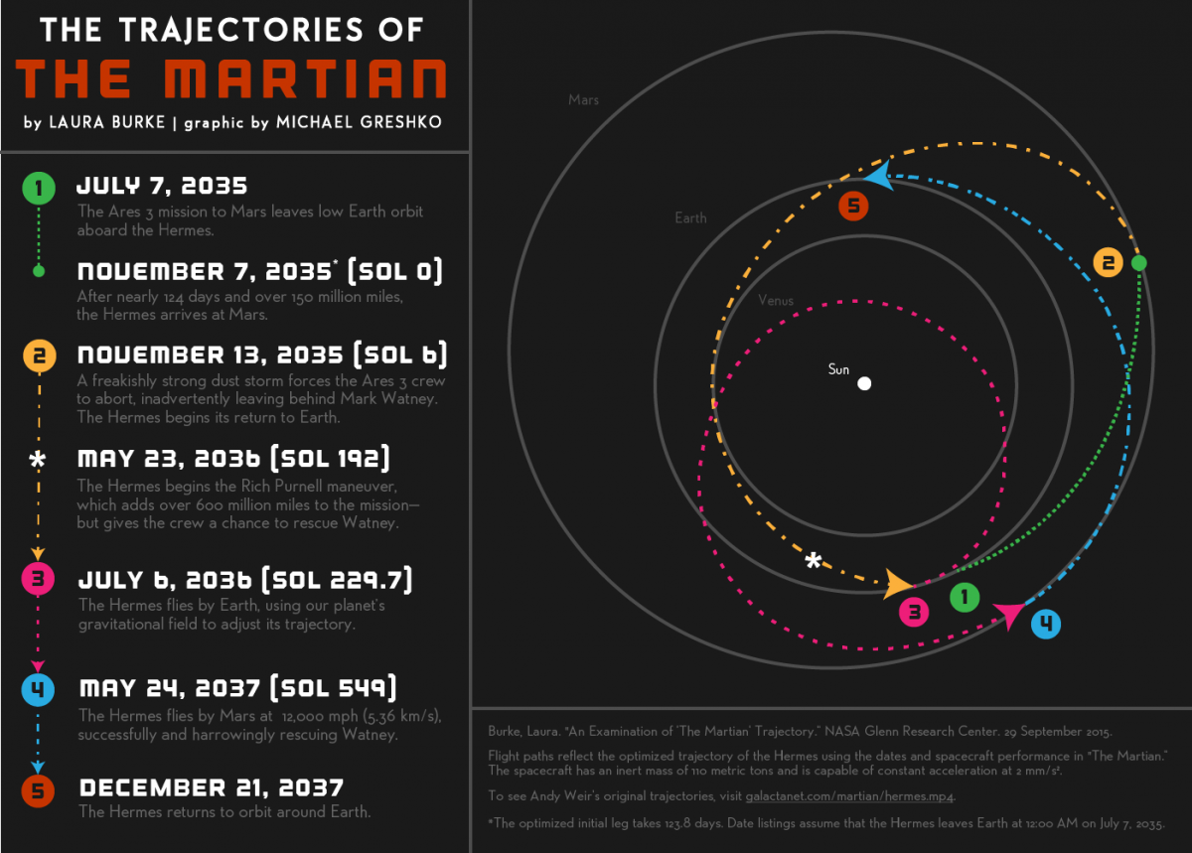
The Martian: Hermes Spacecraft Trajectories
Gavin VonSeggern

Slide 2
Hermes Trajectories: Methods
In the story, the spacecraft “Hermes” travels from Earth to Mars, accidentally abandons astronaut Mark Watney, then begins travelling back to Earth
Before reaching Earth, the Hermes crew realizes Watney is alive and adjusts their trajectory to slingshot around Earth and head back to Mars
I first programmed the orbits of Earth and Mars around the Sun (assuming circular orbits) and placed them in relative positions for the date 7/7/2035
I then used the Runge-Kutta method to solve the ODE for Hermes’ position and velocity, programming 3 separate trips (Earth to Mars, Mars to Earth, Slingshot) by adjusting Hermes’ angle and initial velocity
I was able to successfully program the first 2 trips but the slingshot proved difficult
Code is executed by running “planetary_orbits.m” which calls on “kepler_ode_final.m”

Slide 3
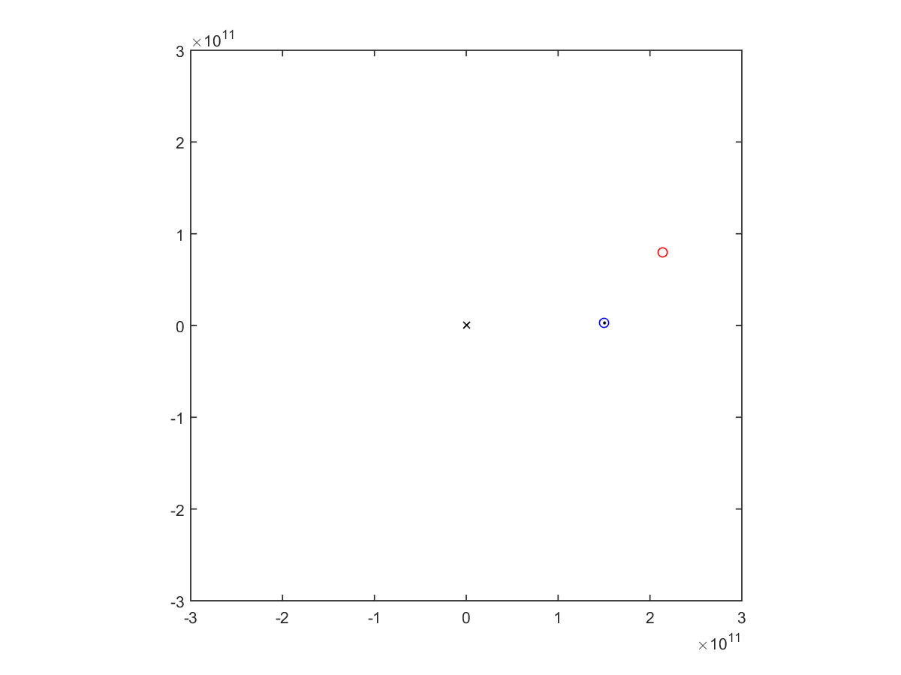
Trip 1: Earth to Mars
124 Earth Days

Slide 4
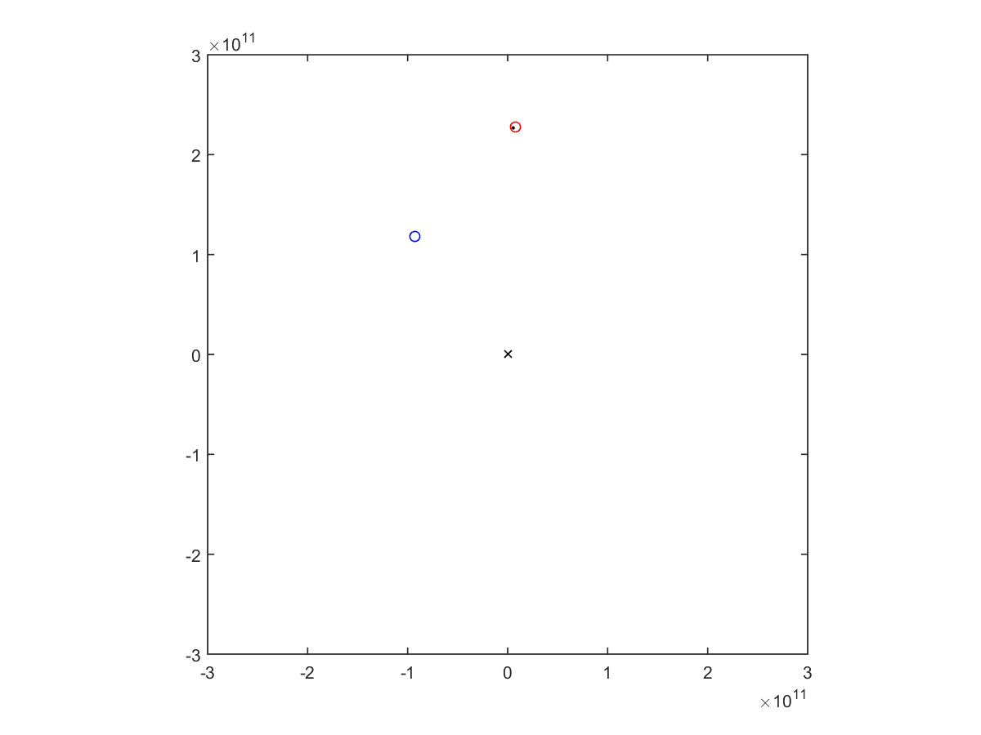
Trip 2: Mars to (almost) Earth
148 Earth Days

Slide 5
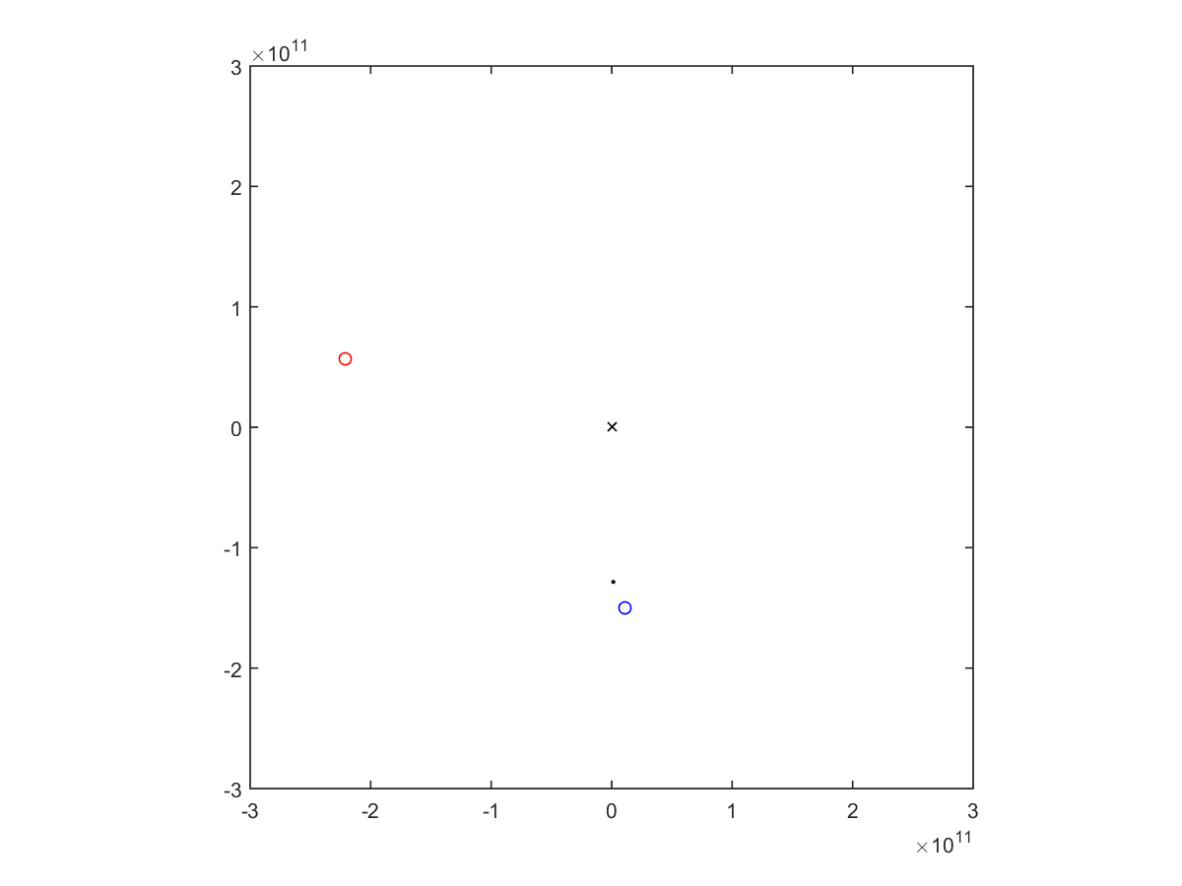
Trip 3: Attempted Slingshot
12 days from repositioning to closest earth flyby (~10,000 km)
No gravitational force experienced

