Slide 1
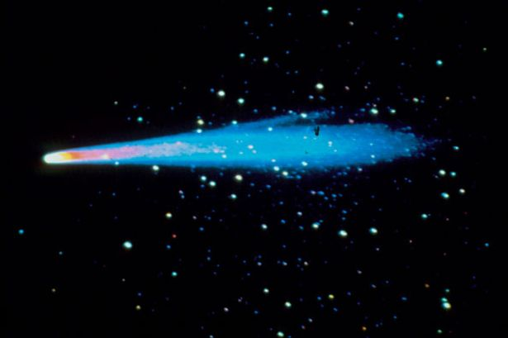
7 BODY SOLAR SYSTEM SIMULATION
JOSHUA HOLMES

Slide 2
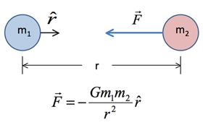
METHODS USED
Ode
Runge Kutta
Newton’s Universal Law of Gravity

Slide 3
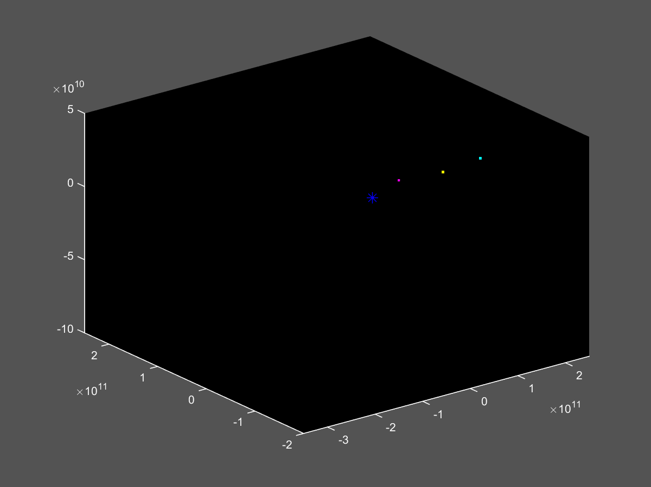

Slide 4
Steady Planetary Mass Increase
Flat rate of 4e+24kg addition every 12 hours
Extremely exaggerated addition level
System becomes unstable

Slide 5
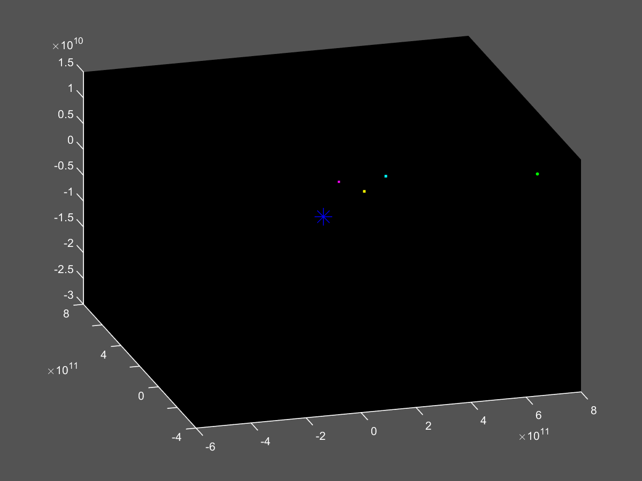

Slide 6
