Slide 1
Chaos: triple pendulum
Makana Roh
EPS 109; Fall 2015

Slide 2
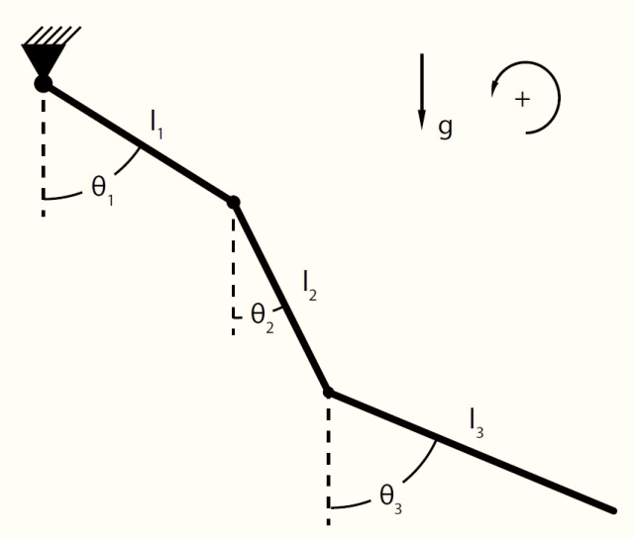
Lagrangian Mechanics
Goal: Derive the equations of motion for the triple pendulum
Lagrange’s Method implemented in symbolic python (too complex to derive by hand)
$$L≡(kinetic) −(potential)$$
$$\frac{∂L}{∂θ_{i}}−\frac{d}{dt}\left(\frac{∂L}{∂\dot{θ_{i}}}\right)=0$$
This method produces three coupled, nonlinear, second-order, ordinary differential equations.
To integrate the system, I used the fourth order Runge-Kutta method shown in class.

Slide 3
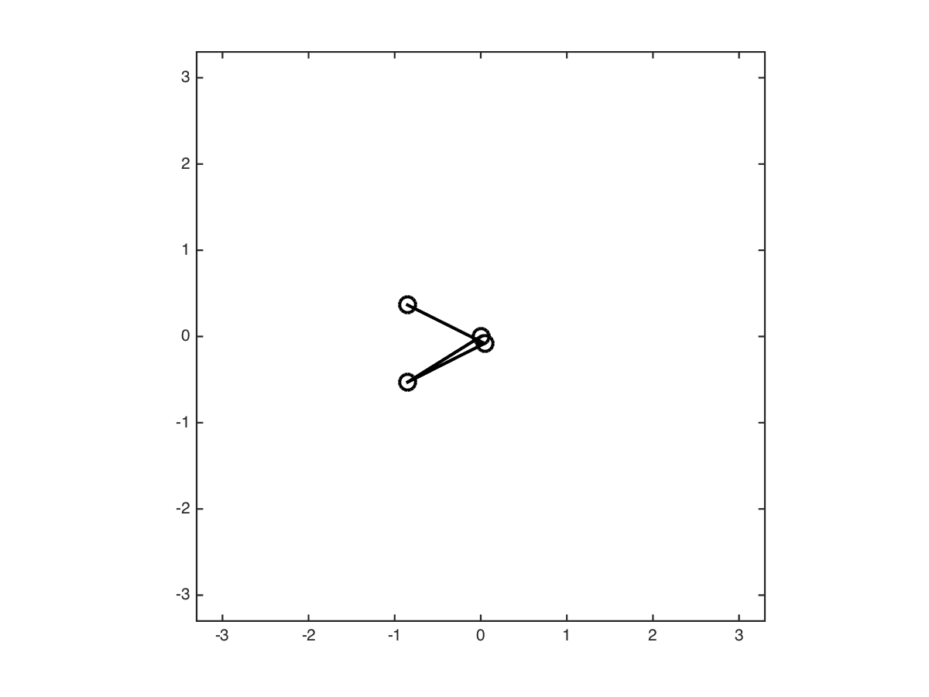

Slide 4
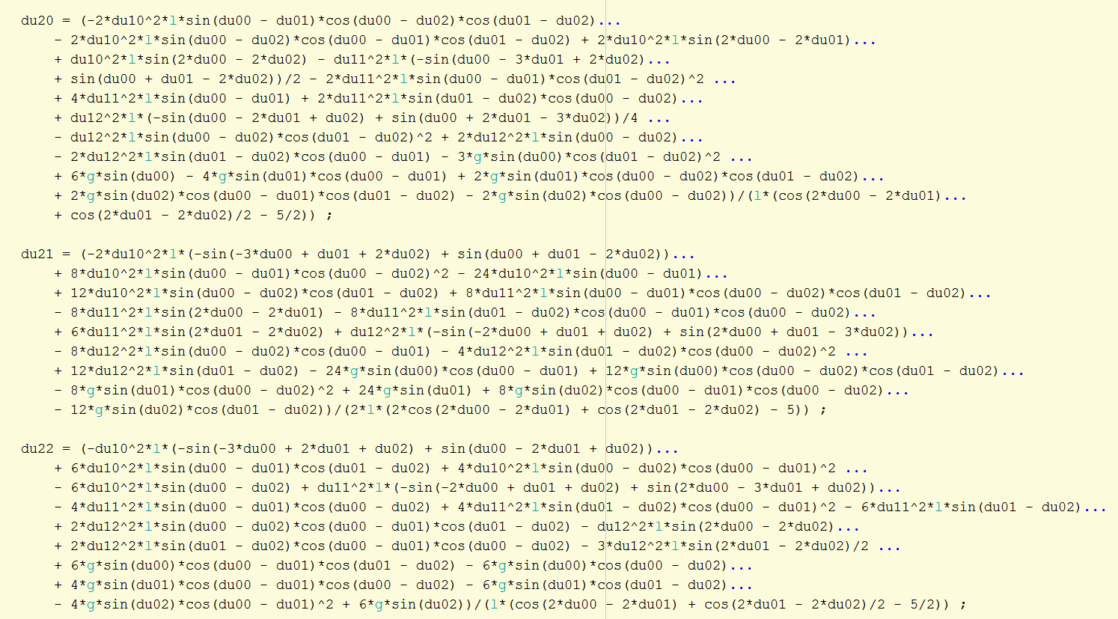
If you are curious, these are the closed-form, fully simplified ODEs for describing the triple pendulum system.
This took about 5 minutes to compute on my personal computer.

