Slide 1
Waves On A String Aaron Marriott

Slide 2
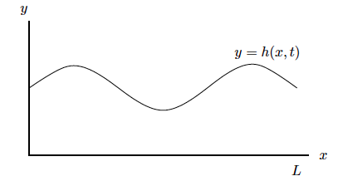
Discretized solution of the wave equation finite difference approximation
Files
There are 2 additional cases oscillating B,C,’s and reflected BC’s
3 files plucked.m , oscillate.m and reflected.m
Each can be run by pressing run

