Slide 1
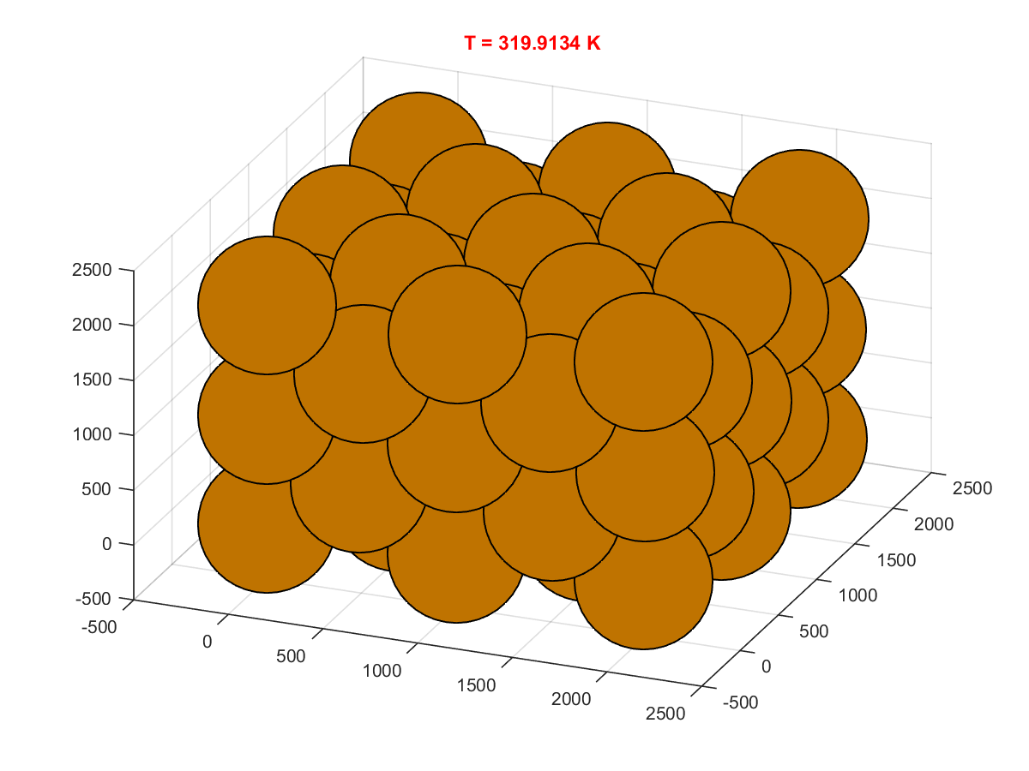
Simulation of Solid Copper Molecular Dynamics
Rustin Domingos
EPS 109 – Fall 2015

Slide 2
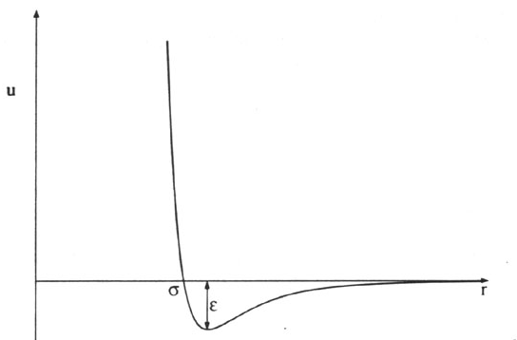
Methods
Topic
Model the behavior of copper atoms in FCC crystal structure at varying temperatures
Used Lennard Jones potential to model the pair-wise interactions of atoms
Not a very accurate potential for the system – but works for simulation (should be adjusted with Embedded Atom Model)
Periodic Boundary Conditions consider every atom to be at the center of a cube
Main code – run FinalProject.m
Initial Conditions
Calculate Forces
Integrate Equations of Motion
Update Positions/Velocities
Create Image

Slide 3
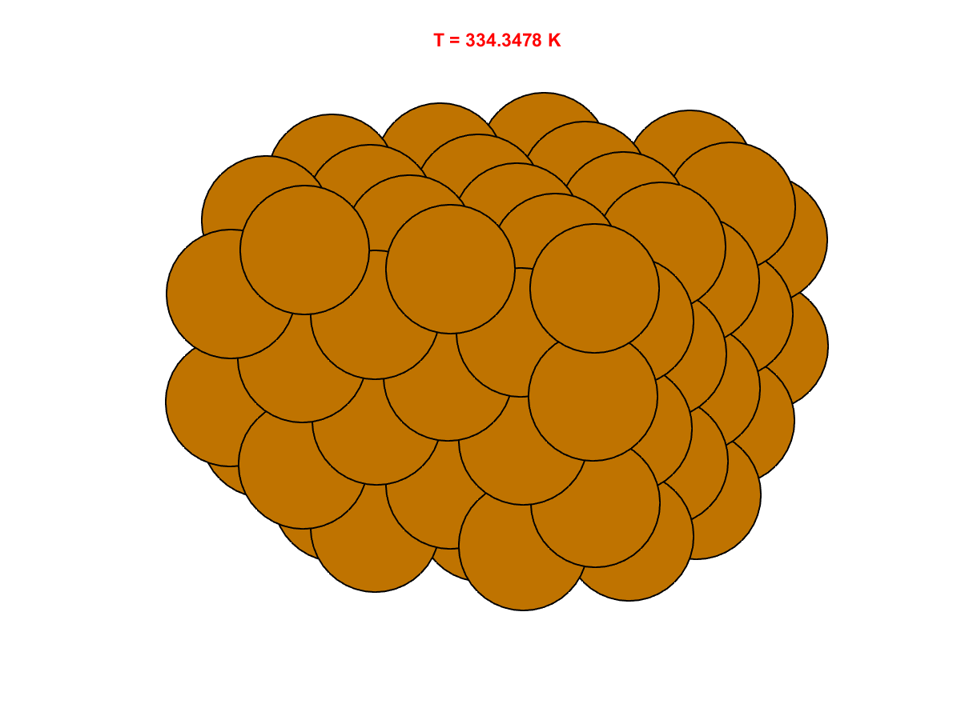
Room Temperature Far Above Melting

Slide 4
Heating the Solid
~1% increase in Velocities every
10 time steps (10 * 10^-15s)
Incredibly fast heating

